Slide 1

  GfG Instrumentation, Inc.
  GfG Instrumentation, Inc.
  1194 Oak Valley Drive, Suite 20
  Ann Arbor, Michigan 48108
  Toll free (USA and Canada): (800) 959-0329
  Direct: +1-734-769-0573
  Service e-mail: service@gfg-inc.com
  Internet: www.goodforgas.com

Slide 2

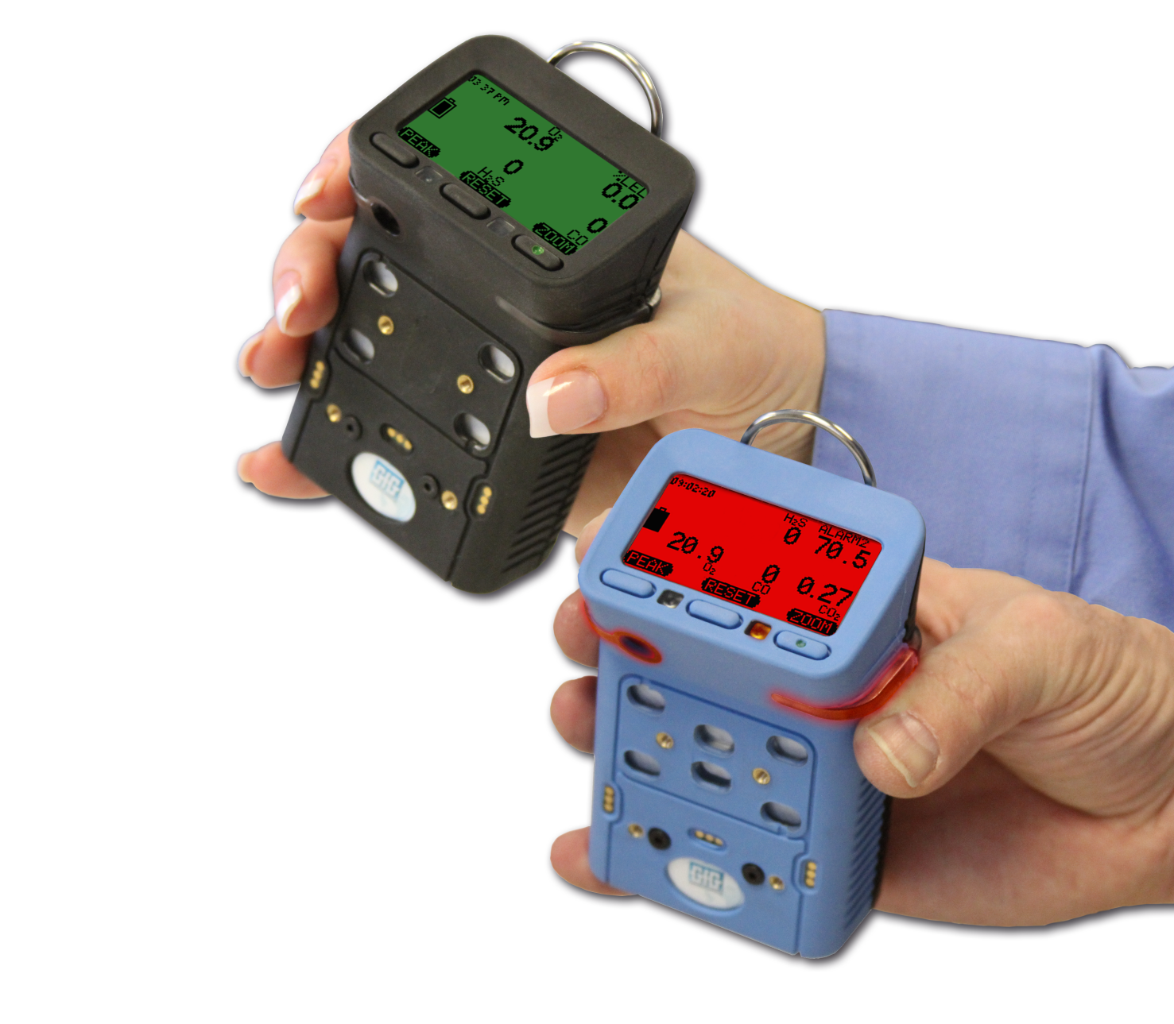

GfG Instrumentation
World-wide manufacturer of gas detection solutions

Slide 3
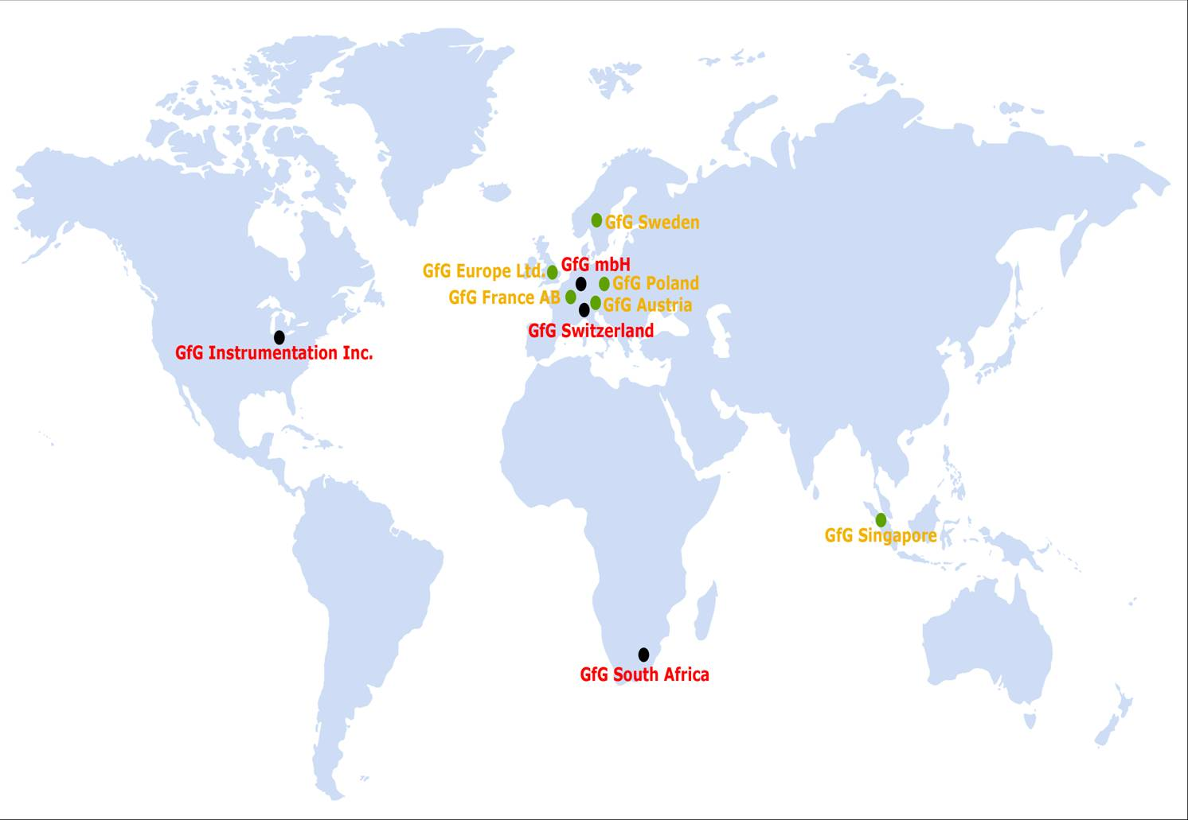
One of the World’s Leading Manufacturers of Gas Detection Products

Slide 4

GfG Instrumentation mbH
Worldwide headquarters in Dortmund, Germany
An industry leader in development and production of gas measurement technology for over 50 years
Founded in 1961
Over 300 employees worldwide in 2012

Slide 5
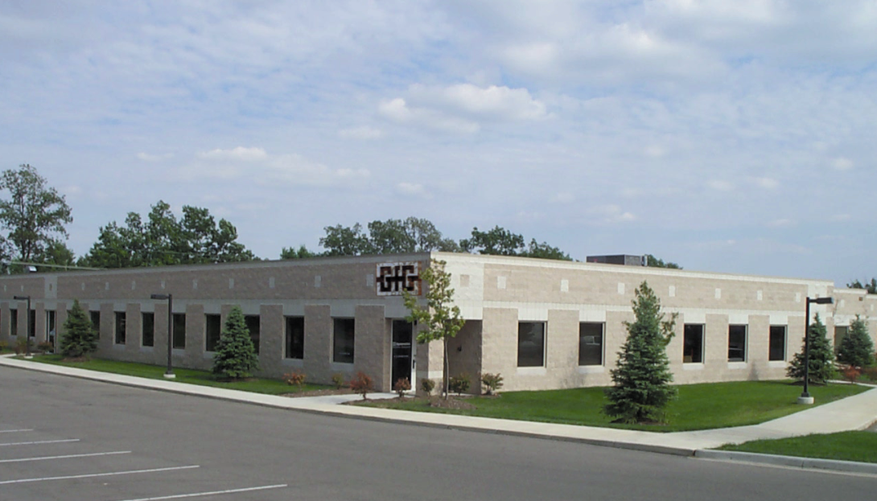
GFG Instrumentation, Inc.
Headquarters in Ann Arbor, Michigan, USA
Responsible for manufacturing, design, and sales support for North and South America
Originally founded in 1963 as Dynamation, Inc.

Slide 6
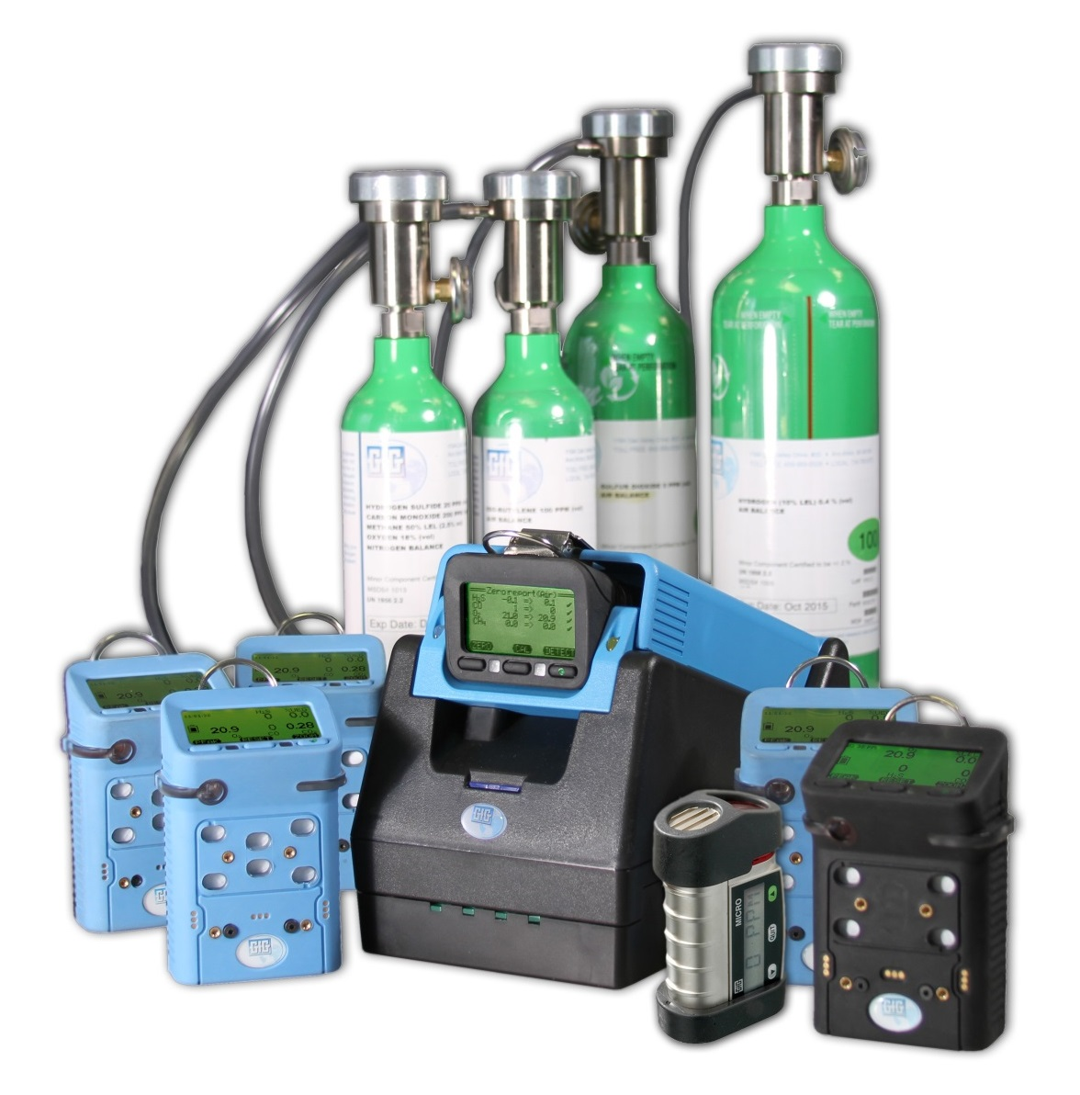
GfG Instrumentation
Exceptional designs with best cost of ownership in the gas detection industry
September 12, 2014 GfG Instrumentation company overview
Slide 6

Slide 7

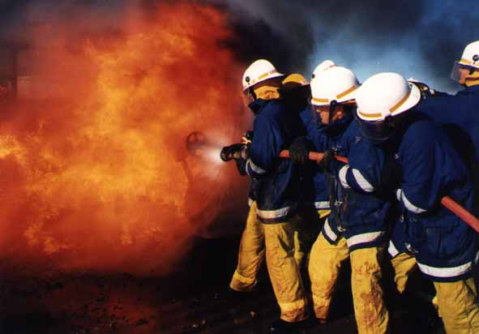
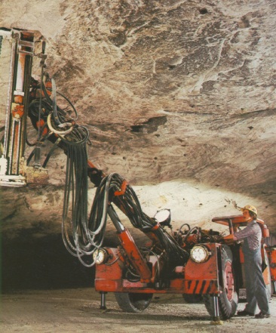
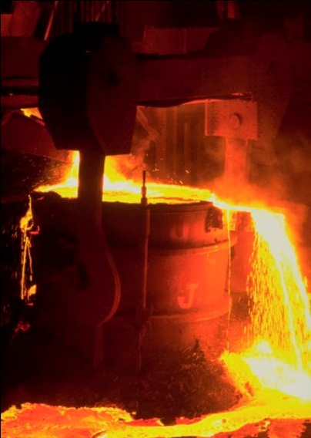
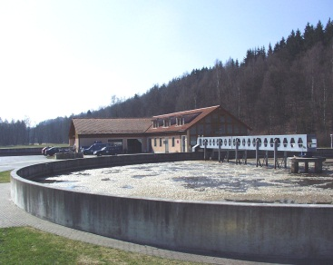


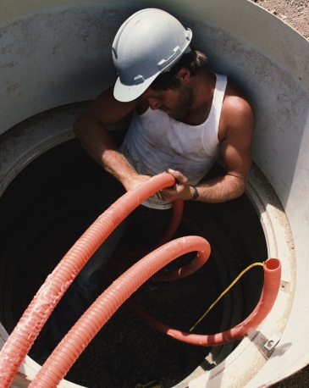

GfG Product Applications
Confined space
Fire Service
Emergency response
Oil industry
Chemical industry
Steel industry
Water / waste water
Sewer entry
Telecommunications
Municipal departments
Refrigeration systems
Power generation
Pulp and paper

Slide 8
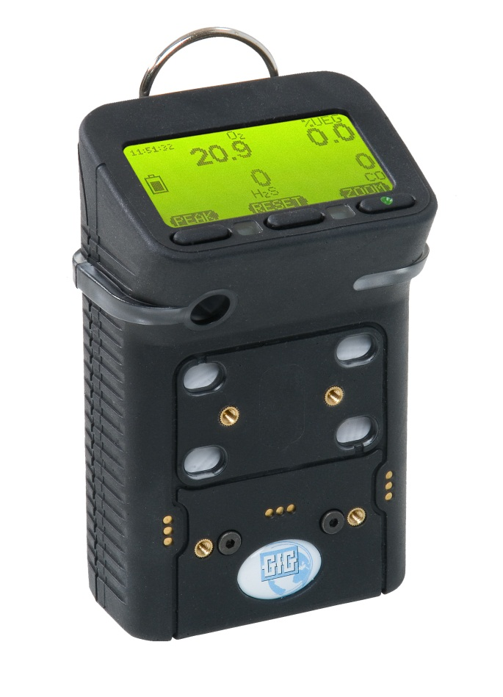
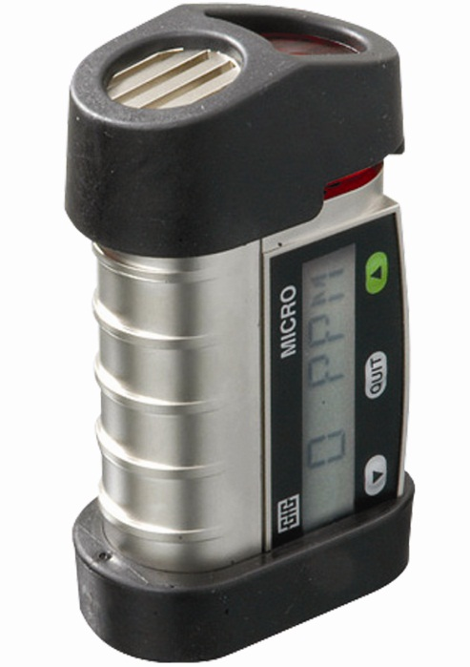
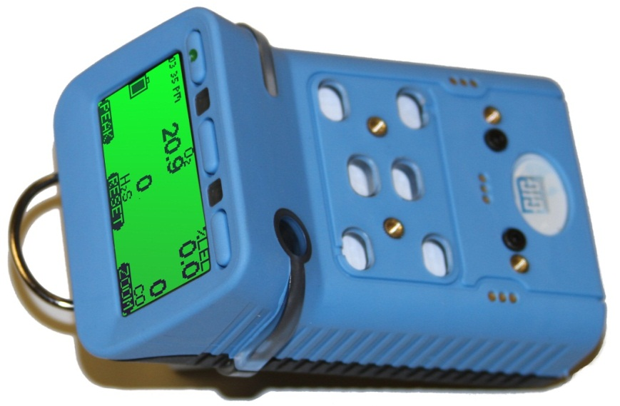
Portable gas detectors
Micro IV
single-gas detector
G450
4-gas detector
G460
1 - 6 gas detector

Slide 9
MICRO IV Single Sensor Gas Detector
Compact and affordable single gas detector
Available for wide range of toxic gases, hydrogen or oxygen
Stores long-term and short-term average values (TWA, STEL)
Event logger standard
Data logger standard
Display backlight standard
Vibrator alarm standard
IR Communication Interface

Slide 10
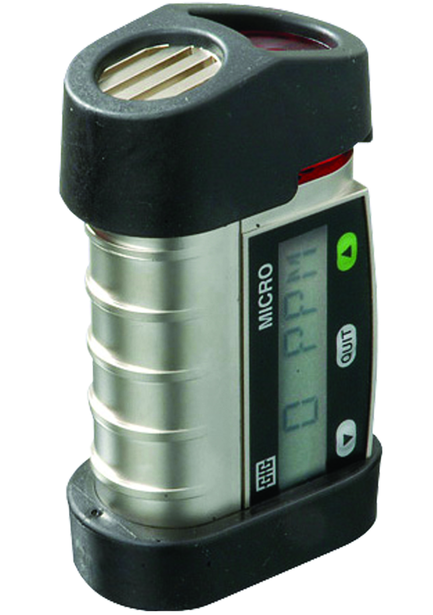
MICRO IV Single Sensor Gas Detector
Small and lightweight
Extremely robust
Very loud buzzer 95 dB(A)
Bright alarm
Easy and fast sensor replacement
Up to 6 month continuous operation with one battery
Leave turned on, or turn off when not in use to extend battery life
3 alarm thresholds per gas
Certification: c-UL-us Intrinsically Safe for use in Class I, Div. 1, Groups A, B, C, and D Hazardous Locations

Slide 11
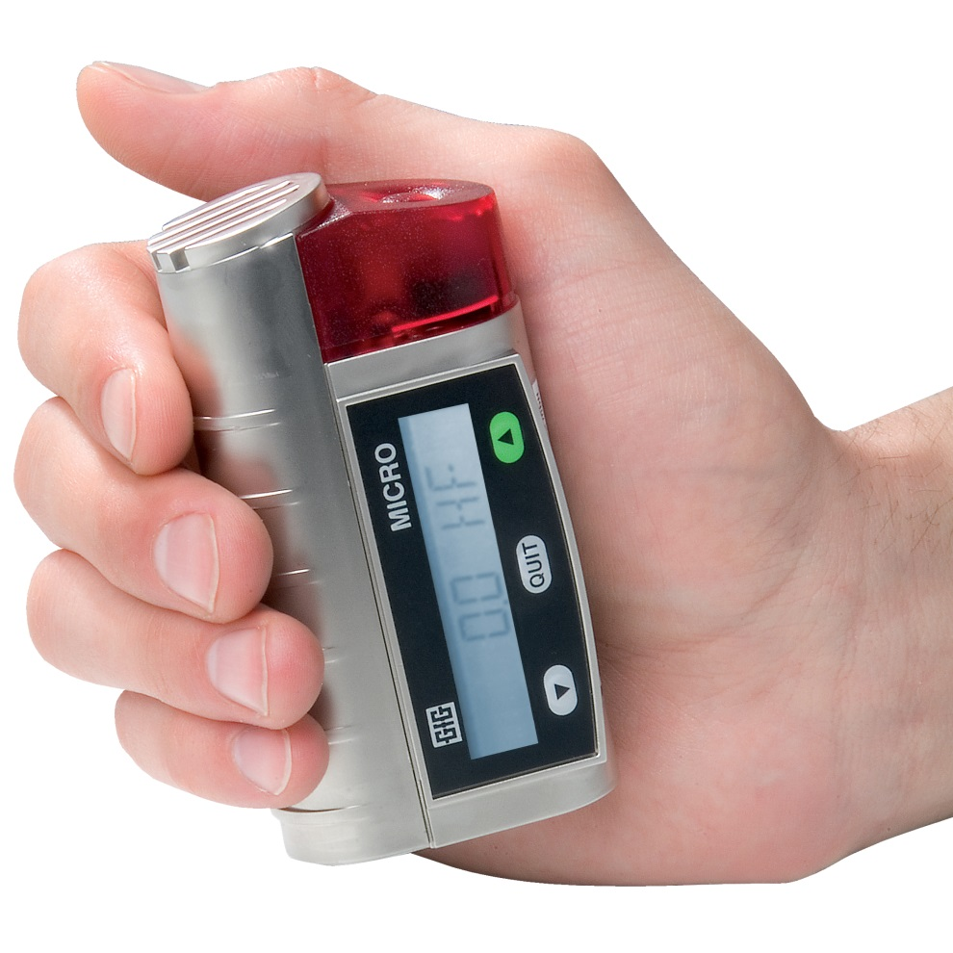
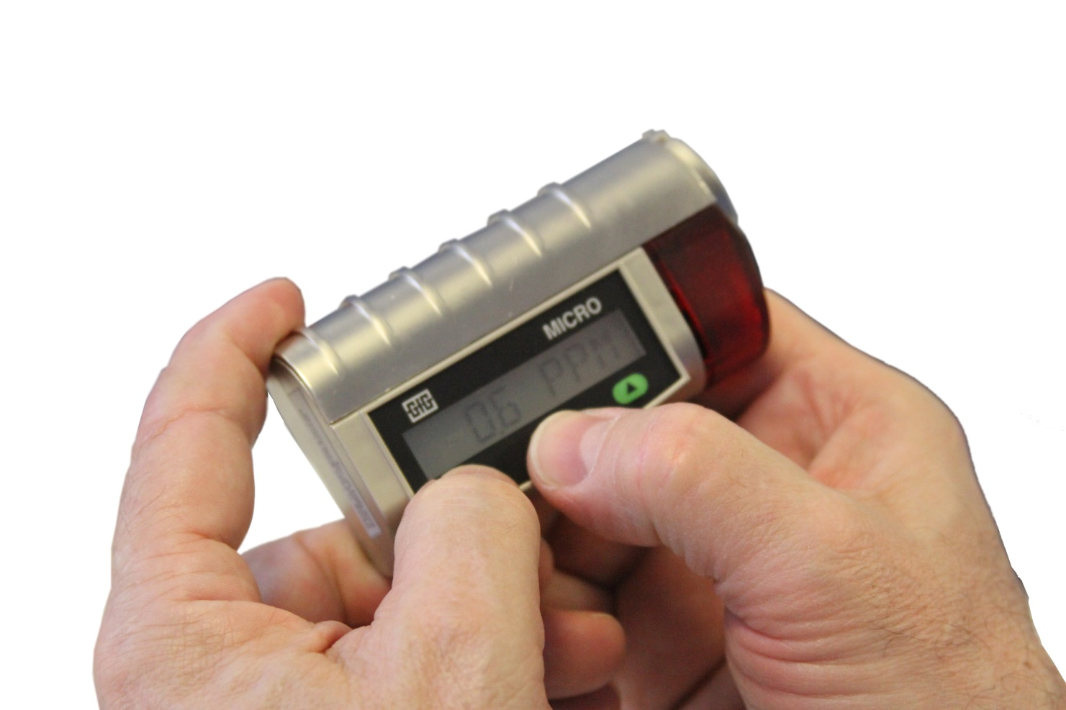
MICRO IV Single Sensor Gas Detector
Display shows in large letters alternating:
  Current gas and gas concentration
  Detection range
Confidence beep adjustable
Keys for Switching ON/OFF
Custom setup with configuration software

Slide 12
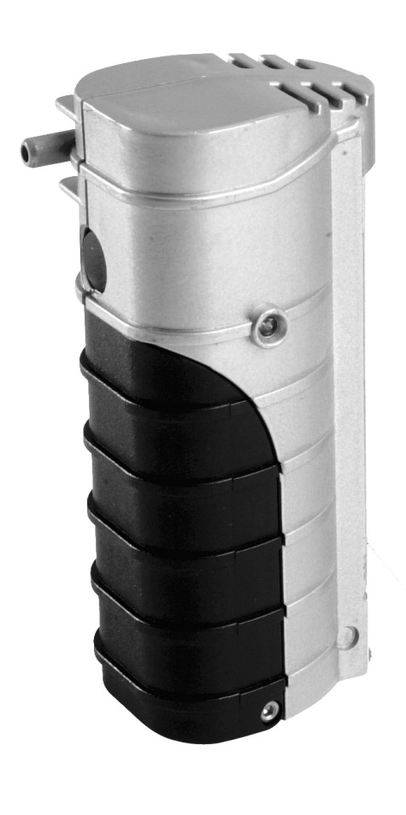
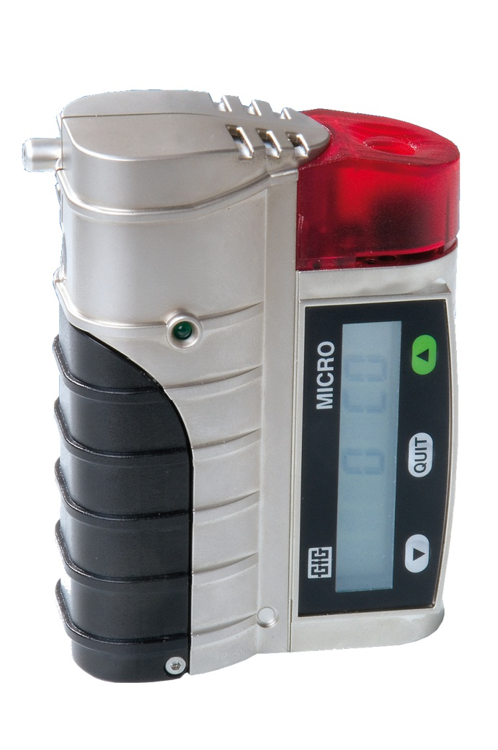
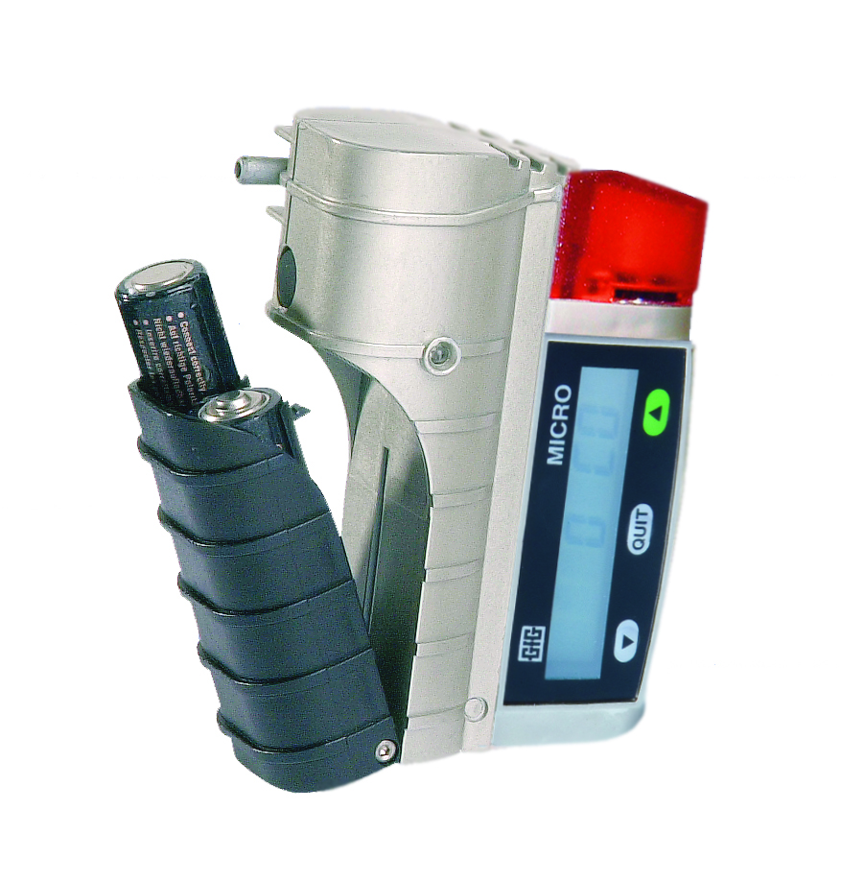
Unique attachable Micro IV motorized pump
Simple slide on design
Add to any Micro IV whenever needed
Pump powered by its own alkaline battery

Slide 13
Data-logging standard!
Logging of all event data
  Date and time of alarm
  Type of alarm
  Gas concentration which triggered alarm
Consistent storage of data
Infrared interface for data transfer via DI 220 data transfer station

Slide 14
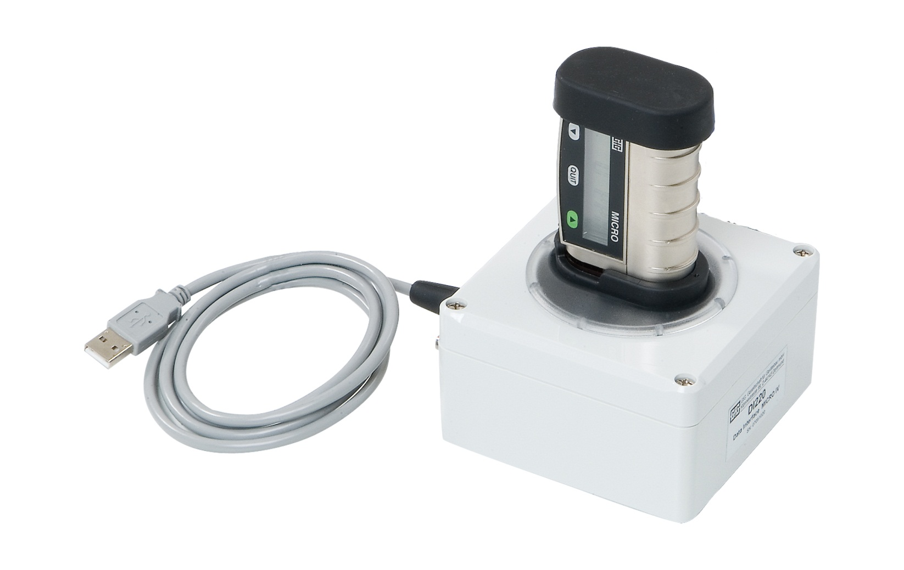
DI-220 Single Unit Docking / Data Transfer Station
Use for:
  Calibration and bump testing
  Instrument setup and programming
  Download monitoring results to PC

Slide 15
Automatically records exposure events
Event Data Device 1
No Date Time Type Value STEL(15min) TWA(8h) Gas BAT MK
1 28.08.2006 16:05 Dev-OFF 85% 343-05 48563
2 28.08.2006 16:08 Dev-ON 90% 343-05 48563
3 28.08.2006 16:13 A1 ON 33 0 0 ppm CO 90%
4 28.08.2006 16:13 A2 ON 73 0 0 ppm CO 75%
5 28.08.2006 16:13 A1 OFF 29 1 0 ppm CO 85%
6 28.08.2006 16:14 A2 OFF 0 1 0 ppm CO 80%
Event Data Device 2
No Date Time Type Value STEL(15min) TWA(8h) Gas BAT MK
1 28.08.2006 16:05 Dev-OFF 65% 343-05 48568
2 28.08.2006 16:08 Dev-ON 70% 343-05 48568
3 28.08.2006 16:13 A1 ON 54 0 0 ppm CO 70%
4 28.08.2006 16:13 A1 OFF 25 0 0 ppm CO 55%

Slide 16
Automatically records time stamped monitoring results
DS220 Data
DV-SN DV-ID Sensor BAT Ver Conf. Blip DS-SN DS-Ver
2 GfG MK343-05/48568 70 2.14 OFF 6070887 2.06
4 MK343-05/48563 90 2.14 OFF 6070887 2.06
6 GfG MK343-05/48567 95 2.14 OFF 6070887 2.06
5 GfG MK343-05/48570 45 2.14 OFF 6070887 2.06
5 GfG MK343-05/48570 45 2.14 OFF 6070887 2.06
2 GfG MK343-05/48568 70 2.14 OFF 6070887 2.06
6 GfG MK343-05/48567 95 2.14 OFF 6070887 2.06
4 MK343-05/48563 90 2.14 OFF 6070887 2.06
Test parameter
Test Gas Gas Bottle Test Date Time Mode Test Ready
200 ppm CO IC-39MNRC 28.08.2006 15:52 Bump Yes
200 ppm CO IC-39MNRC 28.08.2006 15:52 Bump Yes
200 ppm CO IC-39MNRC 28.08.2006 15:52 Bump Yes
200 ppm CO IC-39MNRC 28.08.2006 15:52 Bump Yes
200 ppm CO IC-39MNRC 28.08.2006 15:57 CAL Yes
200 ppm CO IC-39MNRC 28.08.2006 15:57 CAL Yes
200 ppm CO IC-39MNRC 28.08.2006 15:57 CAL Yes
200 ppm CO IC-39MNRC 28.08.2006 15:57 CAL Yes

Slide 17
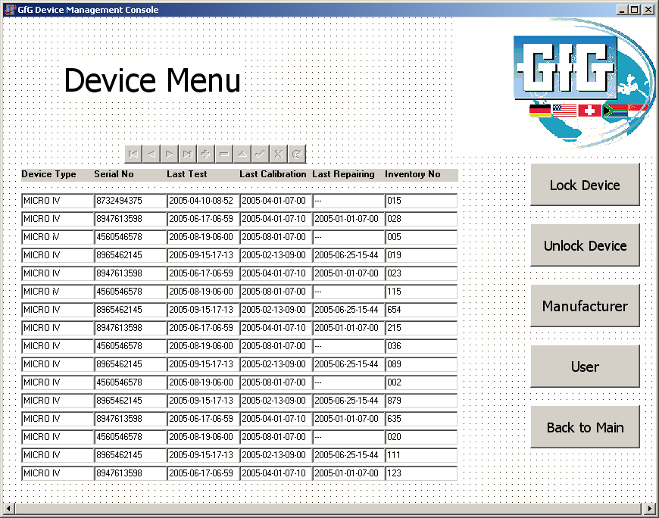

Setup choices
Menu
Copyright GfG 2010 17

Slide 18
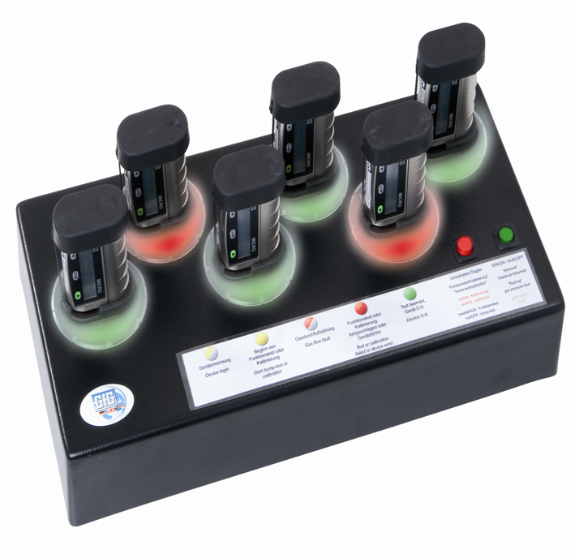
Docking Station Micro IV DS-220
Automatic Teast Station for Micro IV
Auto Bump test
Auto Calibration
Bump or calibrate up to six instruments at the same time
Test results automatically results stored on MMC flash memory card

Slide 19
DS 220 Docking “Station
Complete device management system:
  Automatic bump test
  Automaric calibration adjustment
  Programming interface
  Data transfer
Easy operation
  Push green button for “Bump Test”
  Push red button for “Auto Calibration” adjustment
Test up to 6 detectors simultaneously
No PC required!

Slide 20
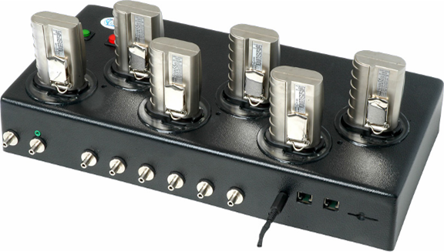
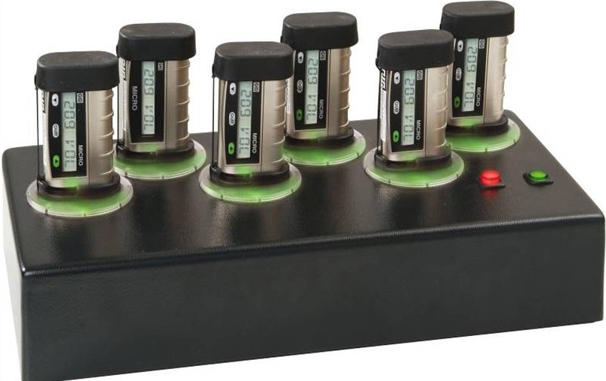
DS 220 Docking Station
Automatically stores results:
  Battery capacity
  Alarm thresholds
  Visual alarm
  Audible alarm
  Serial number (detector)
  Sensor serial number
  Software version
  Detector identification
  Faults
  Alarm list
  “Event record” with gas concentration and alarm status
  Response time for alarm 1 and alarm 2

Slide 21
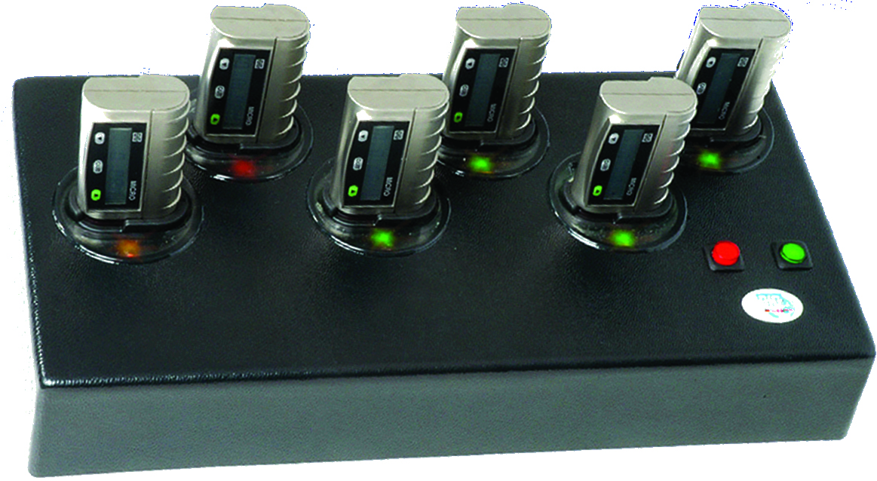
Test Results
LED indicators signal test results:
  Green = Detector OK
  Yellow = Test in process
  Red = Test failed

Slide 22
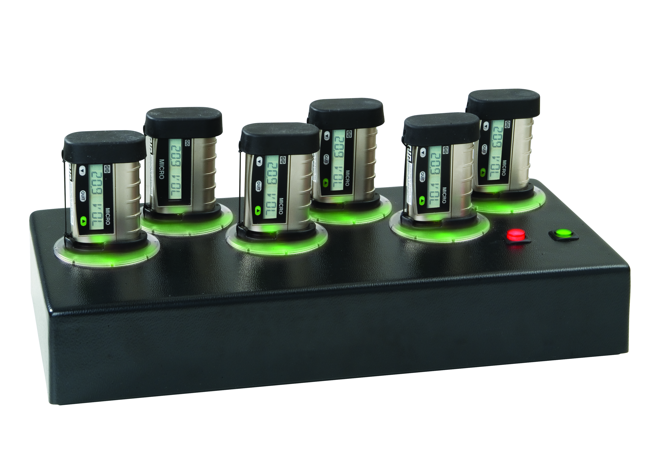
Calibration adjustment
Press red key to start automatic calibration
Up to 6 instruments can be adjusted simultaneously
No mishandling possible
Shorter waiting time, faster completion!

Slide 23
Automatically store test and calibration results
Test result
BUMP test
Adjustment
Horn Error T-A1 T-A2 T-50% ZPT-before SPAN-before ZPT-akt SPAN-akt
Ok 3,2 4,2 7,2
Ok 2,7 3,7 5,7
Ok 2,4 3,4 6,4
Ok 1,4 3,4 5,4
3,9 1820,4 -0,9 1886,8
1,6 1888,0 -3,1 2050,8
-4,1 1701,6 -7,6 1761,6
-5,6 1713,6 -9,3 1772.0

Slide 24
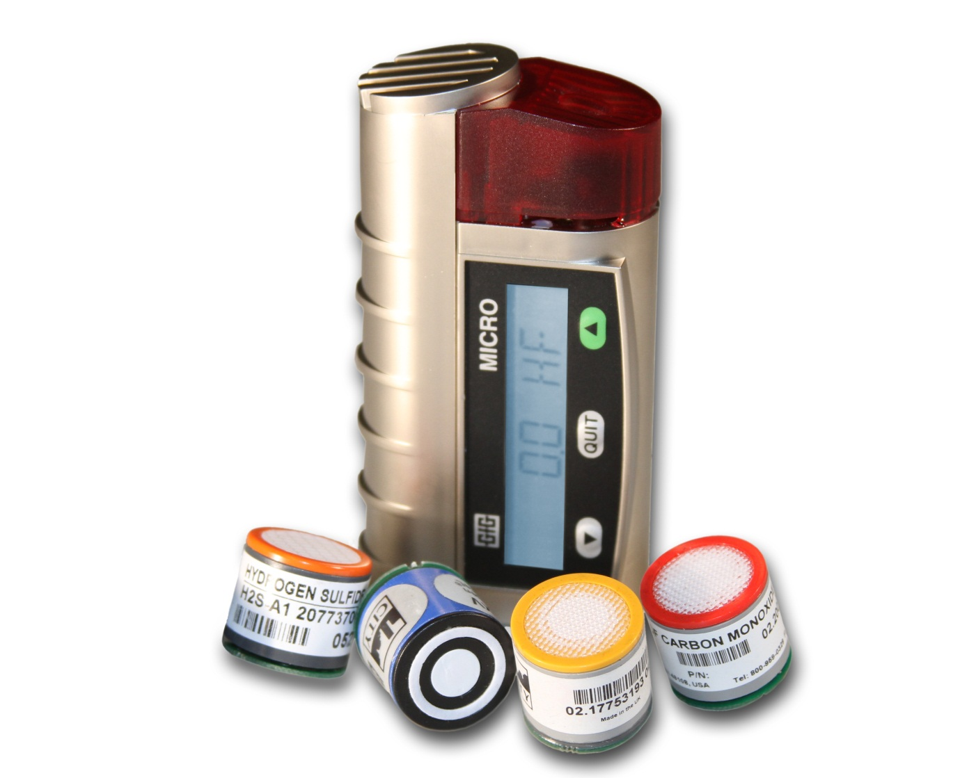
MICRO IV Single Sensor Gas Detector
Available for use with a wide range of dependable, substance specific electrochemical sensors
O₂, CO and H₂S sensors warranted for 3-full years
Optional range and resolution available for many sensors
Plug-and-play sensor design makes changing or replacing sensors a snap

Slide 25
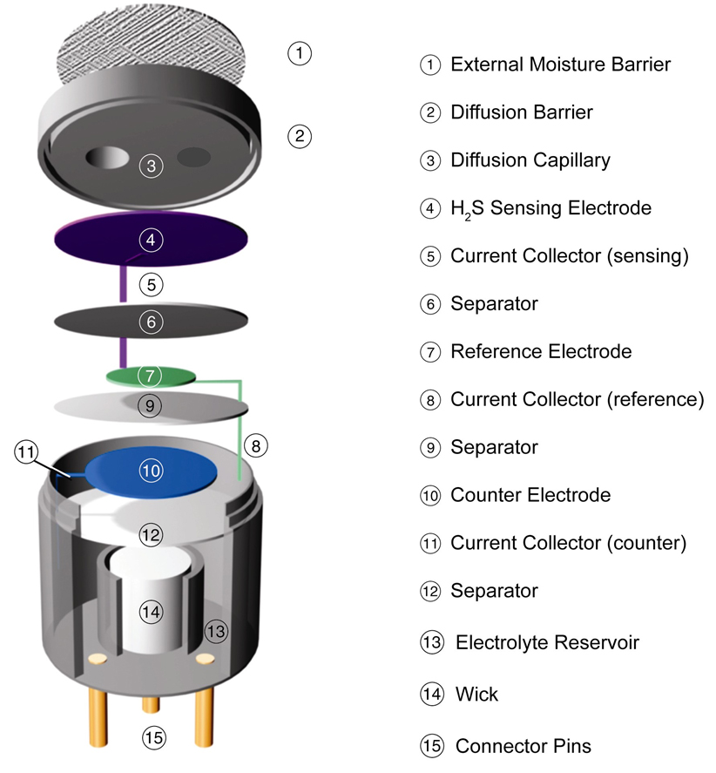
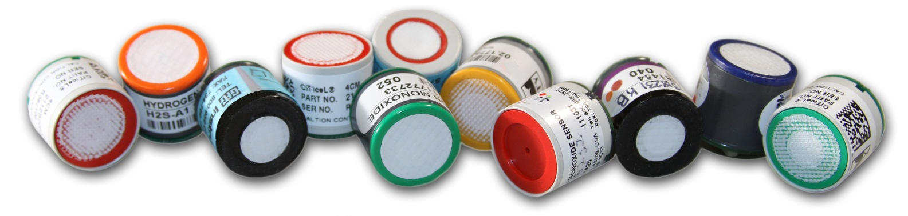
Substance-specific electrochemical sensors
Gas diffusing into sensor reacts at surface of the sensing electrode
Sensing electrode made to catalyze a specific reaction
Use of selective external filters further limits cross sensitivity

Slide 26
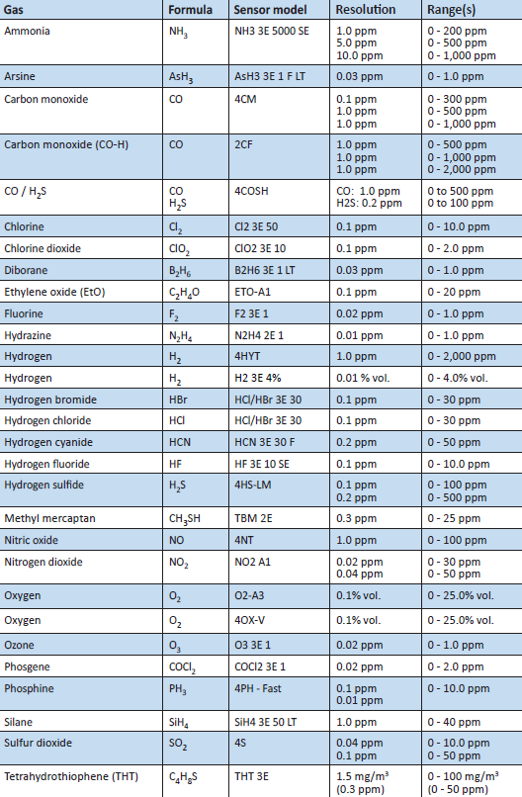
Available electrochemical sensors, standard ranges and resolution
More types of EC sensors available every year, both for individual toxic gases as well as sensors designed to detect a range of toxic or combustible gases

Slide 27

Additional gases detectable by means of relative response
Electrochemical sensors are designed with specific usage requirements in mind
The same manufacturer may offer multiple models of sensor for the detection of the same gas, but that are optimized for different sets of interferents and operating conditions
Thus, cross sensitivities may vary widely between different models and brands of sensors!
In addition, response values may differ at concentrations other than the ones listed in product documentation
Discuss with manufacturer BEFORE attempting to use relative response values to measure additional gases

Slide 28
Typical Electrochemical Detection Mechanism
H₂S Sensor:
Hydrogen sulfide is oxidized at the sensing electrode:
H₂S + 4H₂O H₂ SO₄ + 8H⁺ + 8e-
The counter electrode acts to balance out the reaction at the sensing electrode by reducing oxygen present in the air to water:
2O₂ + 8H⁺ + 8e- 4H₂O
And the overall reaction is: H₂S + 2O₂ H₂ SO₄
4HS Signal Output: 0.7 μ A / ppm H₂S

Slide 29
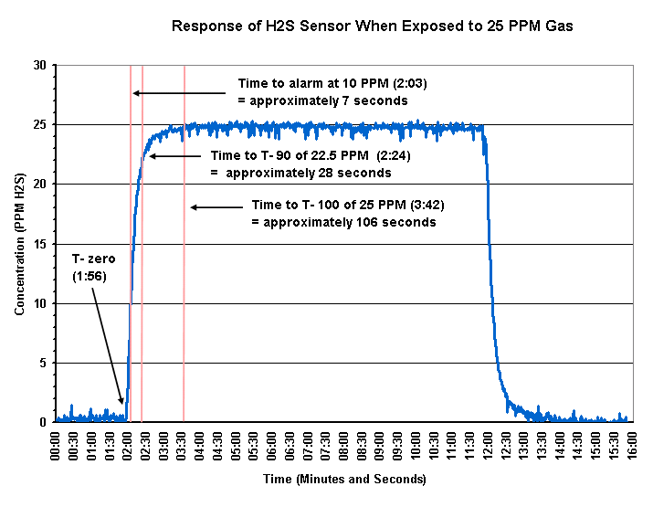
Electrochemical Sensor Performance

Slide 30


Notable recent gas and vapor TLV® updates
Hydrogen sulfide (2010)
Sulfur dioxide (2009)
Nitrogen dioxide (2012)

Slide 31



Exposure limits for H2S
Old TLV:
  TWA = 10 ppm
  STEL = 15 ppm
New (2010) TLV:
  TWA = 1.0 ppm
  STEL = 5.0 ppm
4
4
0

Slide 32
Are H₂S sensors capable of measuring at the new TLV limits?
The answer is “Yes” BUT with qualifications…..
  Depends on the manufacturer!
  Sensor must be capable of providing 0.1 or 0.2 ppm resolution
  Instrument design must permit setting the alarms at the desired concentration
  Micro IV designed for measurement at TLV concentration limits!

Slide 33





Where should you set the H₂S alarms?
H₂S TLV® only includes STEL and TWA limits; does not include a Ceiling or “Peak” limit
Instruments typically have four user settable alarms for each toxic sensor (Low, High, STEL and TWA)
Suggested alarms:
  NIOSH:
    Low: 10.0 ppm
    High: 15.0 ppm
    STEL: 15.0 ppm
    TWA: 10.0 ppm
  TLV®:
    Low: 3.0 ppm
    High: 5.0 ppm
    STEL: 5.0 ppm
    TWA: 1.0 ppm

Slide 34

Exposure limits for SO₂
OSHA PEL:
  TWA = 5.0 ppm
NIOSH REL:
  TWA = 2.0 ppm
  STEL = 5.0 ppm
Old TLV :
  TWA = 2 ppm
  STEL = 5 ppm
New (2009) TLV:
  STEL = 0.25 ppm

Slide 35
Suggested alarm settings for SO₂
Suggested alarms:
  NIOSH:
    Low: 2.0 ppm
    High: 5.0 ppm
    STEL: 5.0 ppm
    TWA: 2.0 ppm
  TLV®:
    Low: 0.75 ppm
    High: 1.25 ppm
    STEL: 0.25 ppm
    TWA: 0.25 ppm

Slide 36
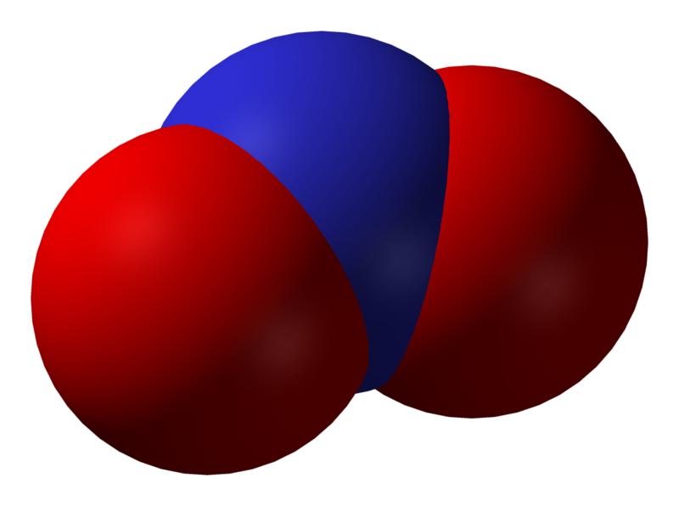

Exposure limits for NO₂
US OSHA PEL:
  Ceiling = 5 ppm
US NIOSH REL:
  15 min. STEL = 1 ppm
Old TLV:
  8 hr. TWA = 3 ppm
  5 min. STEL = 5 ppm
New 2012 TLV
  8 hr. TWA = 0.2 ppm

Slide 37
Suggested alarm settings for NO₂
Suggested alarms:
  NIOSH:
    Low: 3.0 ppm
    High: 5.0 ppm
    STEL: 1.0 ppm
    TWA: 1.0 ppm
  TLV®:
    Low: 0.6 ppm
    High: 1.0 ppm
    STEL: 0.2 ppm
    TWA: 0.2 ppm

Slide 38

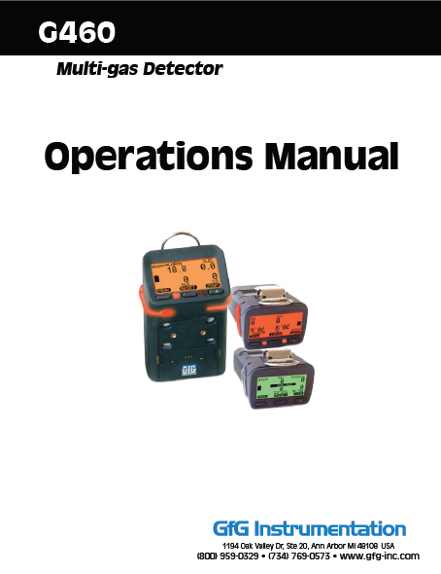
Sales Support: www.Goodforgas.com
Data sheets
Price lists
Manuals
Application Notes
Product images
Print ads
...and more!

Slide 39
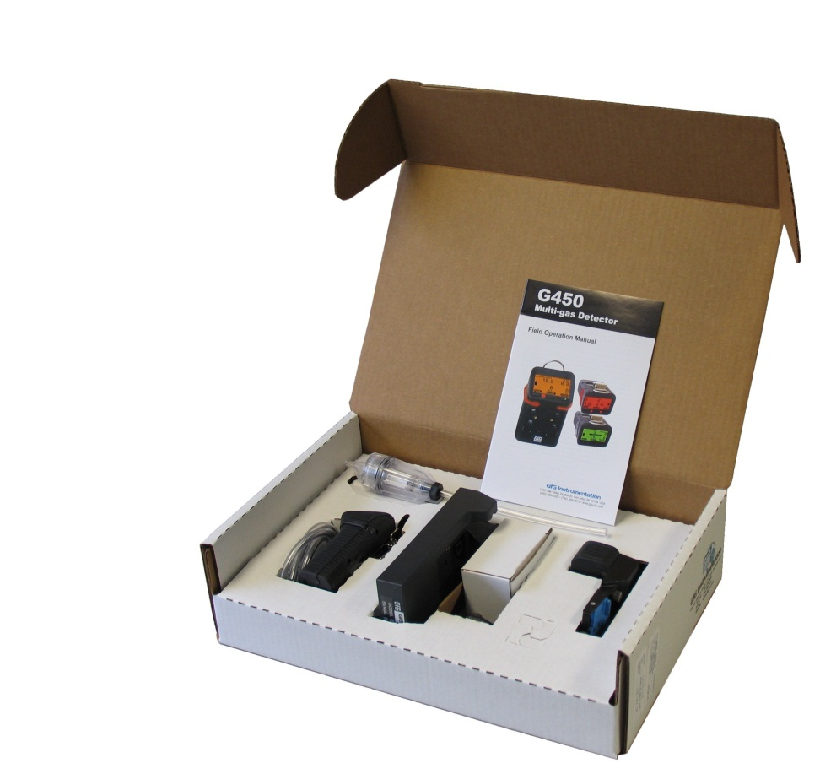
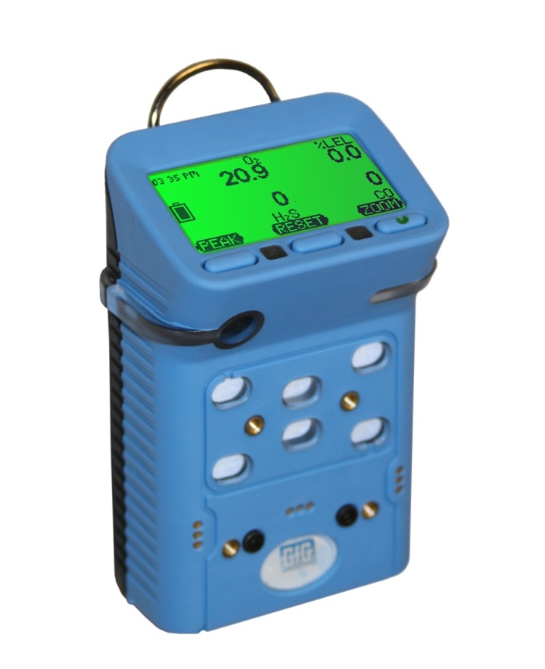

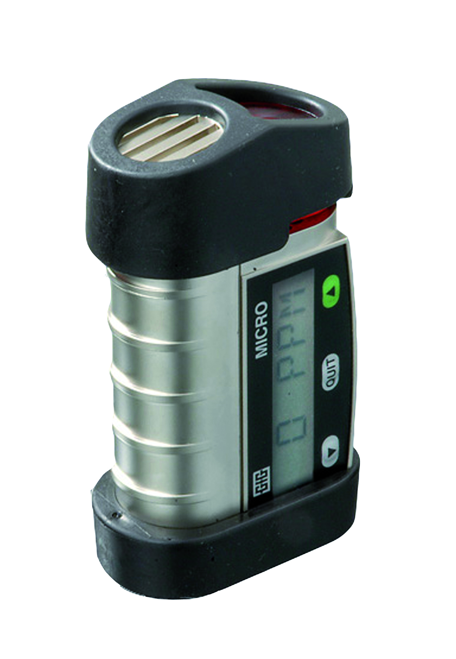
Questions?

