Slide 1
G450 / G460
Updating instrument firmware
GfG Instrumentation, Inc.
1194 Oak Valley Drive, Suite 20
Ann Arbor, Michigan 48108
Toll free (USA and Canada): (800) 959-0329
Direct: +1-734-769-0573
Service e-mail: service@gfg-inc.com
Internet: www.gfg-inc.com
Technical documentation and download site: www.goodforgas.com

Slide 2
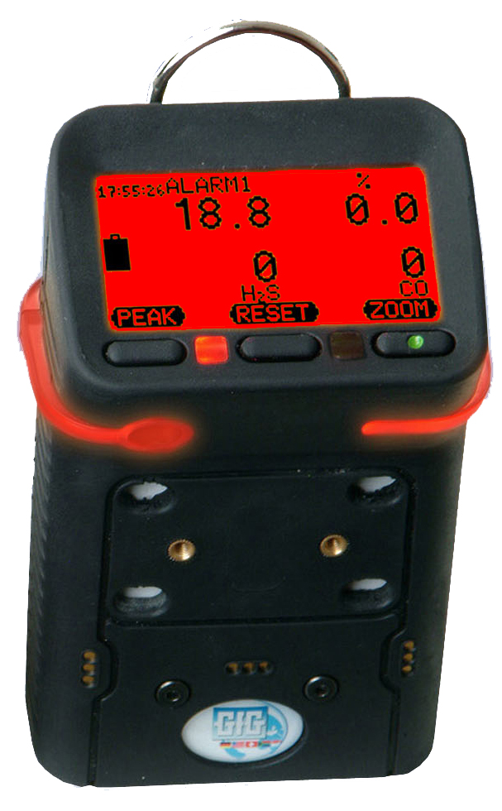
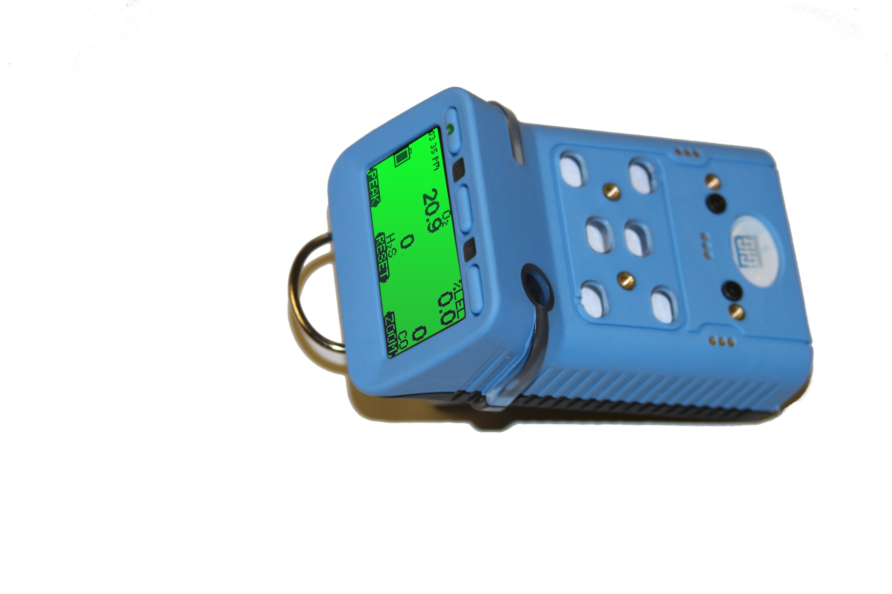
G450 / G460 Advanced Service Procedures
WARNING: Advanced service procedures should only be undertaken by authorized personnel

Slide 3
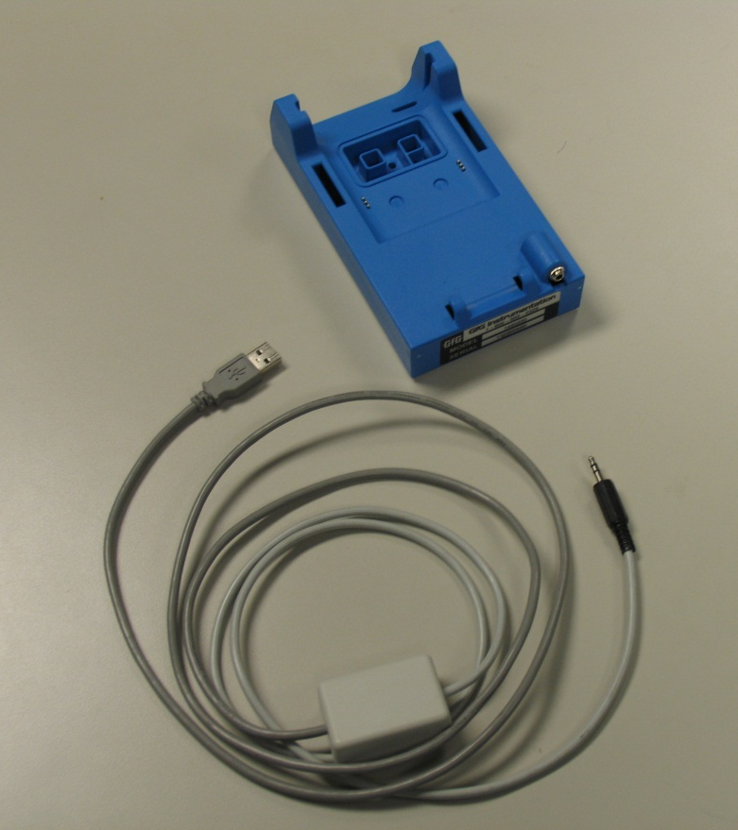
Updating G450 / G460 Firmware
You will need:
Latest firmware version to be installed
Latest version can be downloaded from www.goodforgas.com
Charger cradle and data download interface cable
Make sure the GfG drivers for the interface cable have been installed on your computer

Slide 4
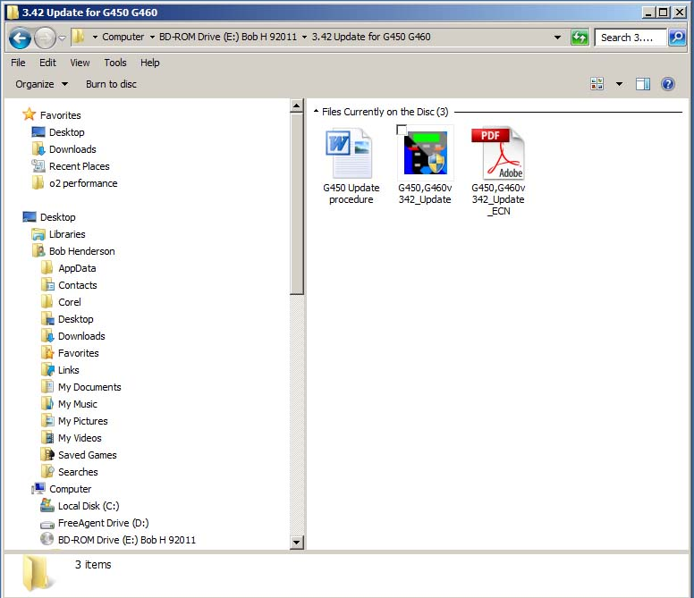
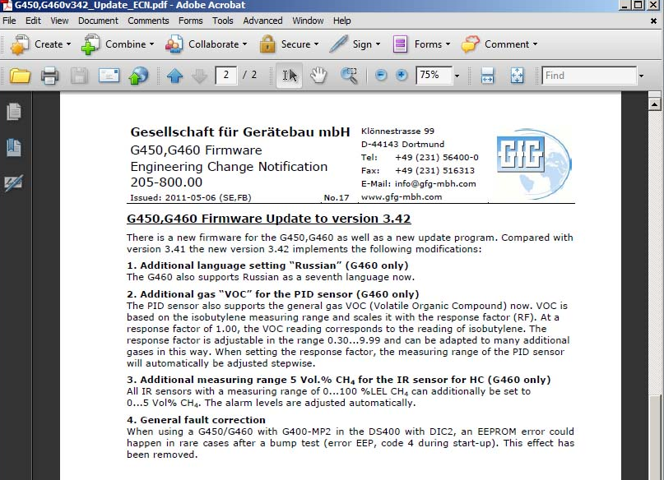
Update firmware: Step 1
Load the new “Update firmware” application onto your computer
The latest version can be downloaded at www.goodforgas.com
Read the description of changes from the previous version
Decide whether to proceed with update

Slide 5
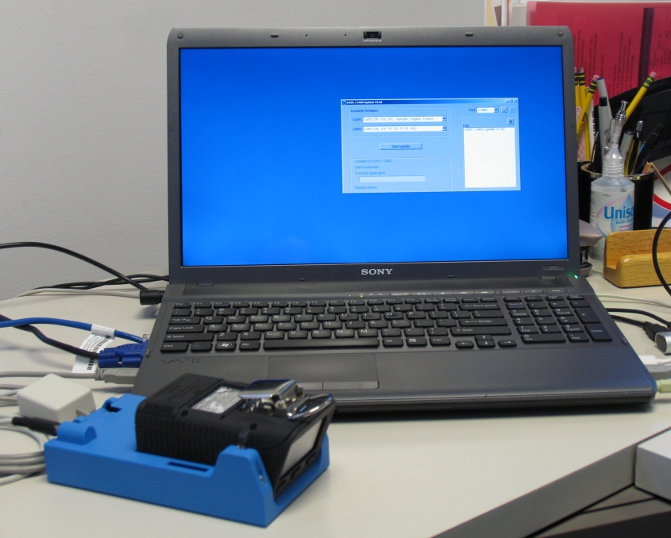
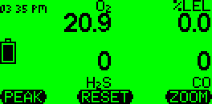
Update firmware: Step 2
Connect download interface cable to cradle and connect cable to USB port in computer
Turn instrument on then place in cradle
Make sure neither the instrument or computer run out of power during update procedure
Make sure battery gauge in LCD shows at least two segments
Do not disconnect or disturb interface cable and instrument during update process
Battery power gauge

Slide 6
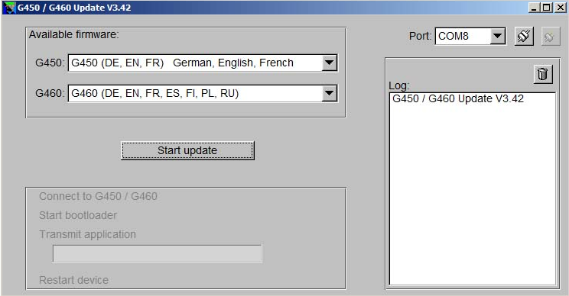
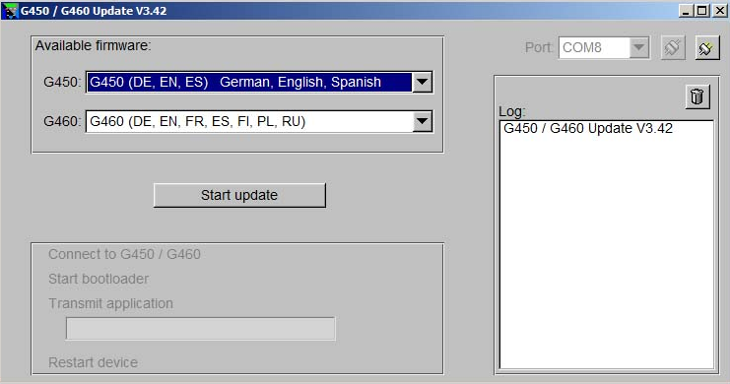
Update firmware: Step 3
Open G450 / G460 Update program
Select com port from pull down menu then click on “connect” button
Note: Correct com port is usually the one with the highest number
Choose desired set of languages from pull-down menu
G450 supports sets of three languages at a time as choices in on-board memory
G460 supports all available languages at same time in on-board memory
Com Port Connect Button
Pull-down G450 language menu

Slide 7
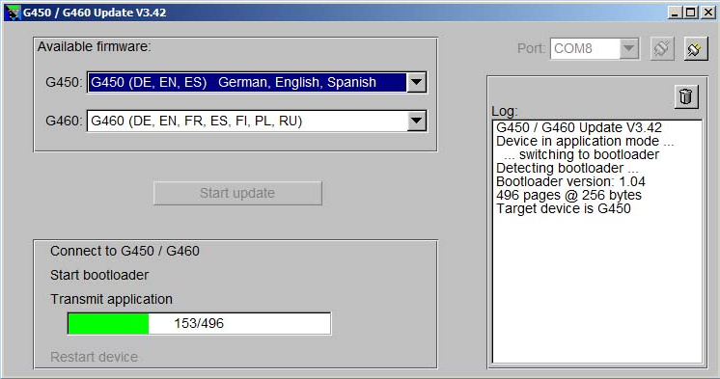
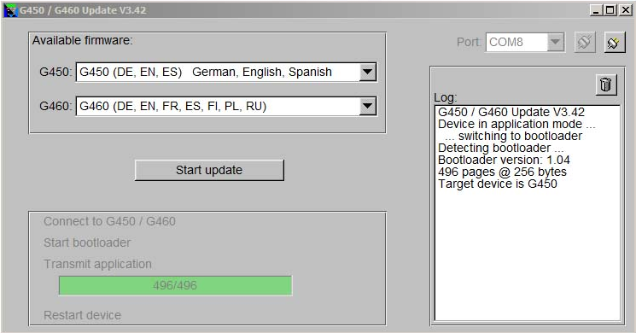
Update firmware: Step 4
Click on “Start Update” button
A green status bar will indicate progress
The instrument will turn itself back on in normal operation when the update is complete
The instrument must be calibrated before it is put back into service!
“Start Update” Button

Slide 8
Update firmware: If a problem is encountered
A red status bar indicates a problem has been encountered
Remove the instrument from the cradle, then replace in cradle and click on the start button to repeat the update process
If the update application fails to restart the procedure, try momentarily disconnecting the interface cable from the computer, and / or closing and restarting the update application

Slide 9
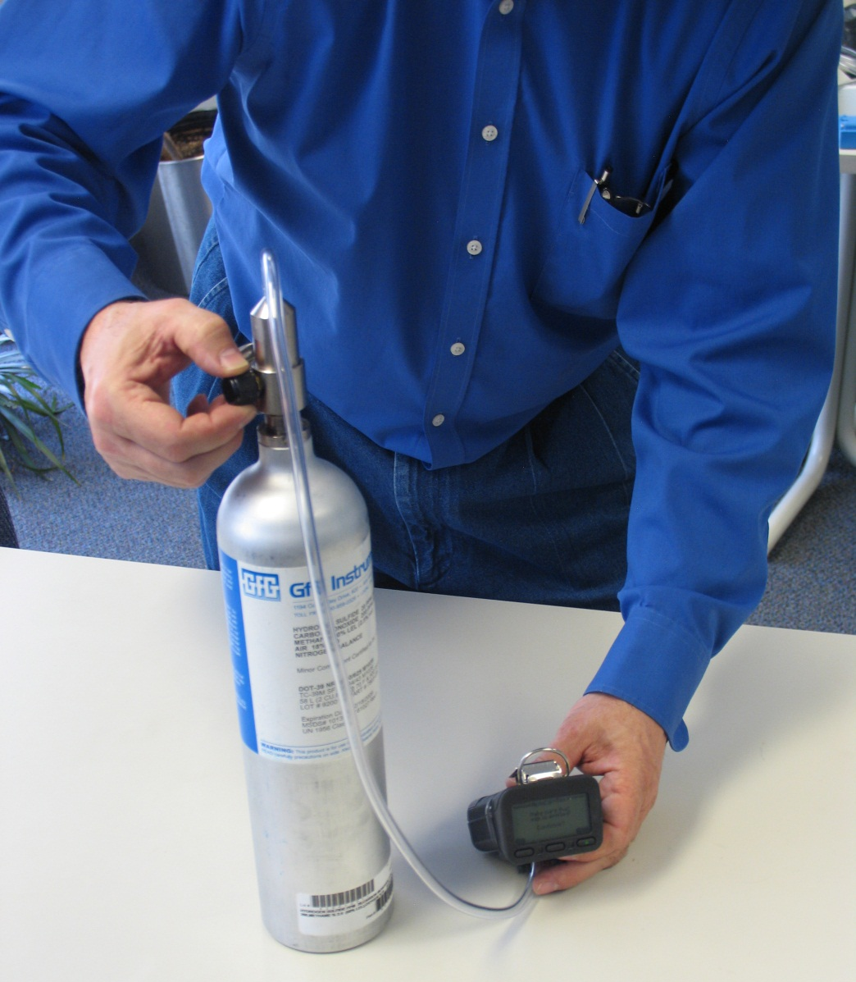
Returning the instrument to service
Calibrate ALL sensors in the instrument (whether or not they have been changed) before returning the instrument to service
It is best to let new sensors stabilize in the instrument for 30 minutes prior to calibration

Slide 10
Questions?

