Slide 1
G460 PID sensor
performance and maintenance
GfG Instrumentation, Inc.
1194 Oak Valley Drive, Suite 20
Ann Arbor, Michigan 48108
Toll free (USA and Canada): (800) 959-0329
Direct: +1-734-769-0573
Service e-mail: service@gfg-inc.com
Internet: www.gfg-inc.com
Technical documentation and download site: www.goodforgas.com

Slide 2
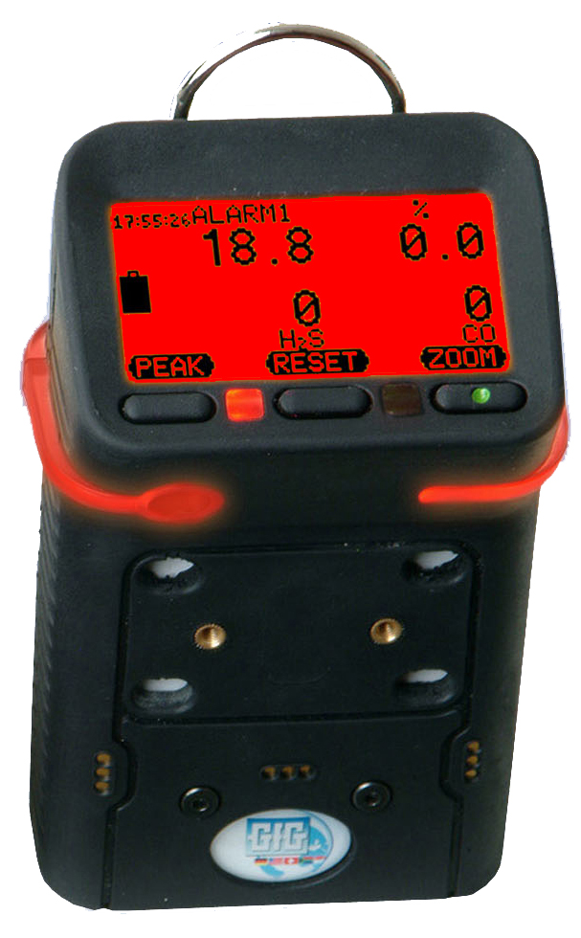
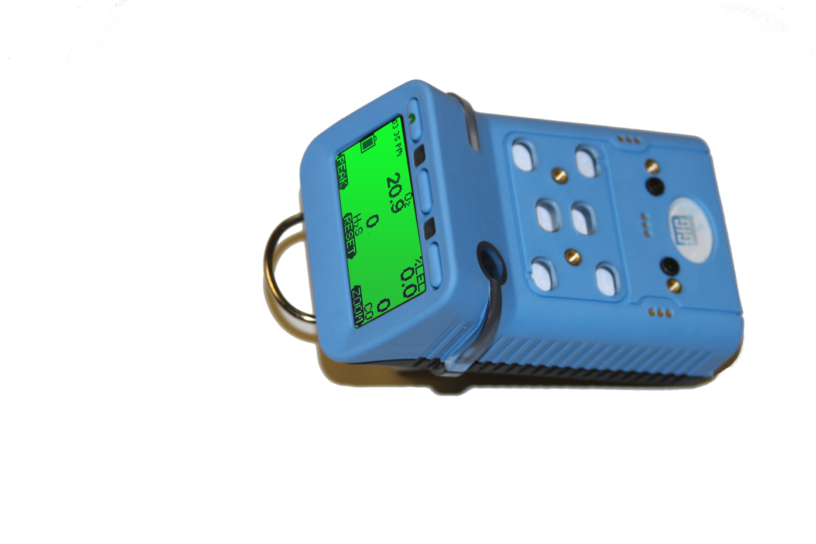
G450 / G460 Advanced Service Procedures
WARNING: Advanced service procedures should only be undertaken by authorized personnel

Slide 3
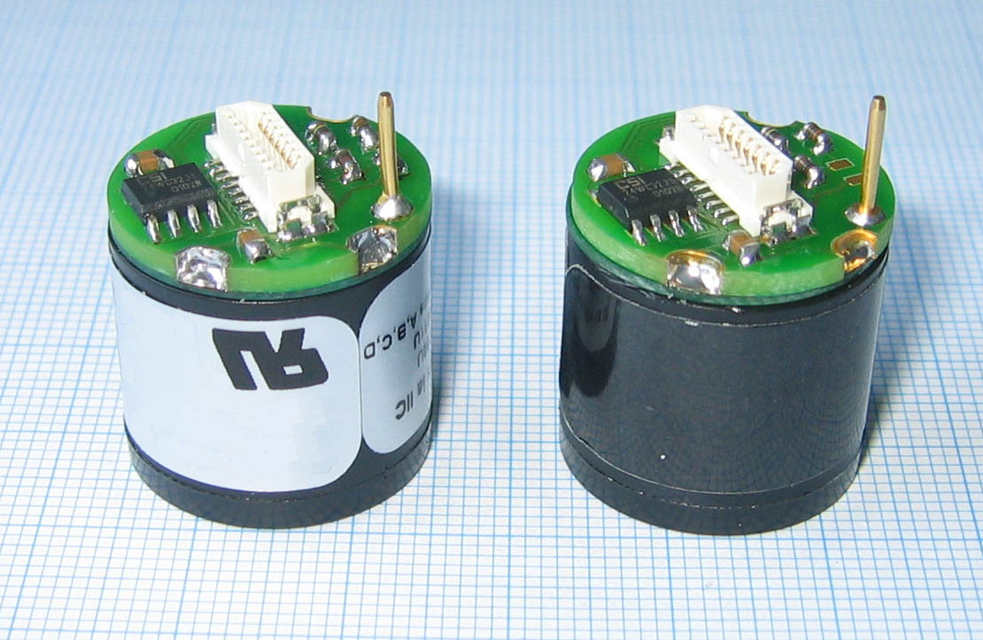
G460 Smart Sensor PID
PID Smart-Sensor
Broad range VOC measurement
Extremely sensitive
Available in two ranges:
0.5 – 2,000 ppm (Standard PID sensor)
0.1 – 500 ppm (Optional high resolution PID sensor)

Slide 4
PID range and resolution
Two versions of the PID sensor available for G460:
“Standard” PID provides 0.5 ppm resolution over 0 – 2000 ppm (isobutylene scale)
“High Resolution” PID provides 0.1 ppm resolution over 0 – 500 ppm (isobutylene scale)
“VOC” choice allows the user to specify custom correction factor for a gas not included in the standard on-board library
The full range for the gas selected depends on the relative response of the sensor to the target gas compared to isobutylene
For instance, when “NH3” (ammonia) is selected, because of the lower relative response to ammonia compared to isobutylene, the full range is expanded from 0 – 2000 (iso scale) to 0 – 6000 ppm (NH3 scale)

Slide 5
PID sensor menu
PID sensor choices include "Range and Gas"
Use to choose correction factor for new gas from PID library
PID readings displayed in measurement units of gas selected
Name of gas selected will appear in the sensor menu PID position
In normal operation screen will show name of new gas
CH4
iButyln
CO
Range and Gas
0-2000ppm iButyln
0-2000ppm Gasolin
0-2000ppm MIBK
0-2000ppm Acetone
0-2000ppm Deether
0-2000ppm Propyln
0-2000ppm iButyln

Slide 6
PID sensor “Gas and Unit” library choices
PID Gas List Abbreviations | Common Name | Range with 0 – 2000 ppm full range PID (ISO) | Range with 0 – 500 ppm full range PID (ISO)
iButyln | Isobutylene | 0 – 2000 | 0 – 500
VOC | Generic VOC with user assigned CF | 0 – 2000 | 0 – 500
Gasolin | Gasoline | 0 – 2000 | 0 – 500
MIBK | Methyl-iso-butyl-ketone | 0 – 2000 | 0 – 500
Acetone | Acetone | 0 – 2000 | 0 – 500
Deether | Diethylether | 0 – 2000 | 0 – 500
Propyln | Propylene | 0 – 2000 | 0 – 500
MEK | Methyl-ethyl-ketone | 0 – 1500 | 0 – 375
Diesel | Diesel | 0 – 1500 | 0 – 375
TrClEyn | Trichloroethylene | 0 – 1000 | 0 – 250
Benzene | Benzene | 0 – 1000 | 0 – 250
Toluene | Toluene | 0 – 1000 | 0 – 250
Xylene | Xylene | 0 – 1000 | 0 – 250
Styrene | Styrene | 0 – 800 | 0 – 200
Jetfuel | Jet fuel (JP-8) | 0 – 800 | 0 – 200
nButnol | n-Butyl-alcohol | 0 – 6000 | 0 – 1500
EtActat | Ethyl acetate | 0 – 6000 | 0 – 1500
nHexane | n-Hexane | 0 – 6000 | 0 – 1500
NH3 | Ammonia | 0 – 6000 | 0 – 1500
cHexane | Cyclo hexane | 0 – 3000 | 0 – 750
VyChlrd | Vinyl chloride (VCM) | 0 – 3000 | 0 – 750
MeBromd | Methyl bromide | 0 – 3000 | 0 – 750
nNonane | n-Nonane | 0 – 3000 | 0 – 750
Octane | Octane | 0 – 3000 | 0 – 750
Heptane | Heptane | 0 - 3000 | 0 – 750

Slide 7
G460 Interchangeable Smart Sensors
Five Smart Sensor positions on PCB:
All you need to do is plug the sensor into a position designed for that type of sensor
EC 1: COSH
EC 1, 2, 3: CO, H2S, O2, NH3, SO2, H2, PH3, HCN
EC 2, 3: NO, NO2, CL2, HCL, ETO, O3, ClO2, HF
EC 2: PID
PL: 1 – 100% LEL “pellistor” sensor
IR: 0.1 - 5.0 Vol % CO2; 0 – 100% LEL combustible; 0 – 100% vol combustible

Slide 8
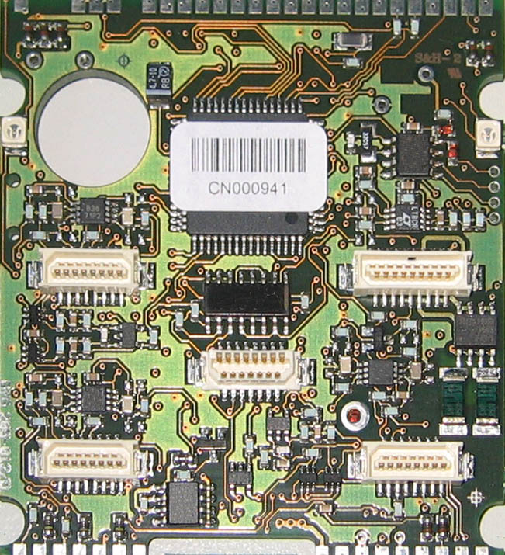
G460 Main PCB: Five Smart Sensor Positions
EC3 (Upper Left)
PL (Upper Right)
EC2 / PID (Lower Right)
IR (Center)
EC1 (Lower Left)

Slide 9
G460 PID maintenance
The G460 PID is protected by both external and internal filters
Because gas diffuses into and out of the sensor (rather than using a pump to pull the atmosphere across the lamp and electrodes) the system is less prone to particulate contamination
Note: The PID lamp and electrodes
should only be cleaned when needed!
The primary symptoms that indicate the need to clean the lamp are:
Unstable readings
Oversensitivity to humidity
Failure to calibrate

Slide 10
G460 PID Maintenance
The following slides show the step-by-step procedure for cleaning the G460 PID
The manufacturer of the PID lamp (Baseline-MOCON, Inc.) has also posted a training video at the following link:
http://vimeopro.com/gasanalysis/pid-tech-plus
The password is: baseline11
G460 PID cleaning kit (PN 7740-026): includes replacement filters, lamp polishing pads, tweezers and compressor stick
Note: The appearance of the Baseline-MOCON
“PID Plus” sensor in the video is slightly different
from the GfG PID version. The procedure for
disassembly and cleaning the lamp is exactly the
same, however.

Slide 11
G460 PID Maintenance Kit
PID maintenance kit components
Inner filter
Outer filter (moisture barrier)
Padded stick
Lamp polishing pad

Slide 12
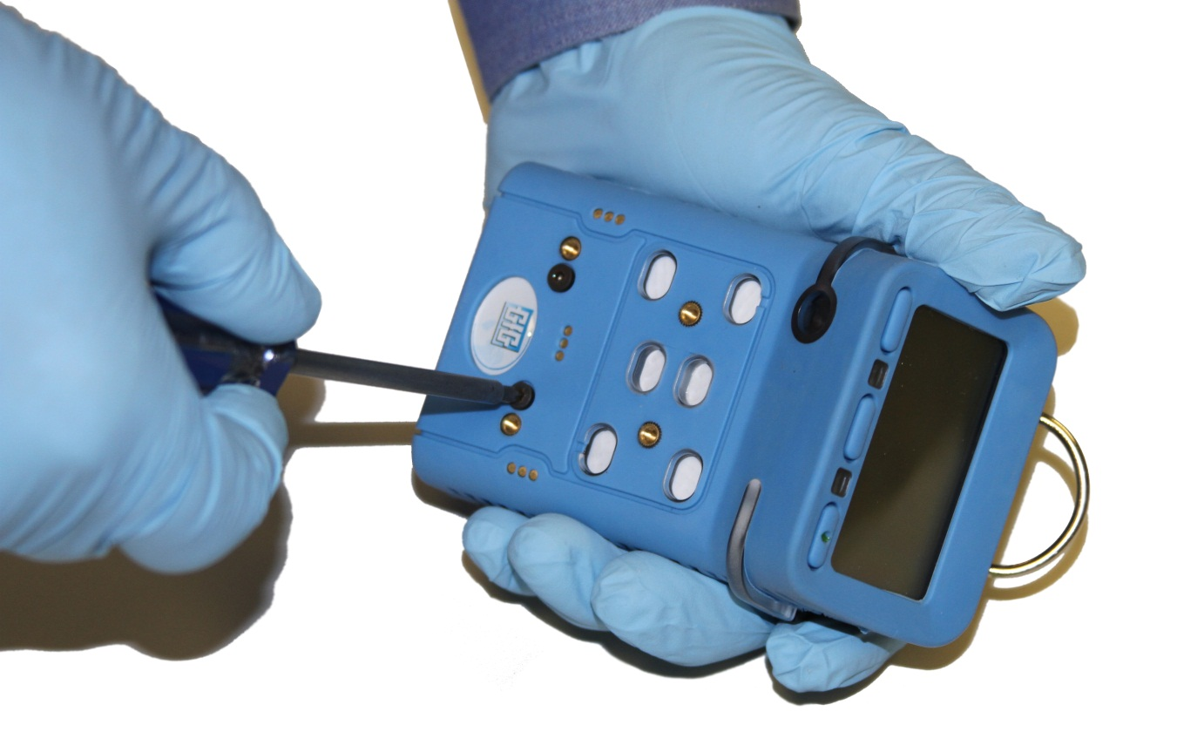
G460 PID Maintenance Cautions
Wear gloves when handling or disassembling PID
Note: Direct contact between fingers and PID lamp, electrodes and other components can leave oils and contaminants behind that can degrade performance

Slide 13
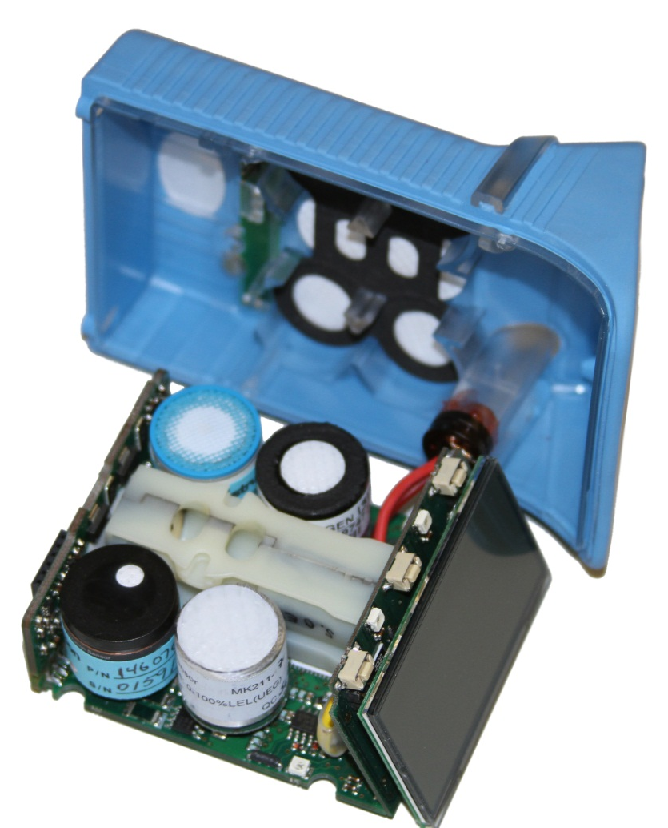
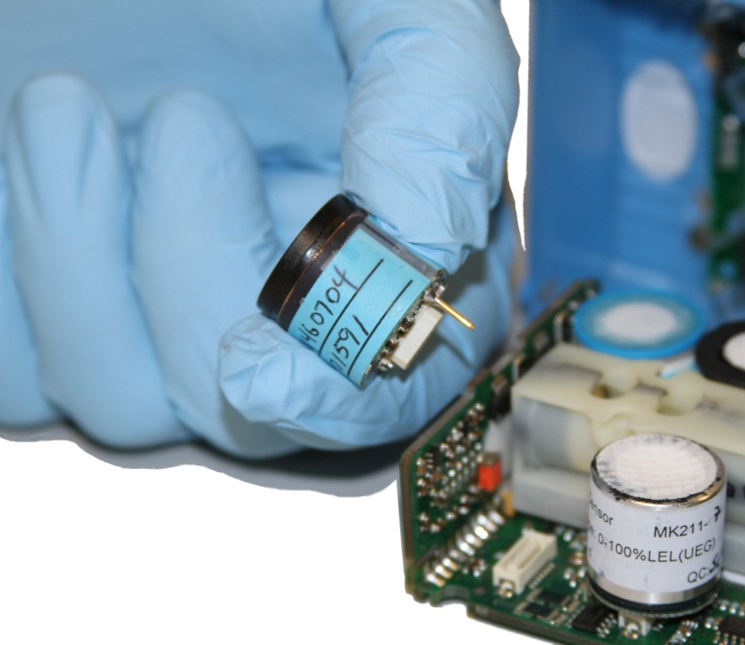
G460 PID Maintenance
Make sure instrument is turned off!
Remove battery, open housing, and CAREFULLY remove main board and display assembly exposing sensors
Remove PID sensor
PID sensor

Slide 14
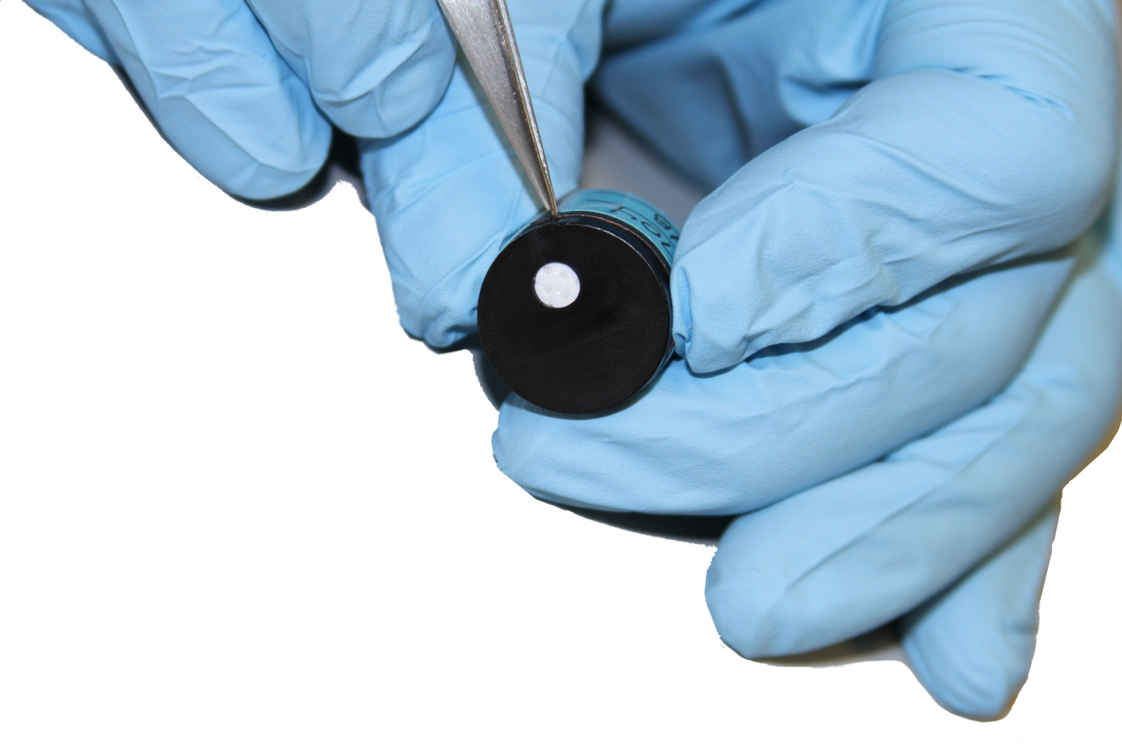
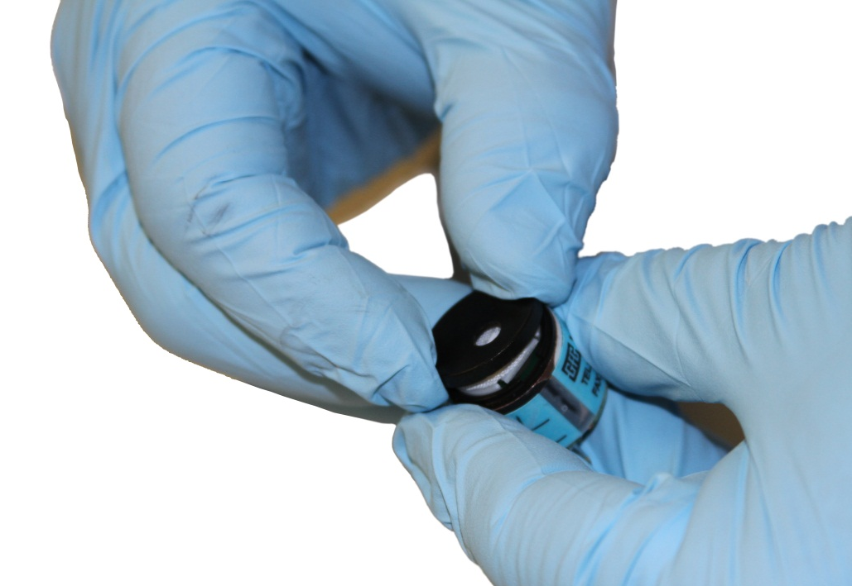
G460 PID Maintenance
Use tweezers to pry the top off of the sensor
Position the tweezers next to the cap opening
Remove the sensor cap

Slide 15
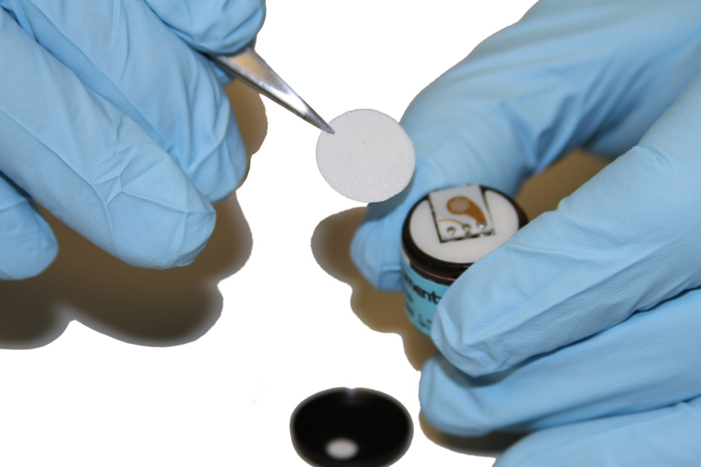
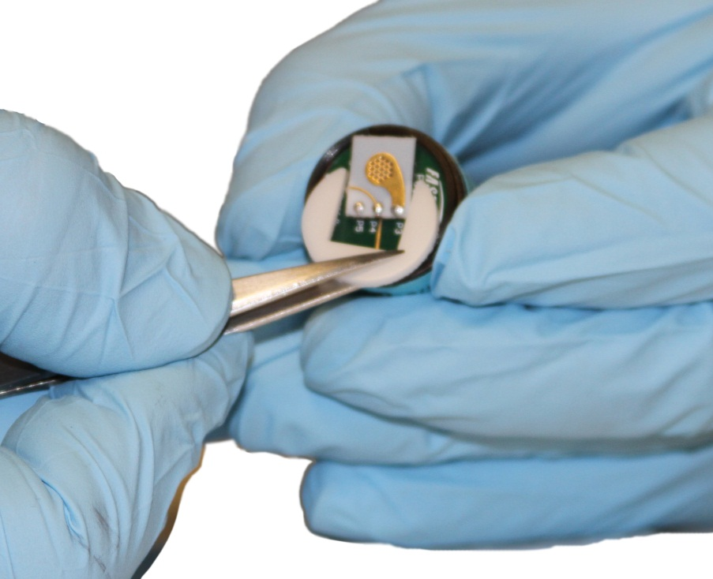
G460 PID Maintenance
Remove filters (inner and outer)
Remove spacer

Slide 16
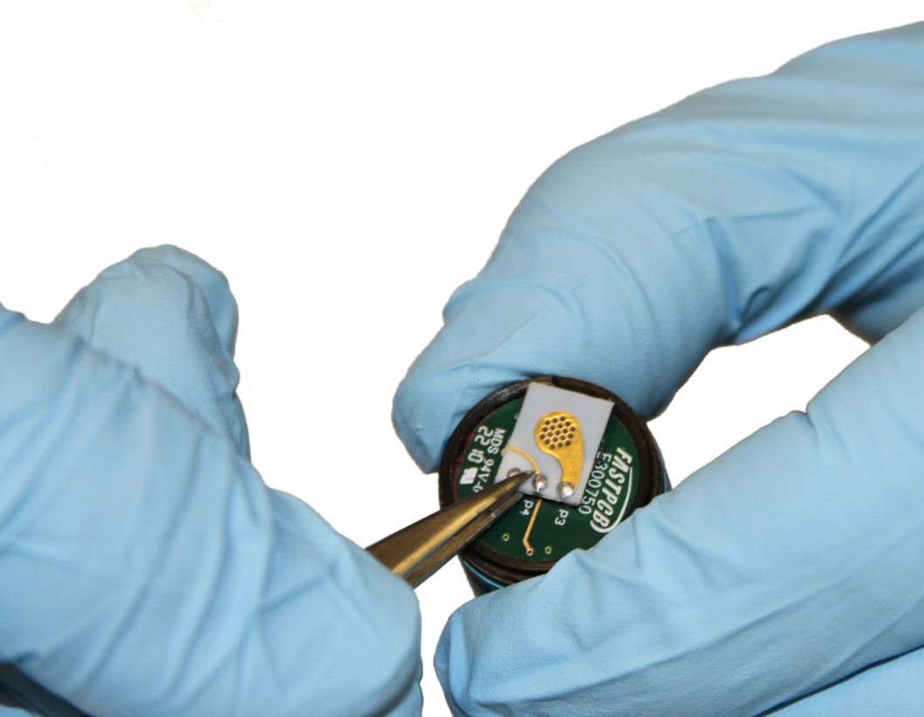
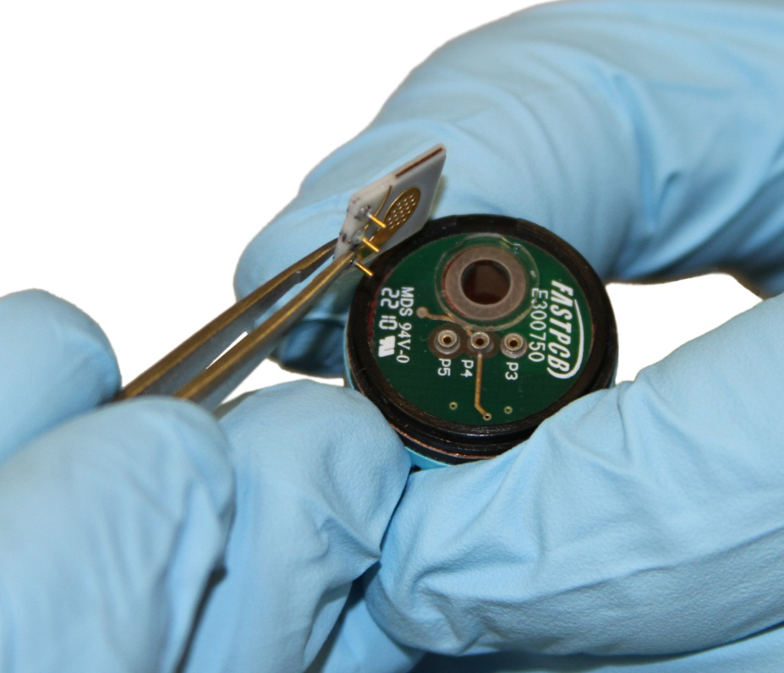
G460 PID Maintenance
Gently remove sensor PCB
Grip at back of board (near pins)

Slide 17
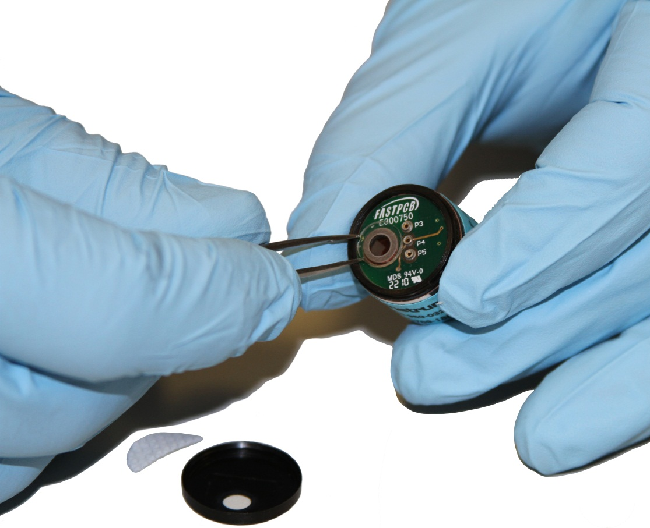
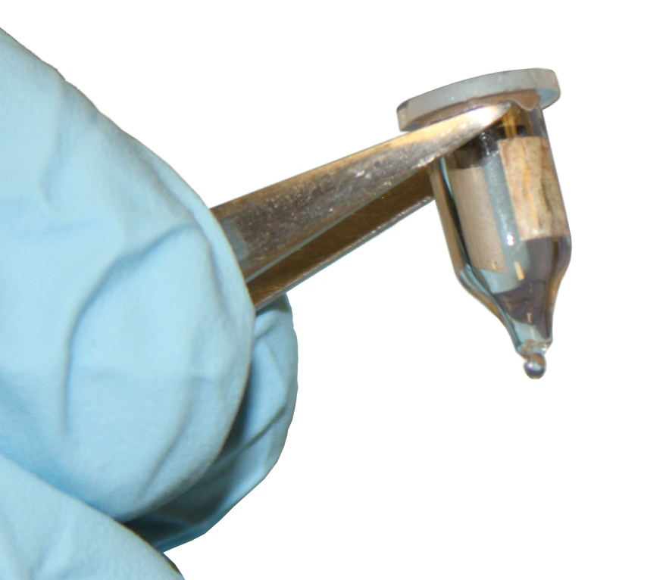
G460 PID Maintenance
Use tweezers to GENTLY pry the lamp out of the sensor
Do not touch window or body of lamp with naked fingers

Slide 18
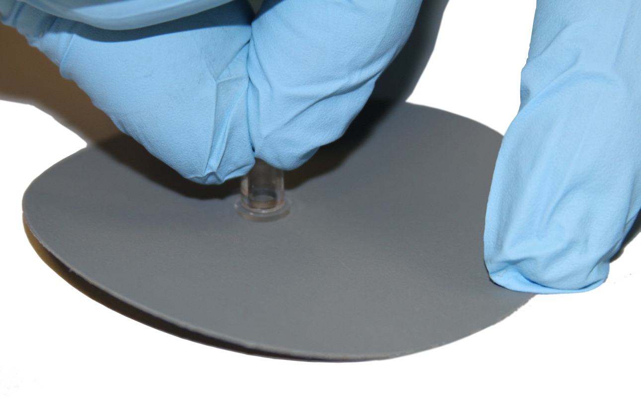
G460 PID Maintenance
Use circular motion to polish face of lamp window with polishing pad

Slide 19
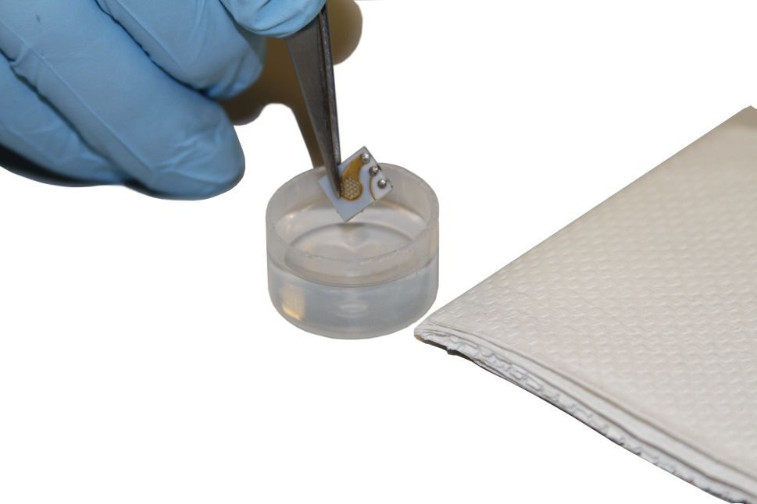
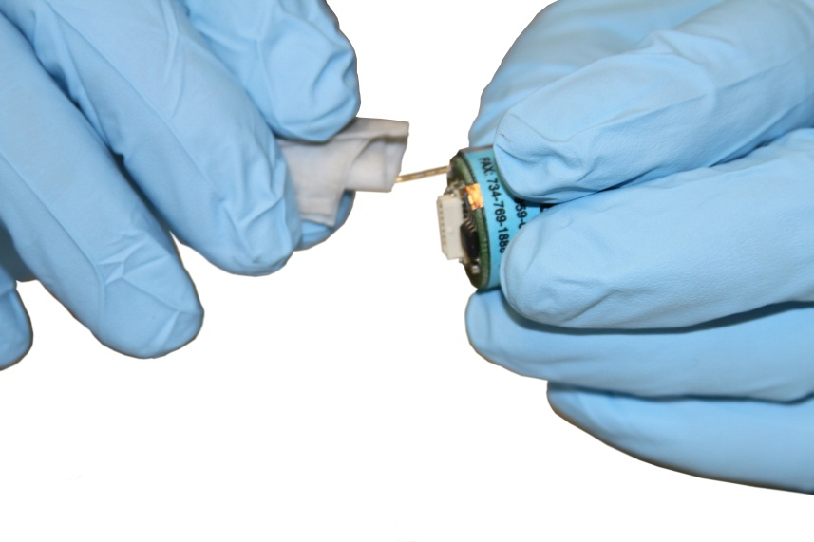
G460 PID Maintenance
Clean any lamp, pin, or electrode PCB surfaces that have come into contact with naked skin with alcohol before reassembling
Make sure that all components are COMPLETELY air-dried before reassembly
Do not use blowers or heated air sources to speed up drying!

Slide 20
G460 PID Maintenance
Insert lamp back into PID sensor assembly
NOTE: Metal pads in PID lamp MUST line up with contacts in socket of sensor assembly
Metal pads
Metal contacts

Slide 21
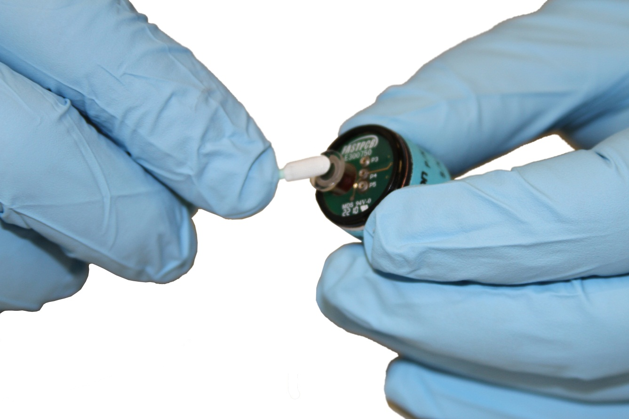
G460 PID Maintenance
Use padded stick to press lamp into place

Slide 22
G460 PID Maintenance
Reassemble:
Sensor PCB
Spacer
Filters (2)
Sensor cap
Plug PID sensor back into instrument
Calibrate the PID sensor before returning the G460 to service!

Slide 23
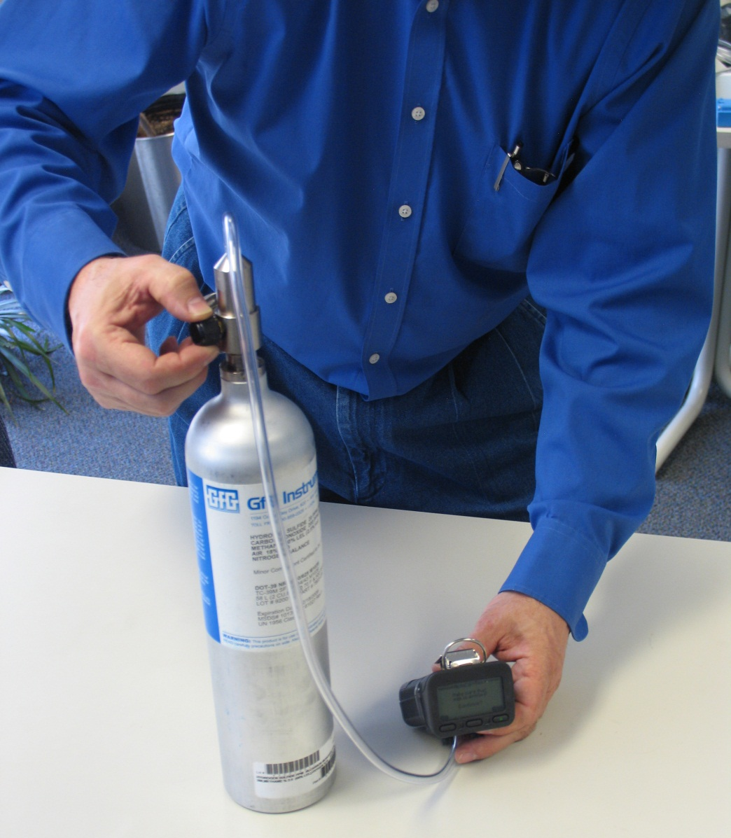
Returning the instrument to service
Calibrate ALL sensors in the instrument (whether or not they have been changed) before returning the instrument to service
It is best to let new sensors stabilize in the instrument for 30 minutes prior to calibration

Slide 24
Questions?

