Slide 1
Products and performance

Slide 2
GfG Instrumentation
GfG is a worldwide manufacturer of portable and fixed gas detection solutions.
For over 50 years, GfG has specialized in the development and manufacturing of high quality, robust and safe gas warning systems and sensors.
High quality, reliable products, excellent service, and the best cost of ownership of any gas detection products on the market!
“Technology for people and the environment.”

Slide 3
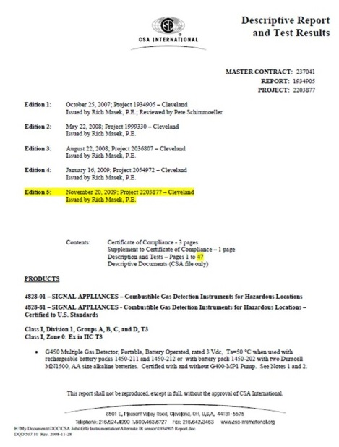
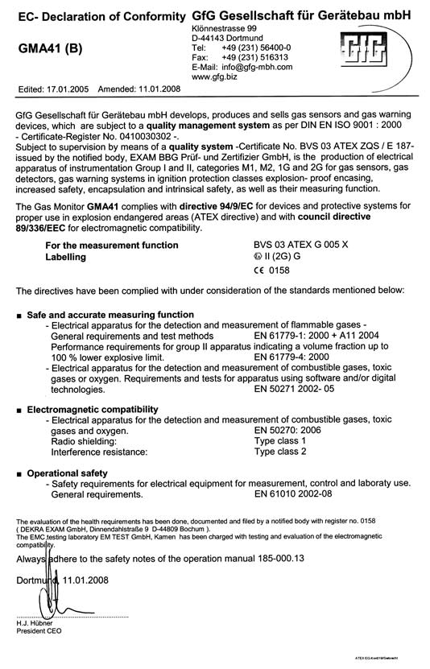
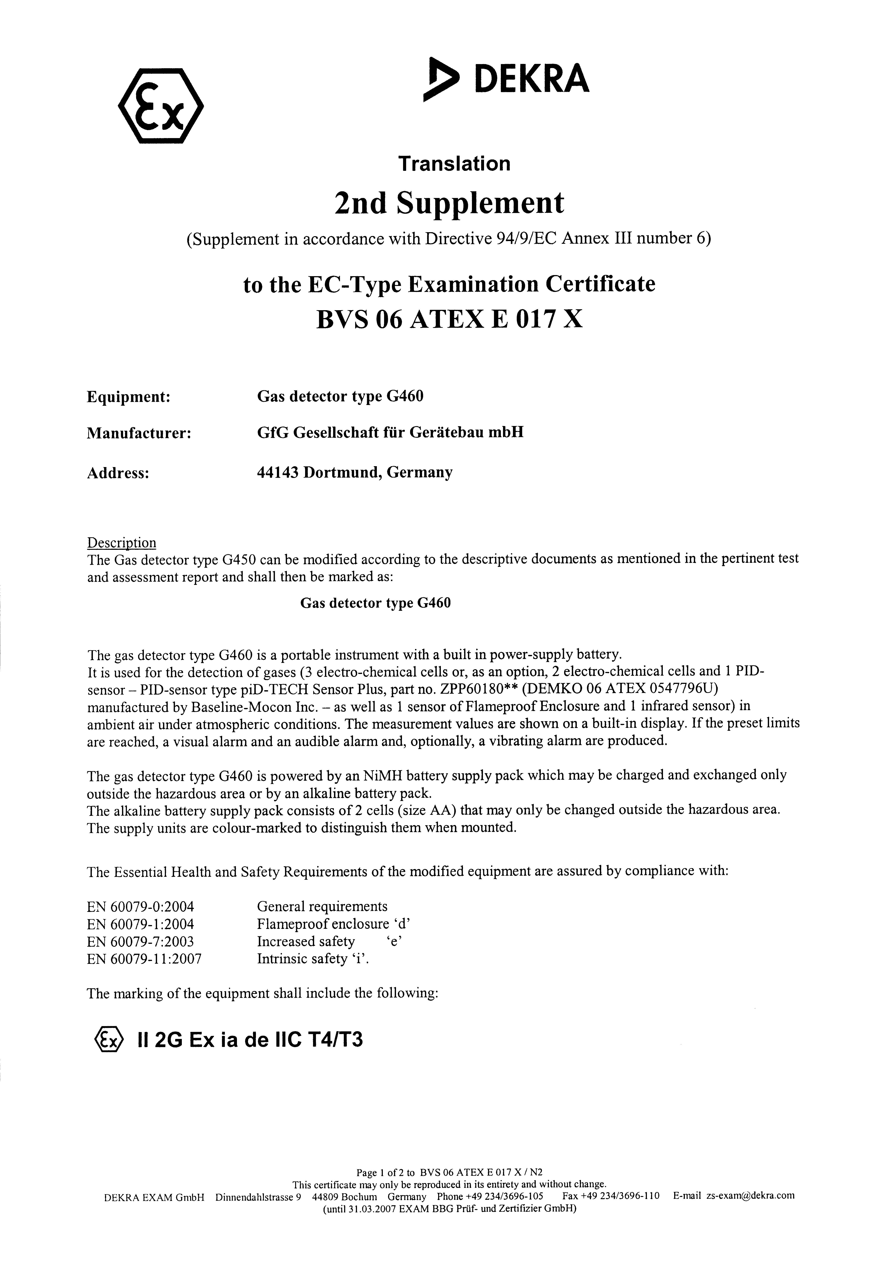
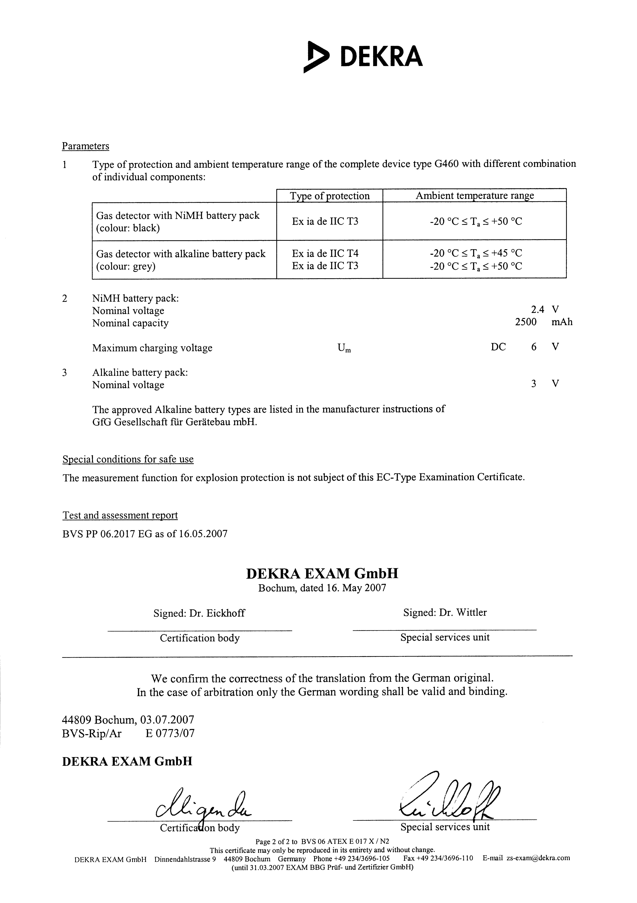
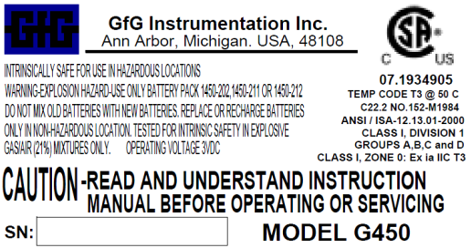
GfG Instrumentation
Certified quality

Slide 4
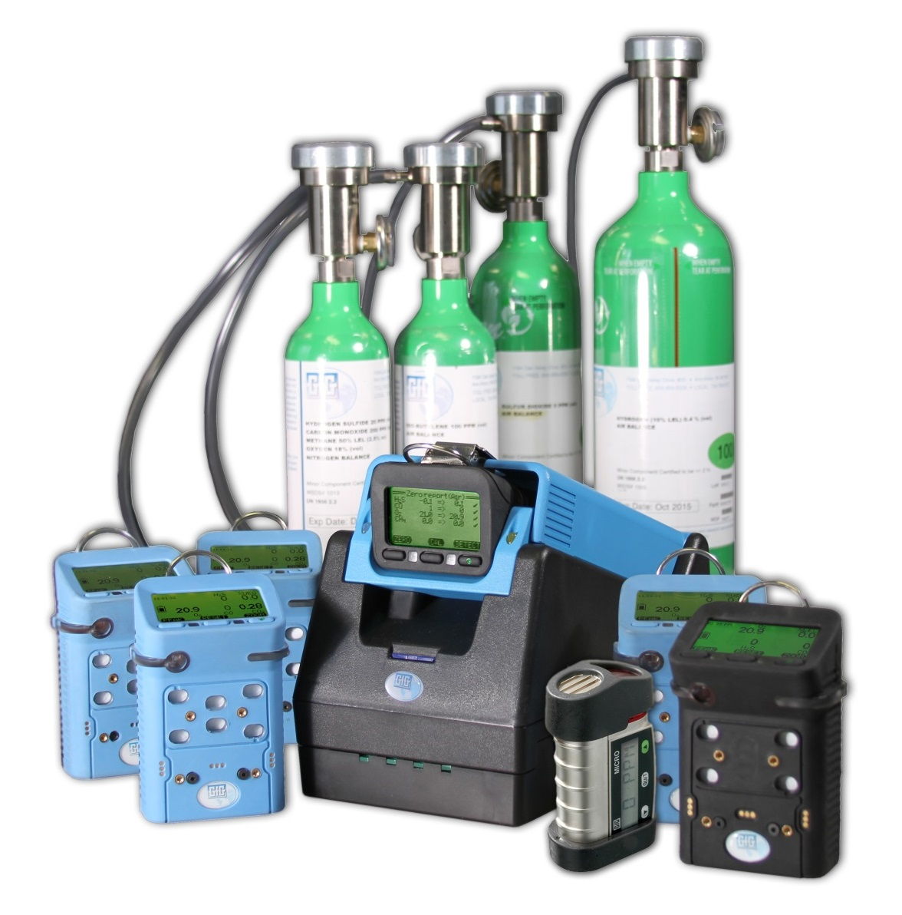
GfG Instrumentation
Exceptional designs with best cost of ownership in the gas detection industry

Slide 5
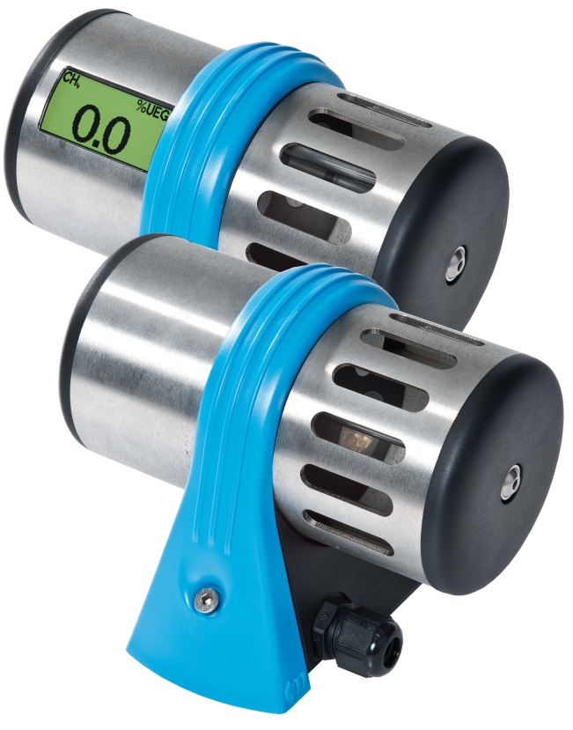
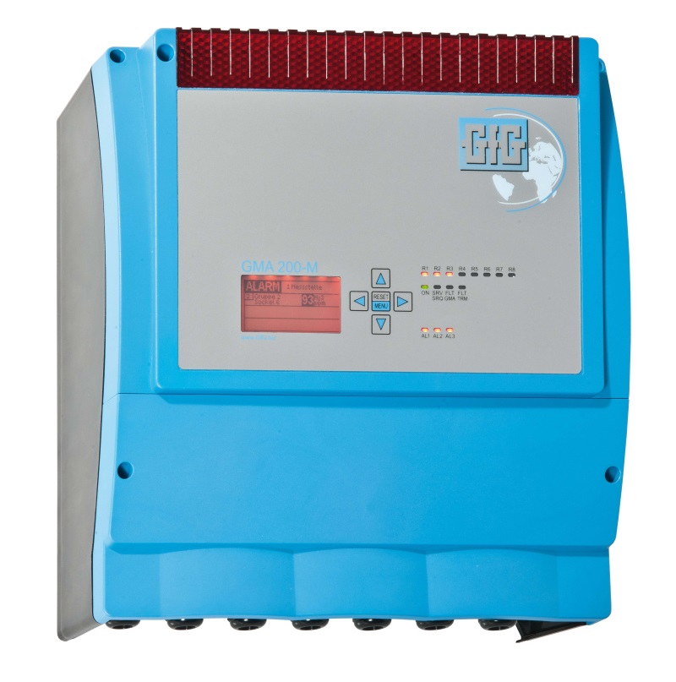
GfG Instrumentation
Technological leadership

Slide 6
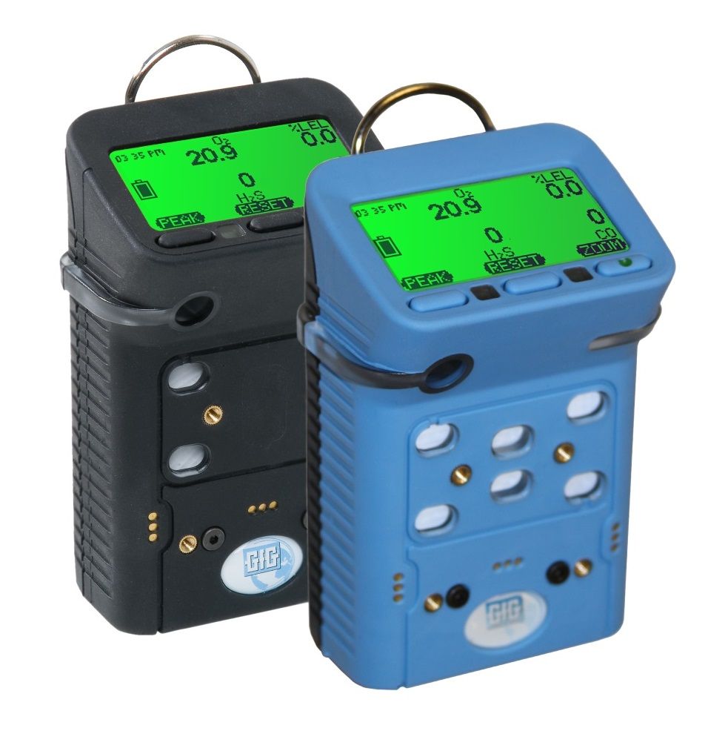
G450 and G460
Multi-gas detectors

Slide 7
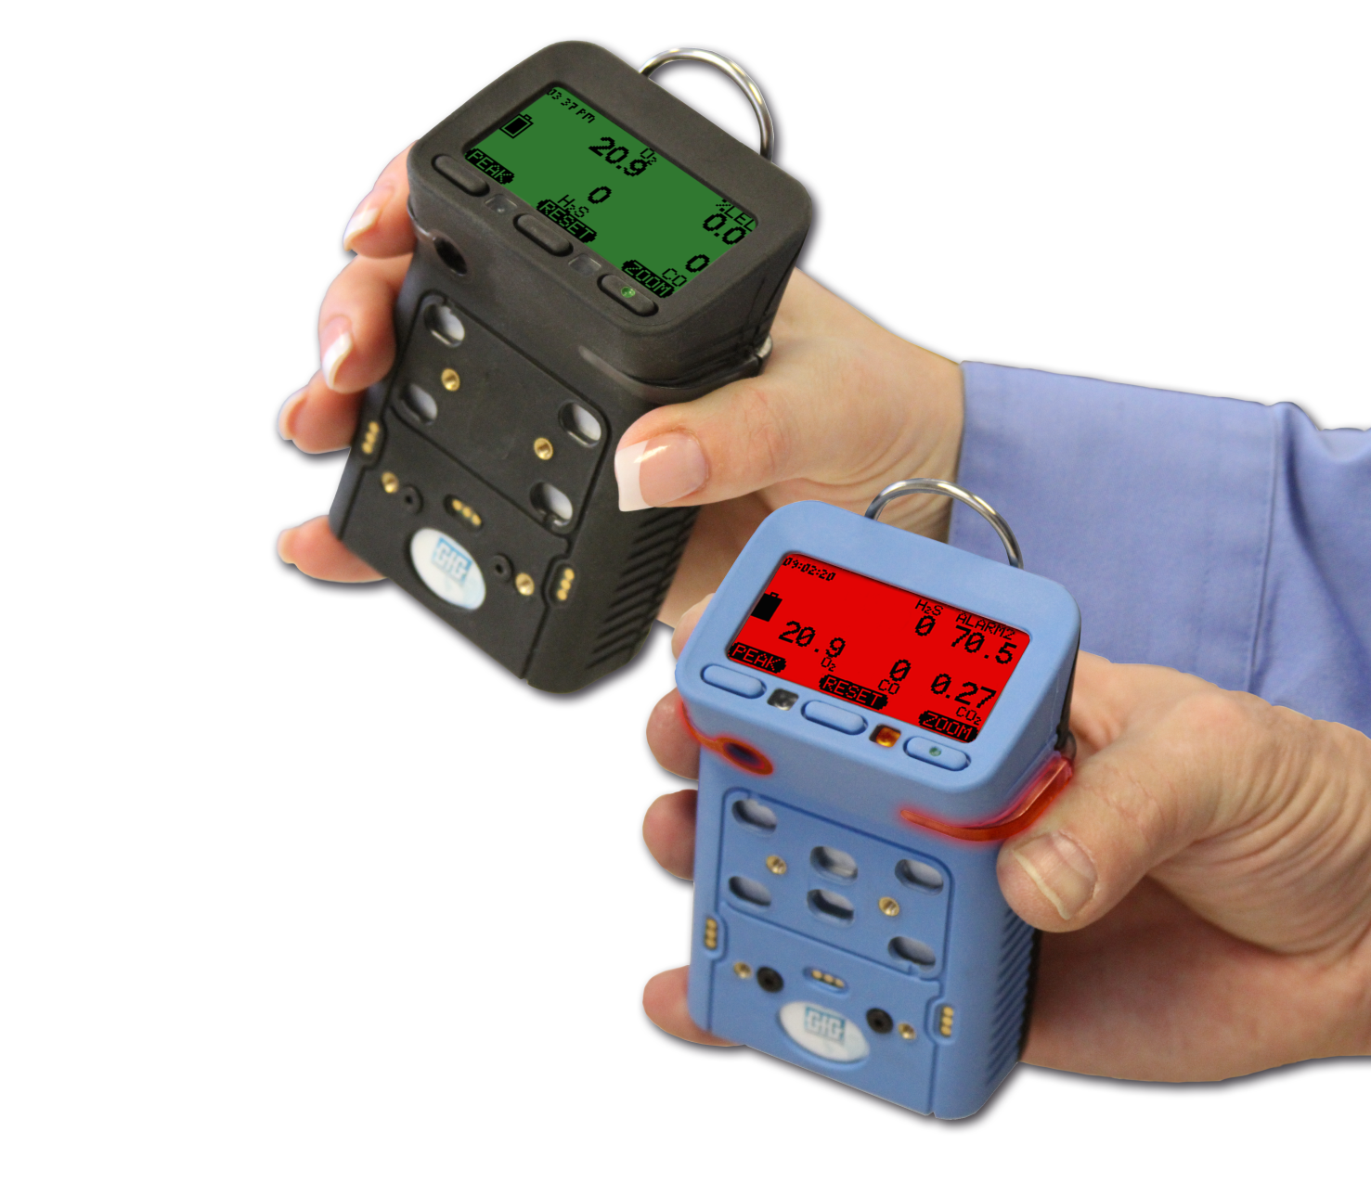
GfG Instrumentation
World-wide reach

Slide 8
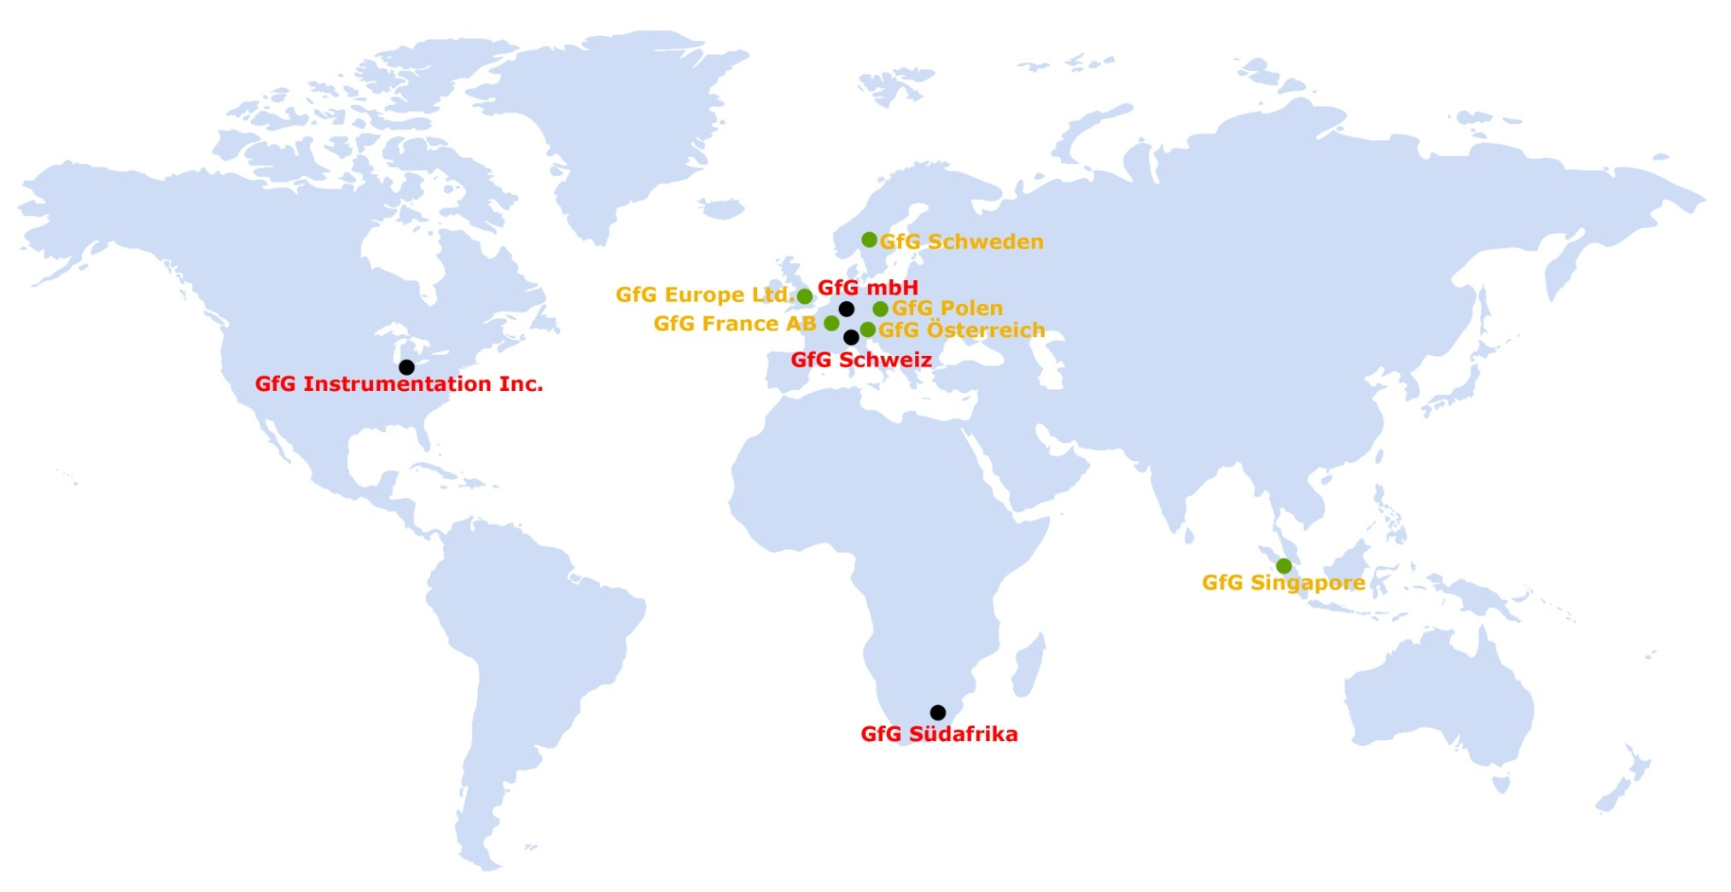
Production plants
Sales companies

Slide 9
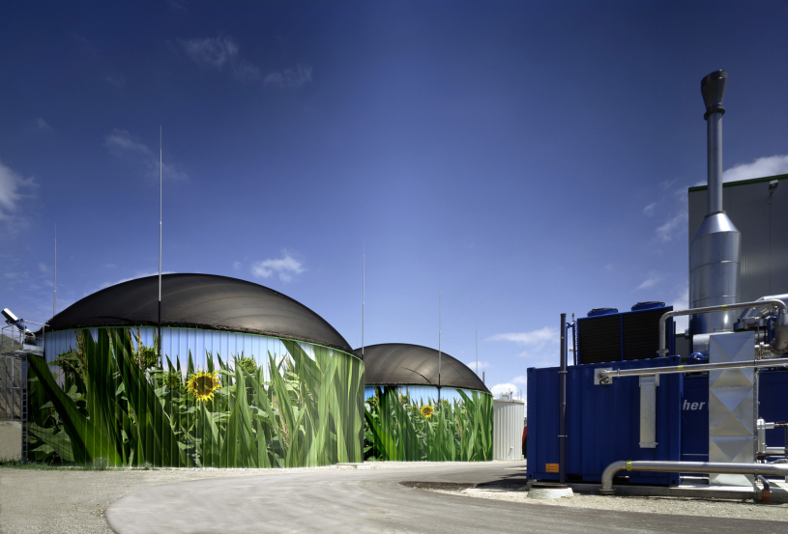
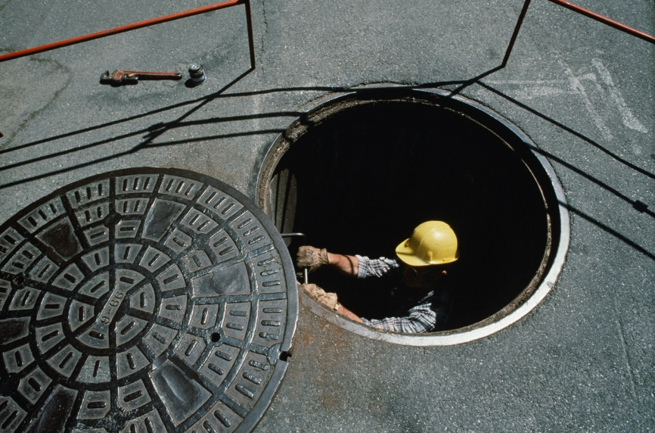
GfG Instrumentation
Technology based solutions for unique applications

Slide 10
Gas detection solutions
Sewage treatment
Gas industry
Coal and steel industry
Automotive industry
Facility protection
Fire brigade
Food industry
Chemical and
Petrochemical industry

Slide 11
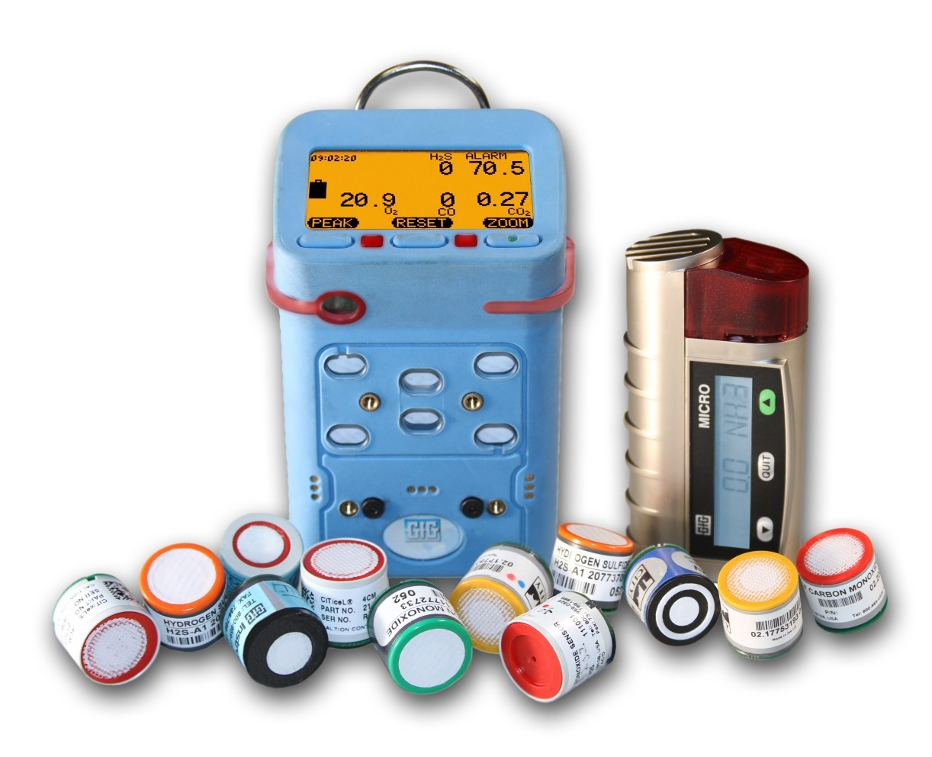
GfG Instrumentation
Best sensor warranties, best product support, best customer value!

Slide 12
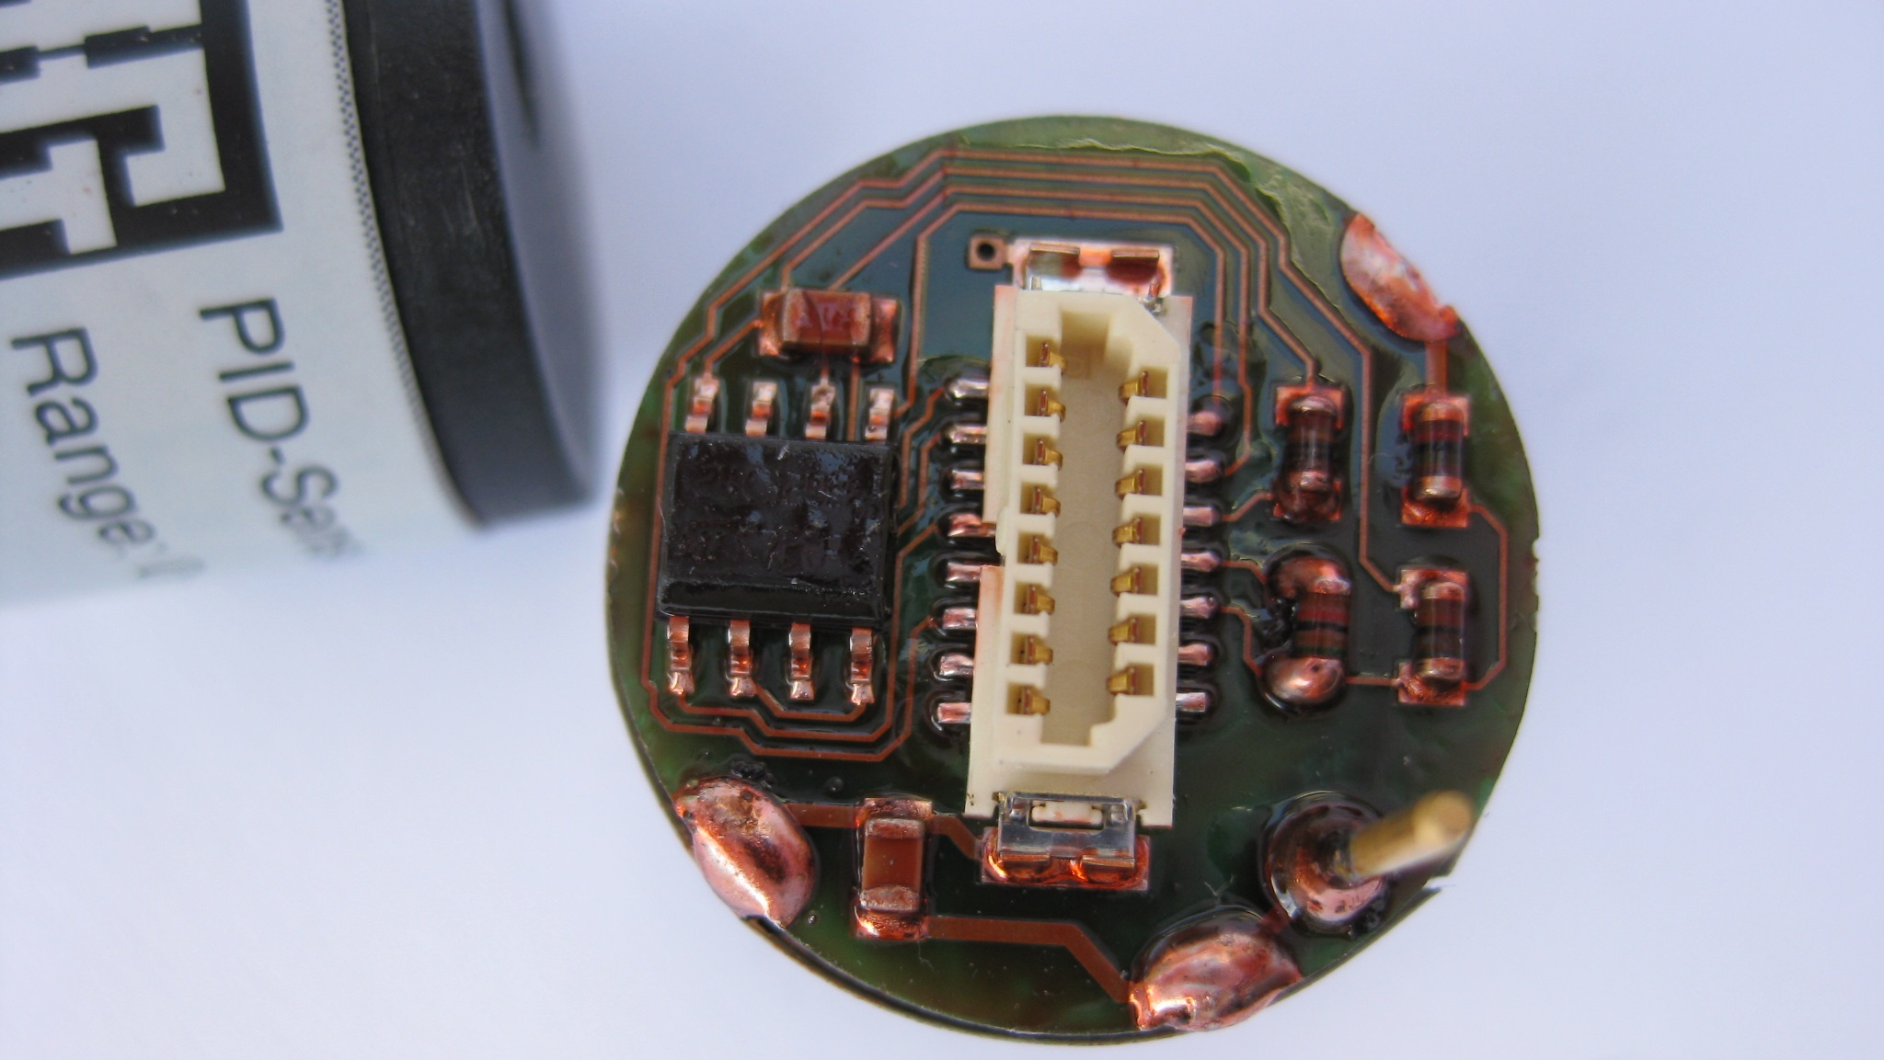
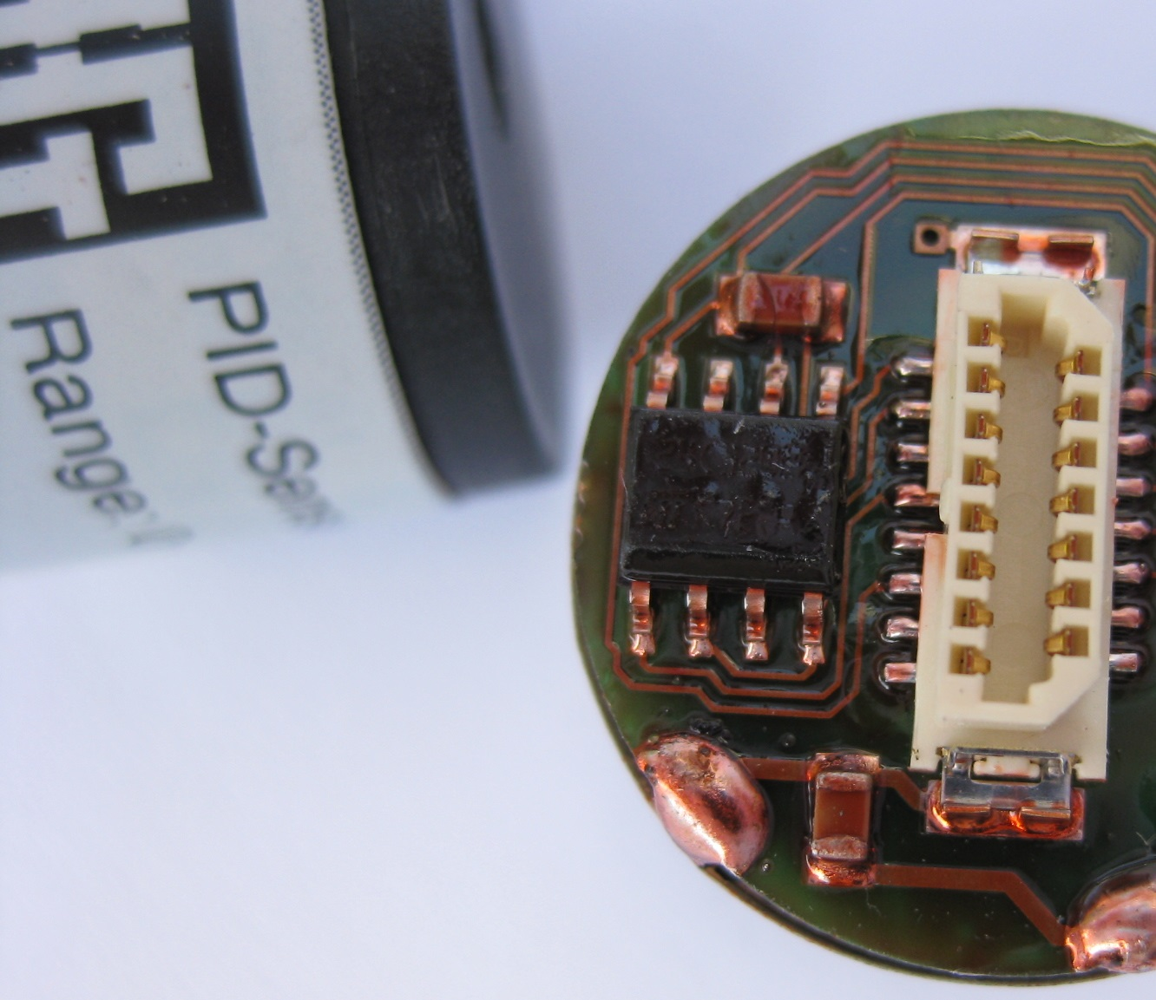
Reliable technology
Portable gas detectors
Fixed gas detection systems
Aqueous measurement systems

Slide 13
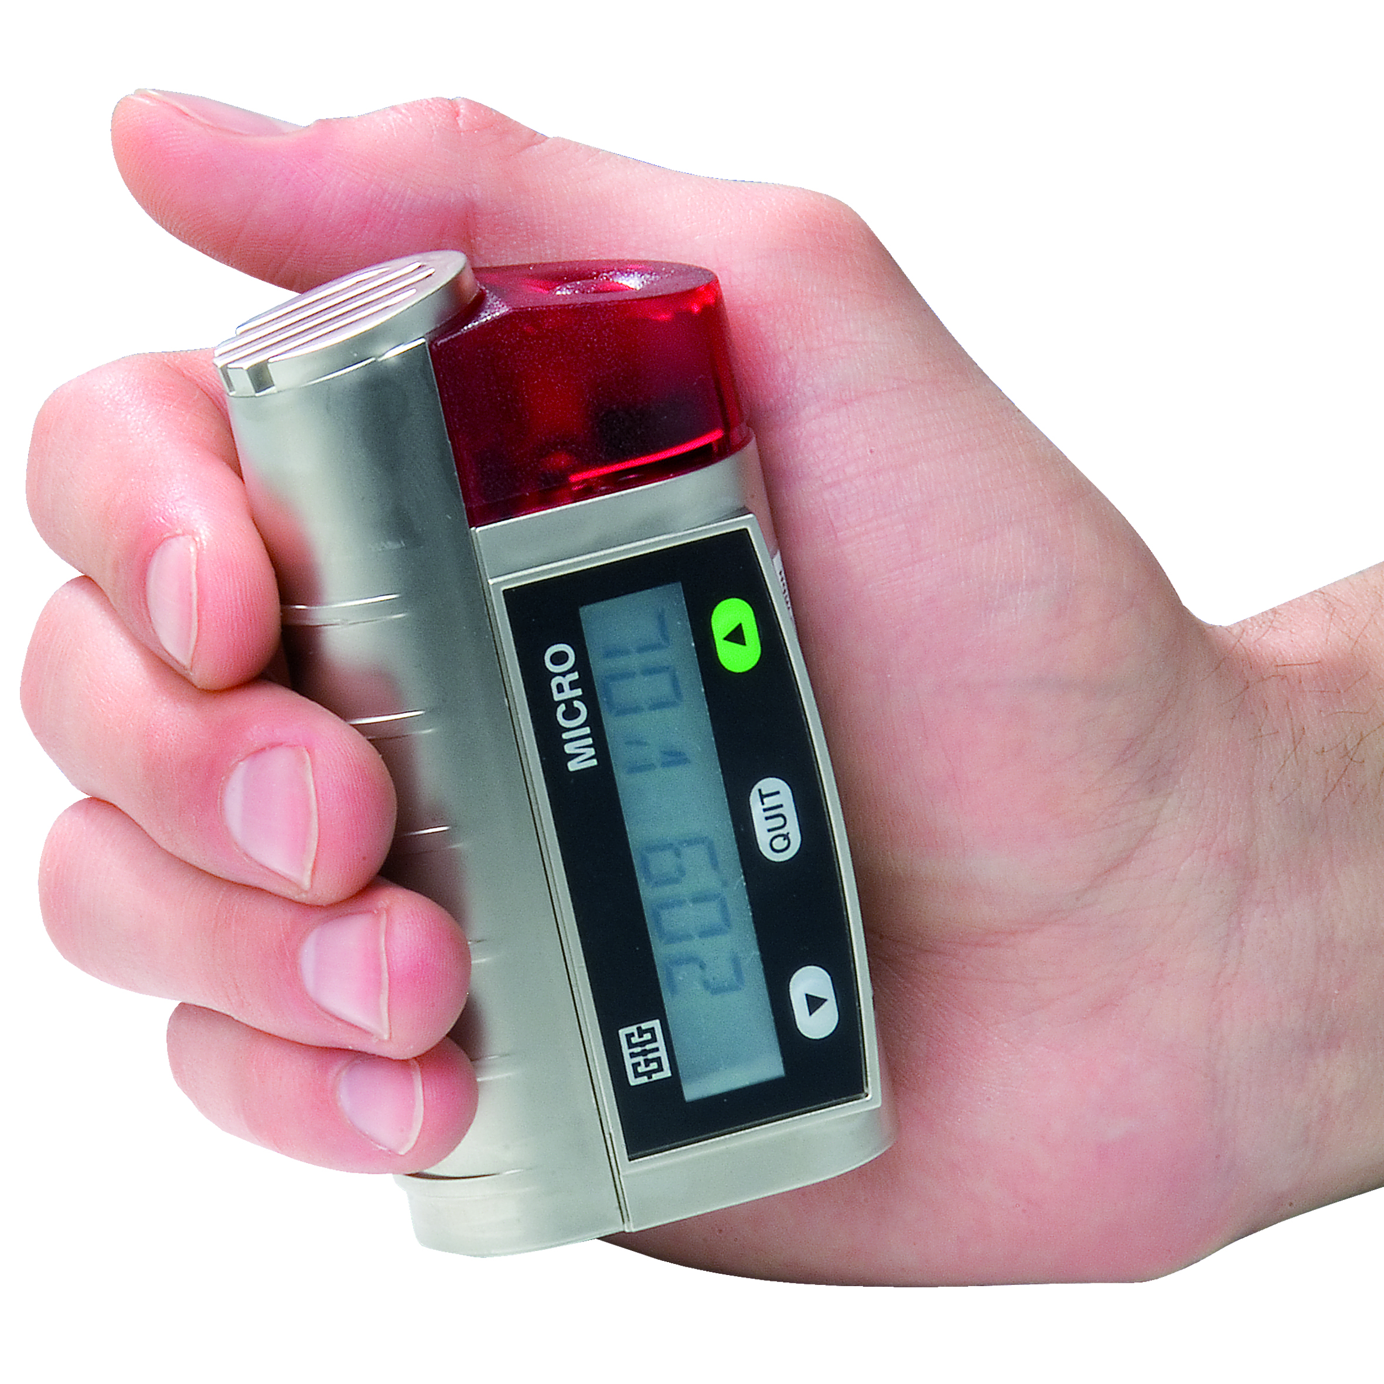
Portable gas detectors
Single-gas detectors

Slide 14
Single-gas detectors
Compact and rugged Micro IV single-gas detectors are the perfect solution for monitoring toxic gases, vapors and oxygen.
Carbon monoxide
Hydrogen sulfide
Sulfur dioxide
Chlorine
Hydrogen cyanide
Nitrogen dioxide
Nitric oxide
Ethylene oxide
Ammonia
Chlorine dioxide
Ozone
Hydrogen
Phosphine
And many more!

Slide 15
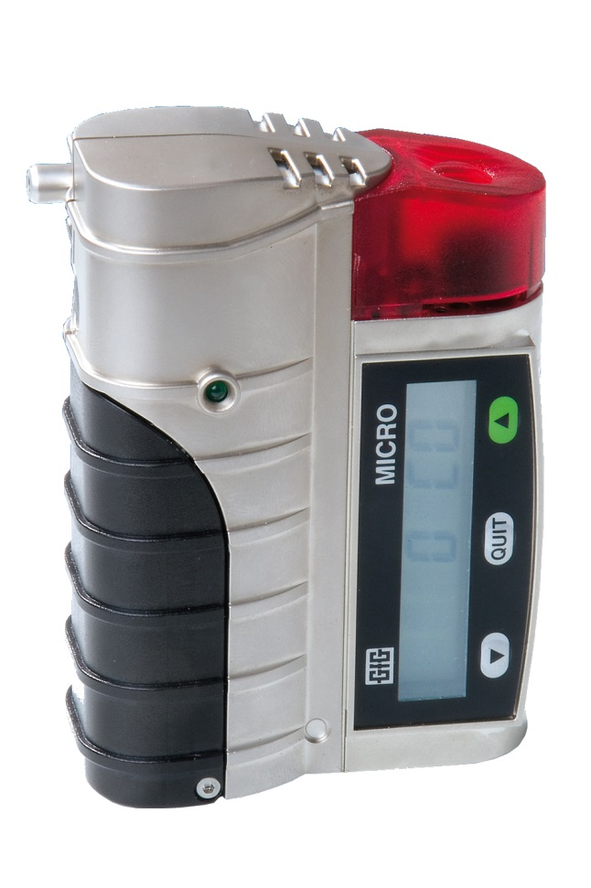
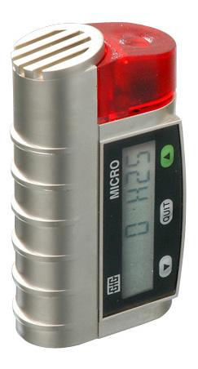
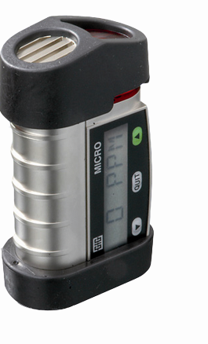
Micro IV
Single-gas detector for toxic gases, hydrogen and oxygen.
With data-logger, memory, infrared interface and Smart sensor technology.

Slide 16
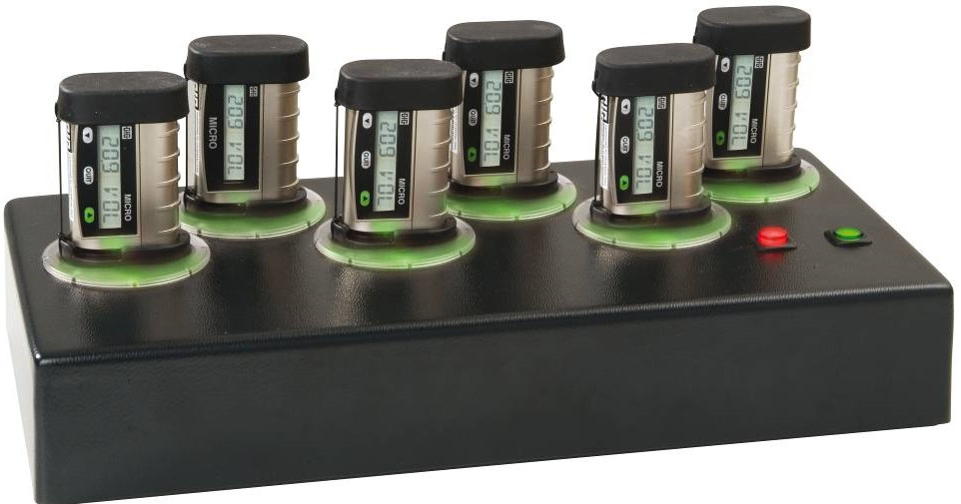
Comprehensive Accessories
Docking and data interface stations, motorized pumps, probes, calibration kits and everything else you need to use and maintain your instruments.

Slide 17
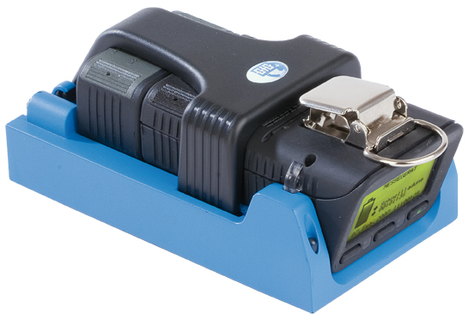
Portable gas detectors
Multi-gas detectors

Slide 18
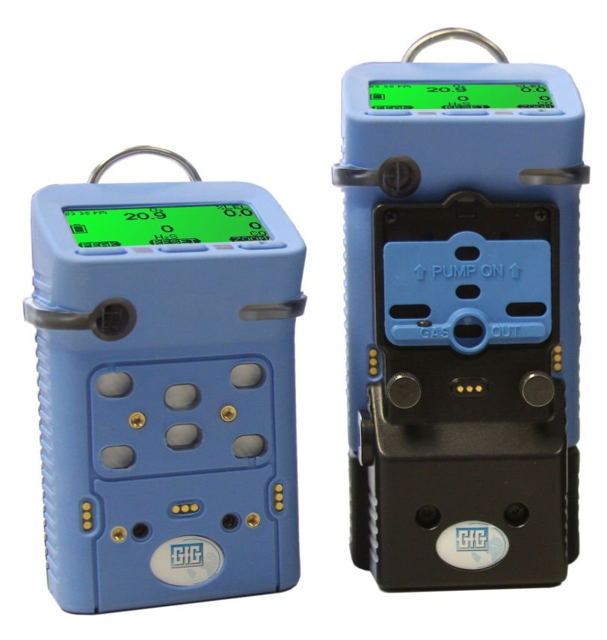
Multigas detectors
GfG multi-gas instruments are compact, reliable and simple to operate.
Loud audible and bright visual alarms give immediate warning of up to 6 gas hazards at the same time.

Slide 19
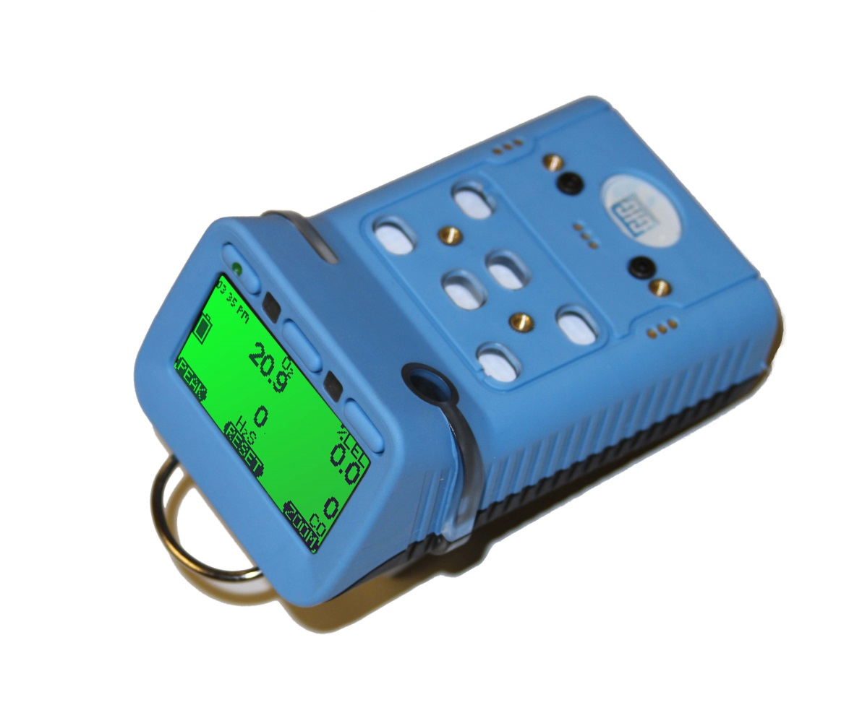
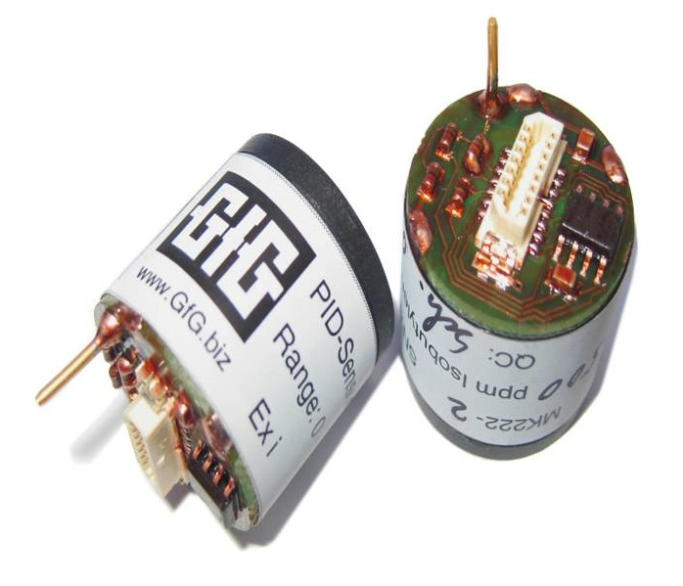
G460
Available with PID Smart-Sensor for broad-range VOC measurement

Slide 20
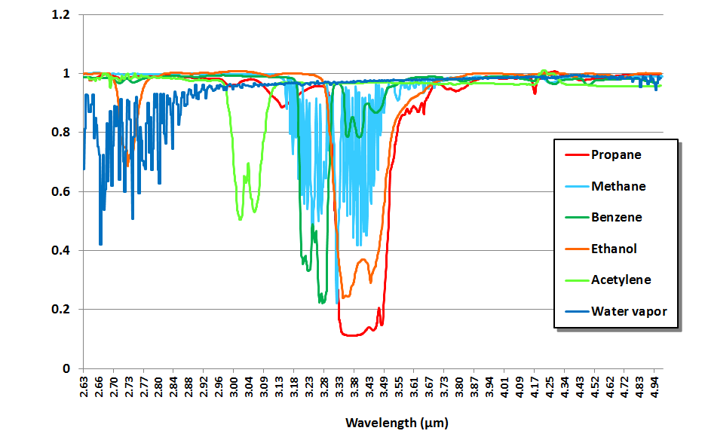
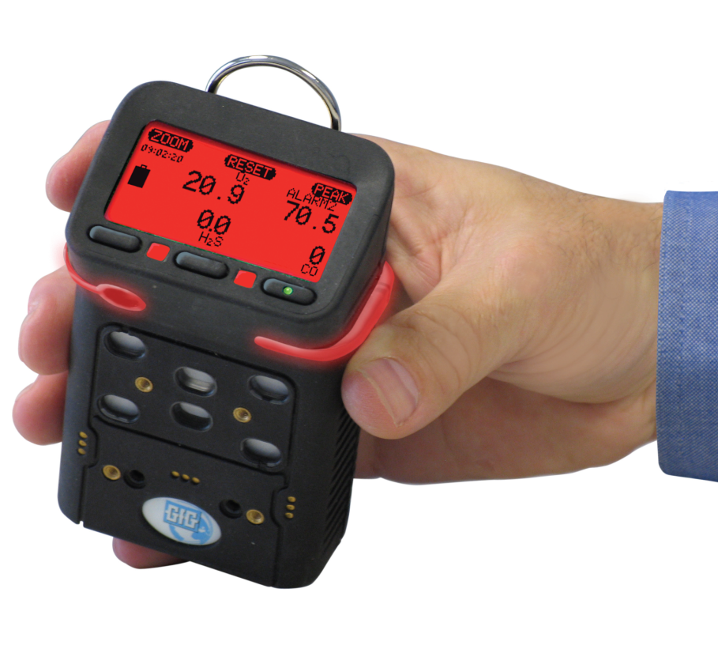
G460
Available with proprietary IR sensor for simultaneous CO₂ and combustible gas measurement

Slide 21
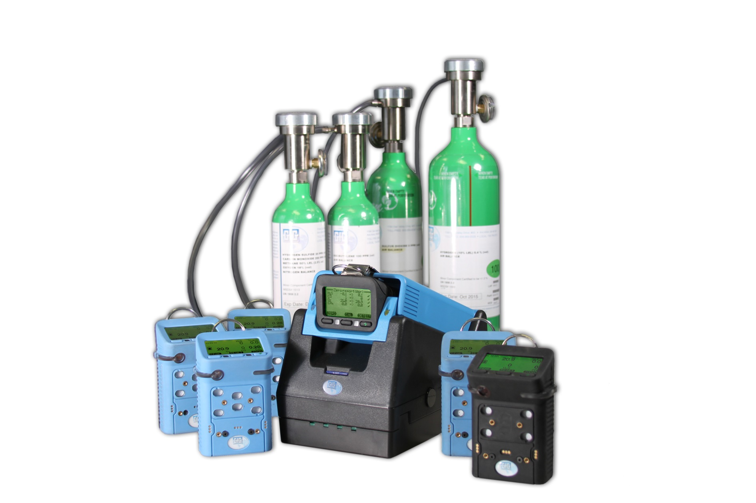
DS 400 Docking Station
The innovative DS 400 provides a completely automatic test, calibration and record keeping system for your GfG instruments.

Slide 22
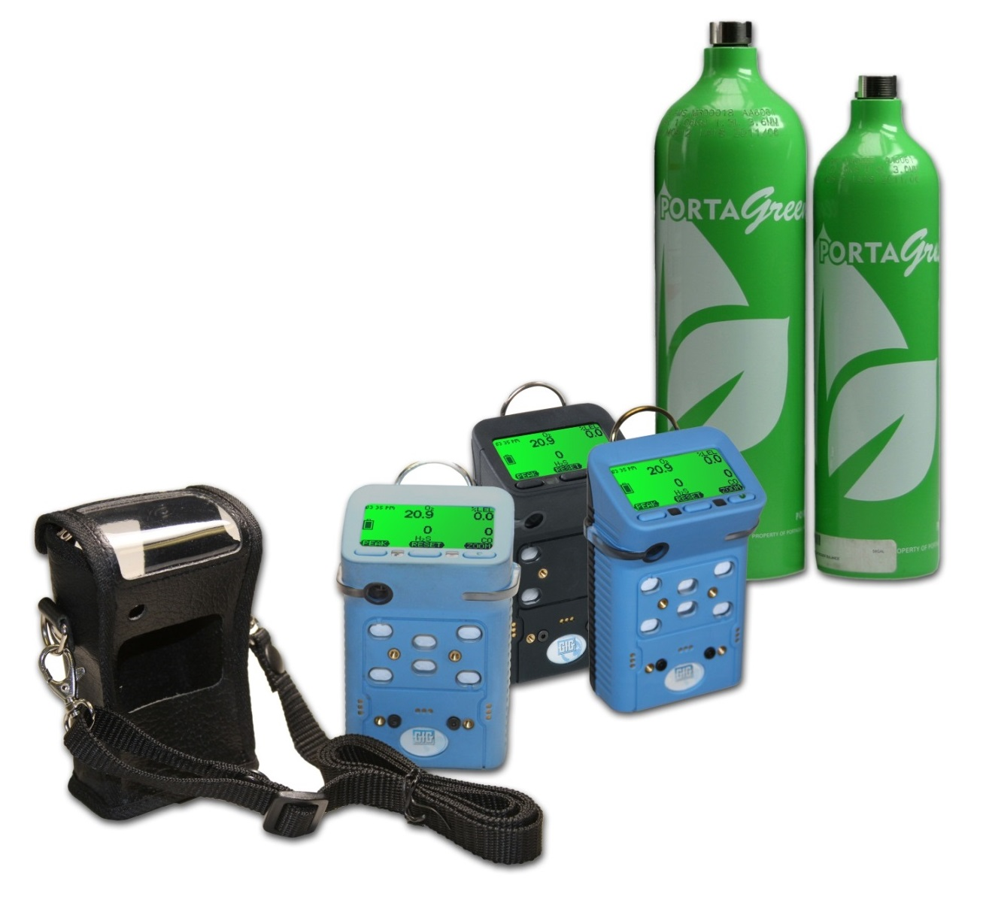
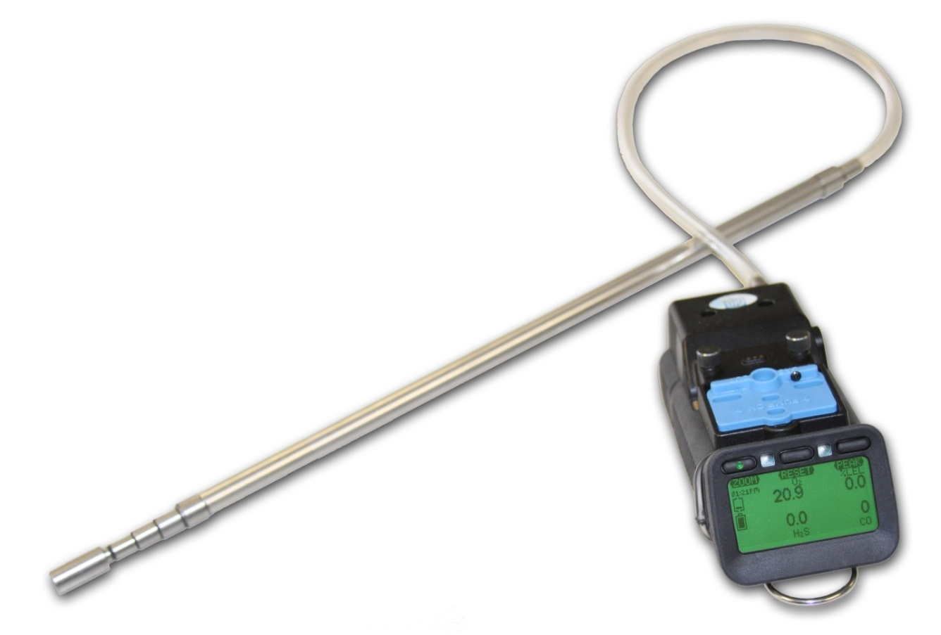
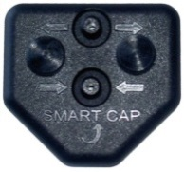
Comprehensive Accessories
Calibration kits, motorized pumps, probes, carrying cases and everything else you need to use and care for your instruments

Slide 23
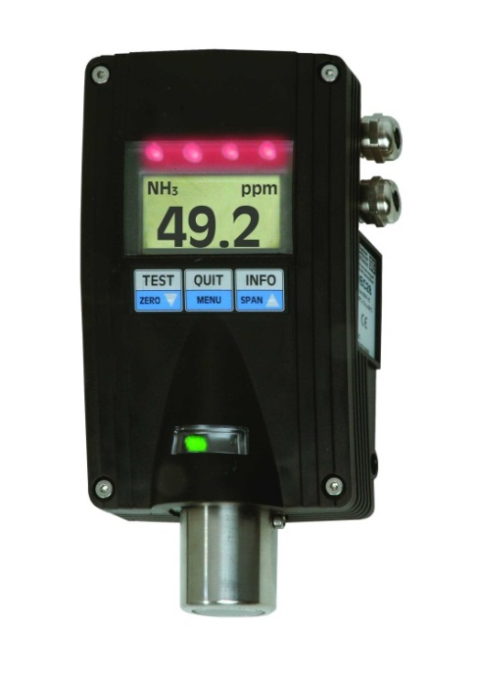
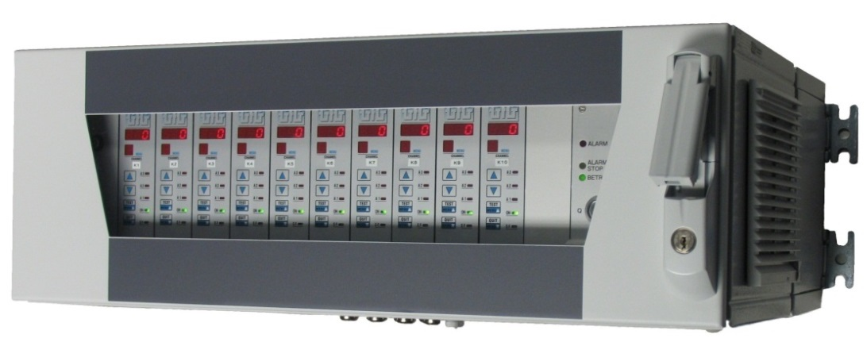
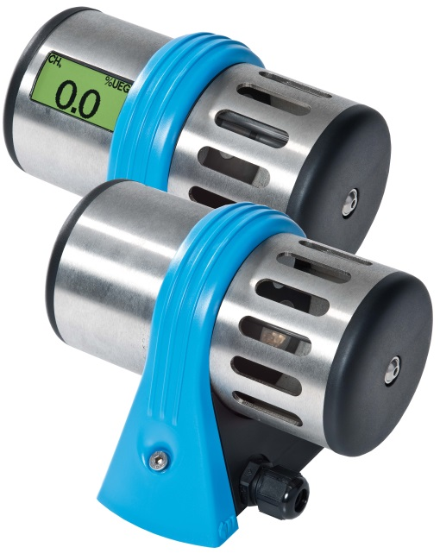
Fixed gas detection systems
Comprehensive line of fixed transmitters and controllers
able to detect over 500 gases

Slide 24
Fixed gas detection systems
Controllers
Transmitters
Stand-alone systems

Slide 25
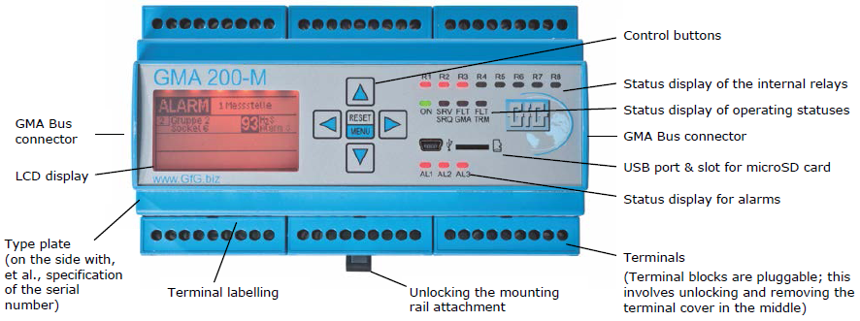
Fixed gas detection systems
GMA 200 Programmable Logic Controller

Slide 26
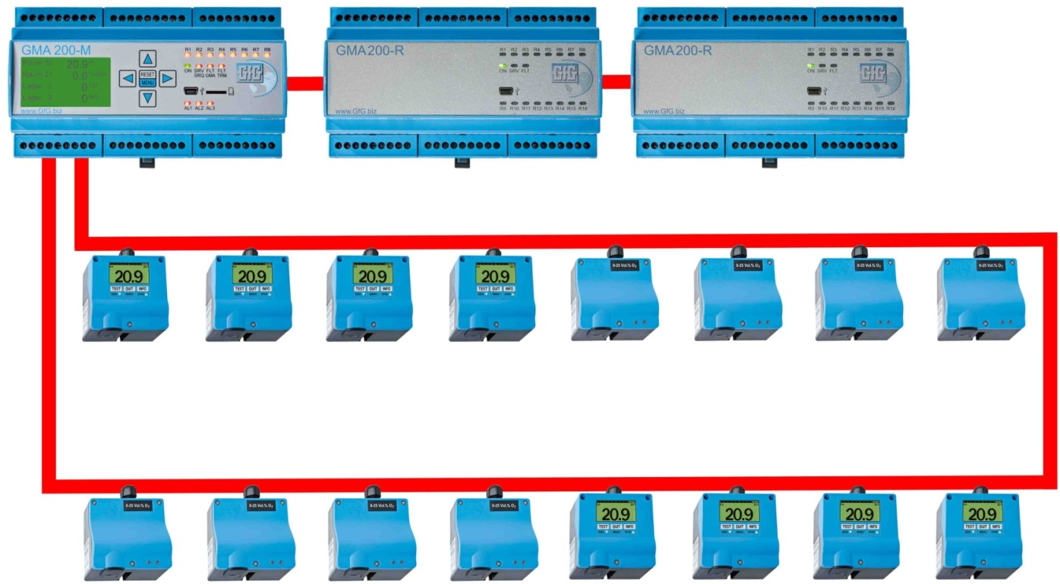
Fixed gas detection systems
GMA 200 Programmable Logic Controller provides complete flexibility for system architecture
GMA-Bus
TRM-Loop-Bus
(Bus1+2)
Loop cabling at digital transmission

Slide 27
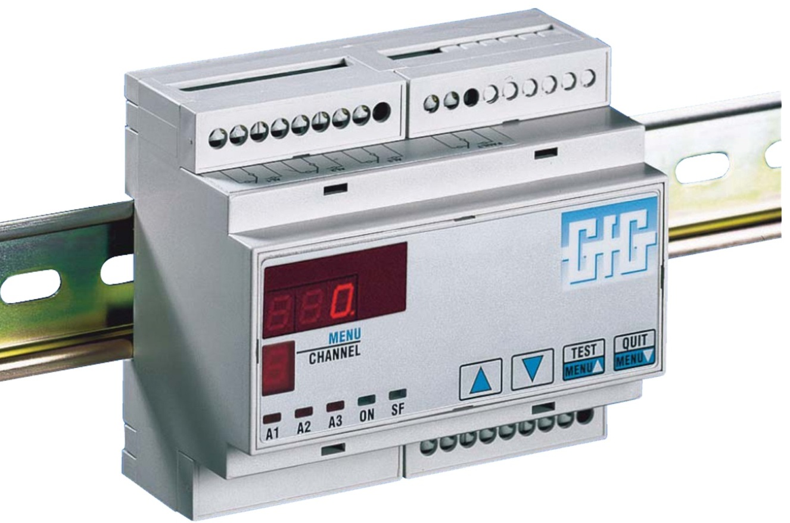
DIN rail mounted controllers
GMA 40 Series controllers are flexible, cost-effective control units for one to four transmitter systems
GMA 40 Series can be clipped directly onto standard DIN rails in switchgear cabinets.
GMA 40

Slide 28
Wall-mount controllers
Complete control systems for wall mounting. Switchgear cabinets or additional housings are not necessary
GMA 200 series controllers provide a complete fixed gas detection system for a wide range of different flammable and toxic gases, and oxygen.
Multiple measuring points can be monitored at the same time.
All transmitter types can be attached.
GMA 200-M

Slide 29
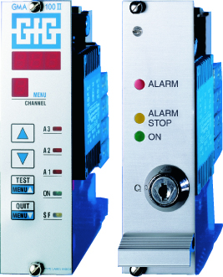
19” Rack mount controller cabinets
GMA100 and GMA300 series are rack-mounted microprocessor-based control and monitoring systems for all measurement tasks.

Slide 30
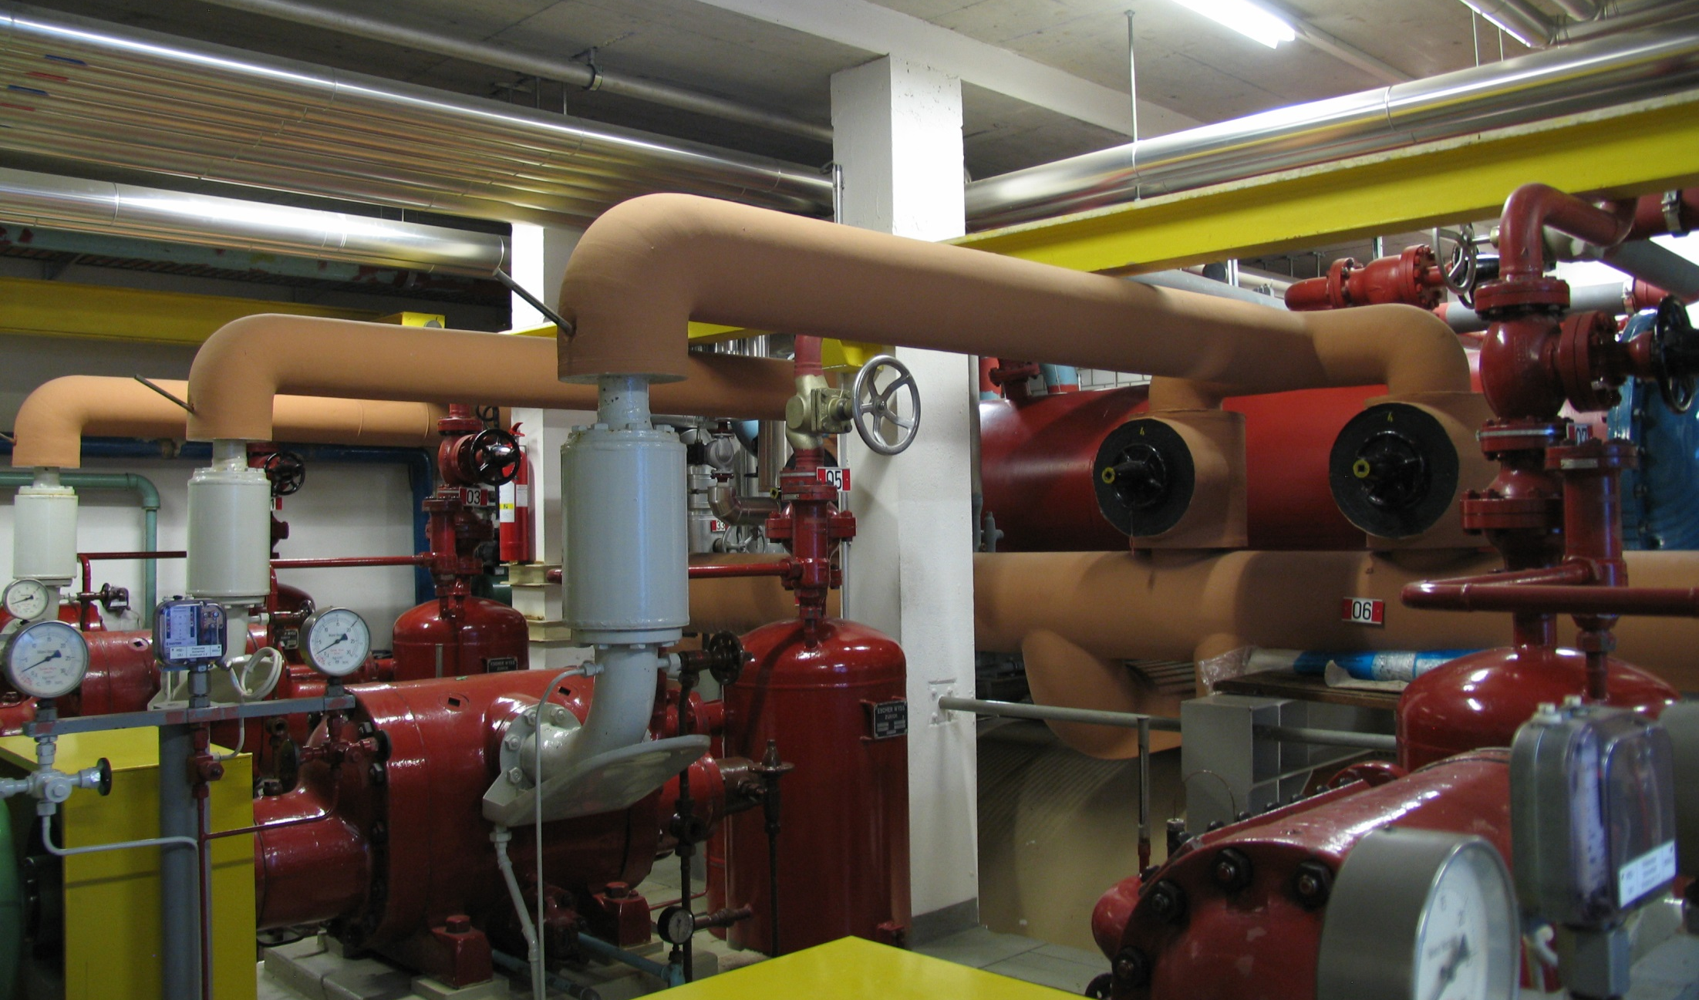
Fixed System
Gas Measurement Transmitters
Combustible gases (EX)
Toxic gases (TOX)
Oxygen (OX)

Slide 31
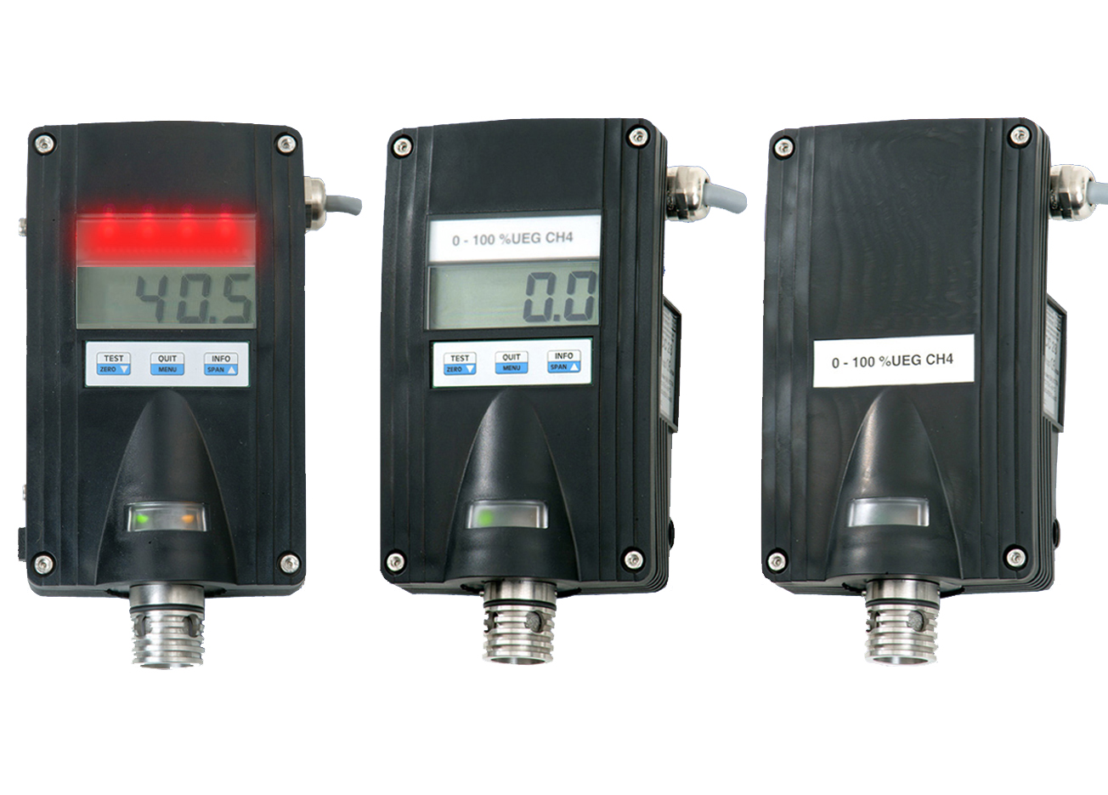
Catalytic LEL Transmitters
Combustible gases (EX)

Slide 32
IR-29 transmitters for LEL gases (EX)
Propriatary infrared technology provides readings based on up to four different wavelengths at the same time
Intrinsically safe IR-29 infrared sensors are extremely sensitive, stable, and cannot be not harmed by sensor poisons
Able to measure wide variety of combustible gases including aromatic VOCs, alcohols and acetylene as well as saturated gases such as methane, butane and hexane
Intrinsically safe IR-29 transmitters can measure heavy LEL range vapors such as diesel and jet fuel that are not measurable by any other technology

Slide 33
Transmitters for toxic gases
Electrochemical (EC)
Charge Carrier Injection (CI)
Chemosorption(CS)
Infrared (IR)

Slide 34
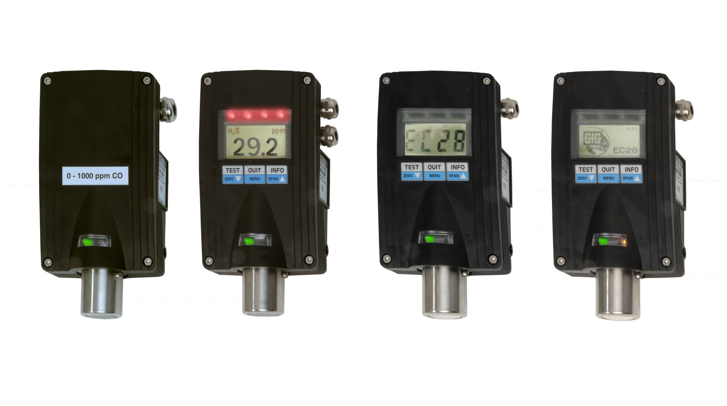
Toxic gas transmitters (TOX)
EC-28 Series of highly configurable toxic gas transmitters can equipped with exactly the right sensors, displays, relays and local alarms needed for the application

Slide 35
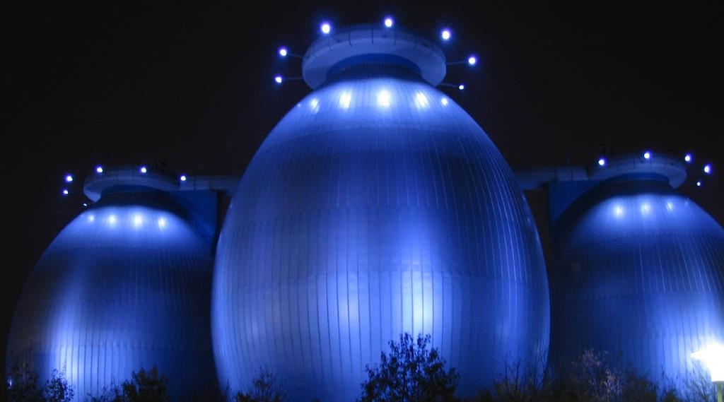
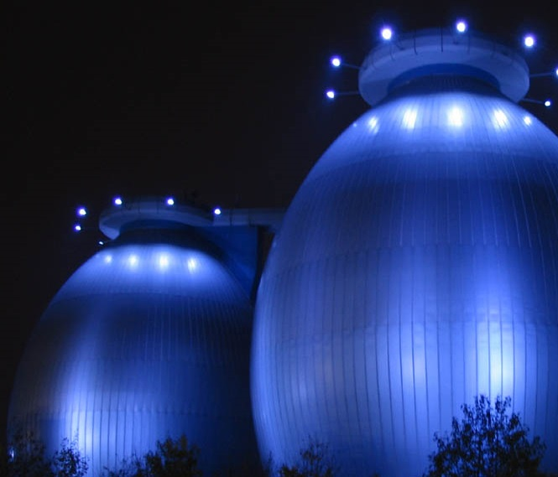
Transmitters for oxygen
Zirconium dioxide (ZD)
Electrochemical (EC)

Slide 36
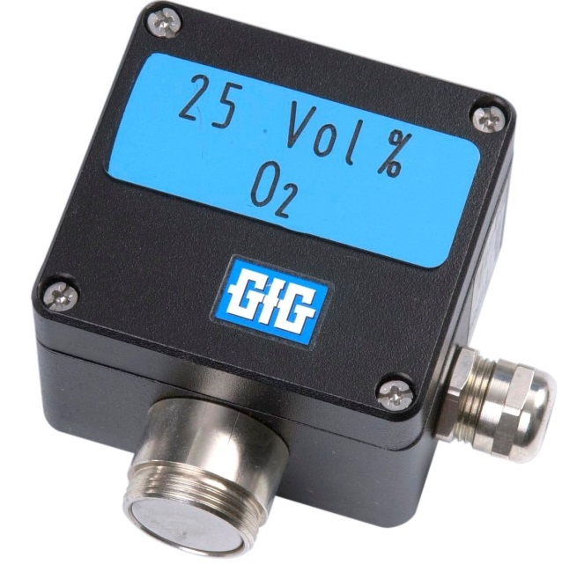
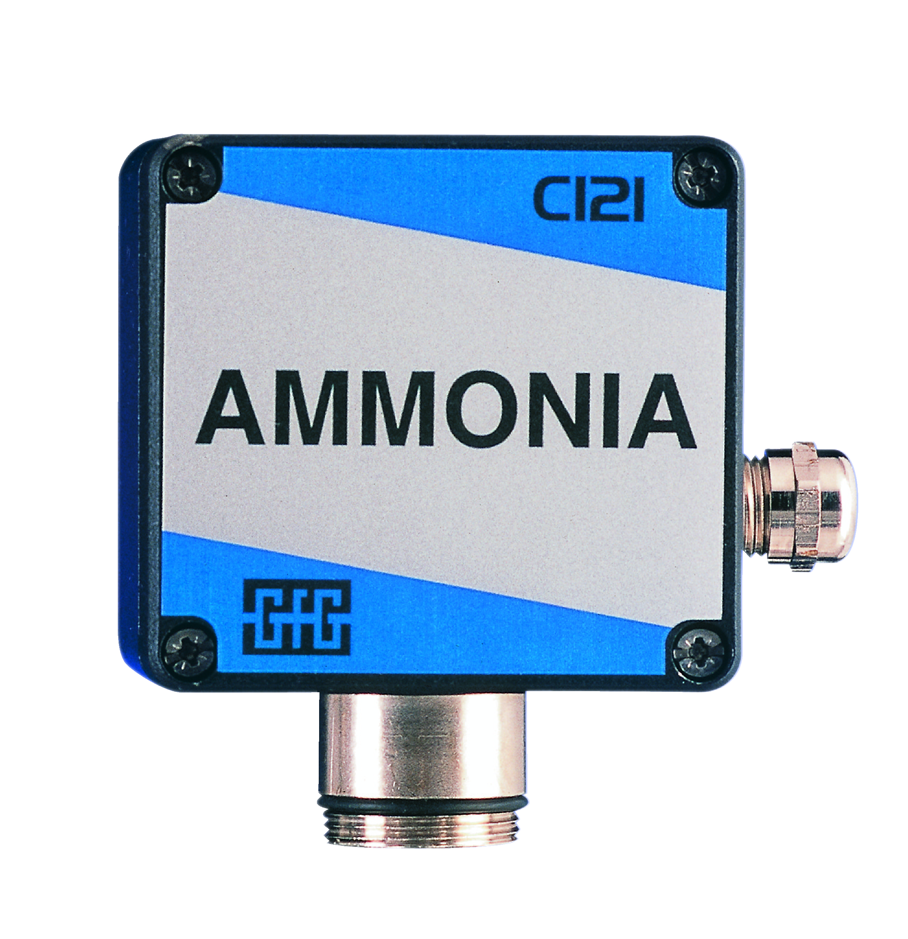
Fixed gas detection systems
GfG CI-21 Ammonia and ZD-21 Oxygen transmitters provide spectacular performance based on unique, proprietary long-lived sensor technology

Slide 37
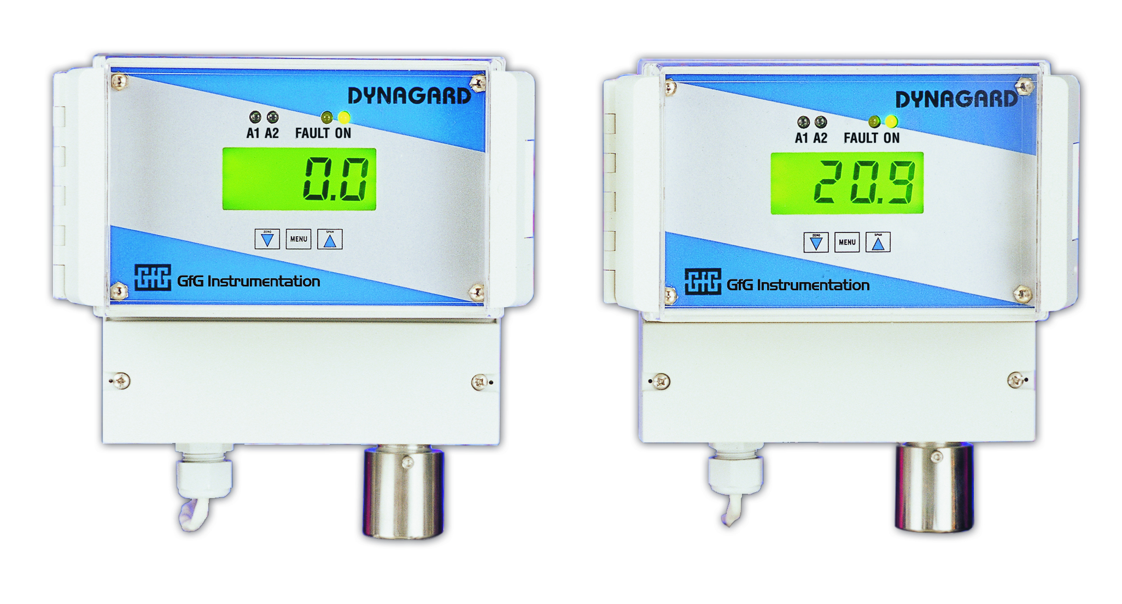
Stand-alone systems
GfG Dynaguard systems include the transmitter and controller in a single integrated easy to install, cost-effective wall-mounted unit

Slide 38
Aqueous measurement systems
GfG MiniCal systems provide real-time measurement of the ammonia concentration in the coolant loops of large refrigeration systems

Slide 39
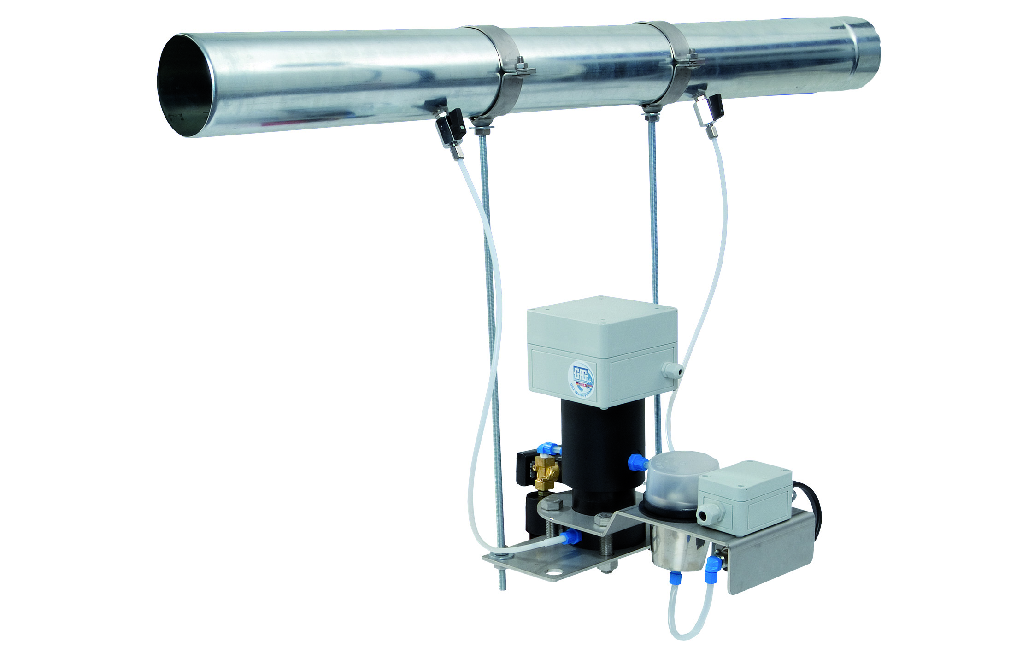
MiniCal III
The MiniCal III system was designed especially for detection of ammonia leakages in cooling circuits. This robust and practical system can be used in water as well as in glycol brine circuits.
The MiniCal III uses ion selective membranes and gas
sensing electrodes for reliable
real-time detection of ammonia leaks.

Slide 40
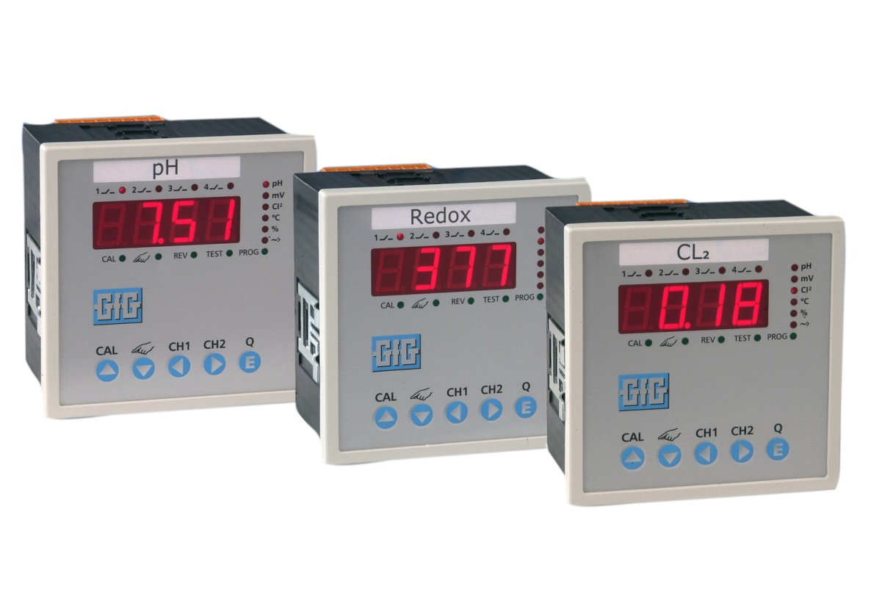
Variocon 2010
GfG Variocon systems provide real-time aqueous pH values, redox readings, and chlorine and ozone measurements

Slide 41
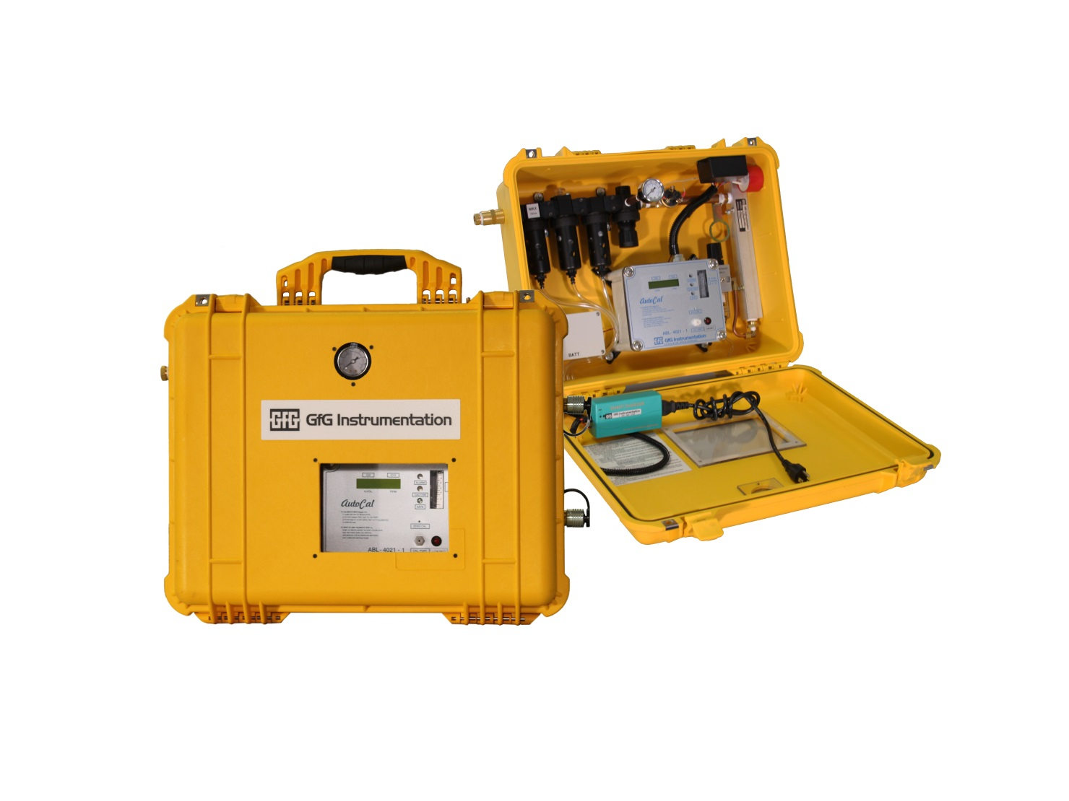
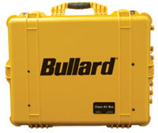
Real-time Air Monitoring (RAM) Fully portable and wall mounted panels for CO monitoring and purification of compressed breathing air

Slide 42
Real-time Air Monitoring (RAM) Stationary compressor and wall mounted panels for CO, oxygen and dew-point measurement

Slide 43
Customer service & Support
The best in the industry!

Slide 44
GfG Instrumentation
The people and the products are what makes the difference!

Slide 45
Thank you for your attention!

