Slide 1
Real time detection of nitrogen dioxide:
Issues, concerns, setting alarms and interpreting data
Bob Henderson

Slide 2
Robert E. Henderson
Speaker Biography
  Bob Henderson is the President of GfG Instrumentation, Inc., a leading supplier of portable and fixed gas detection products. GfG’s instruments are used in atmospheric monitoring applications all over the world.
  Robert has over 38 years of experience in the design, marketing and manufacture of gas detection instruments. Robert is a past Chairman, and in-coming Chair of the AIHA Real Time Detection Systems Technical Committee. He is also a past Chairman and current member of the AIHA Confined Spaces Committee. He is also a past Chair of the Instrument Products Group of the ISEA. Robert has a BS in biological science and an MBA from Rensselaer Polytechnic Institute.

Slide 3
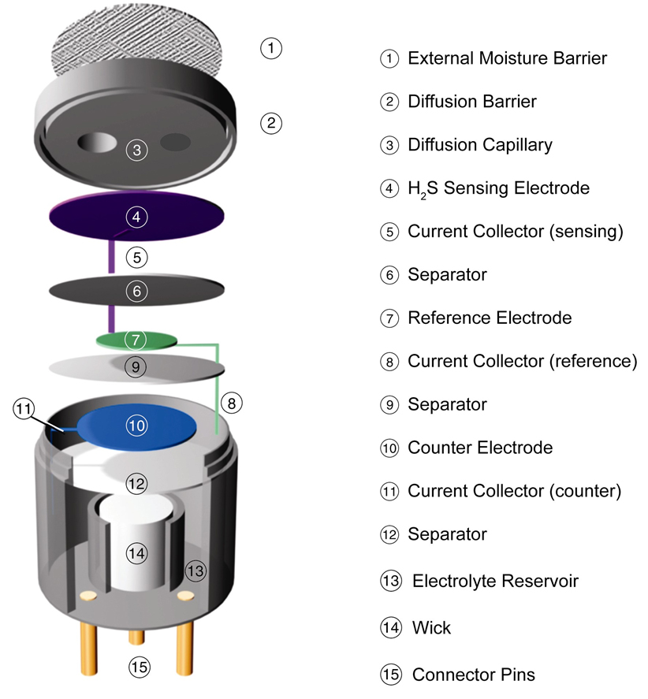
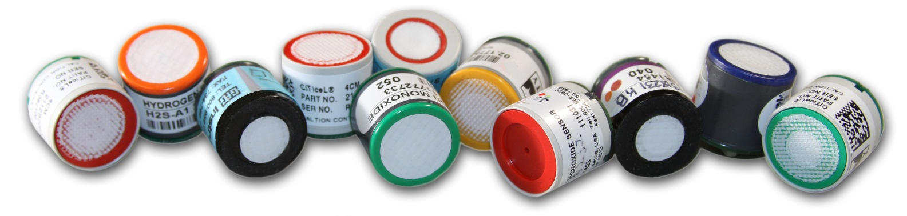
Substance-specific electrochemical sensors
Gas diffusing into sensor reacts at surface of the sensing electrode
Sensing electrode made to catalyze a specific reaction
Use of selective external filters further limits cross sensitivity
MAY 24-26 | DALLAS, TX | 3

Slide 4
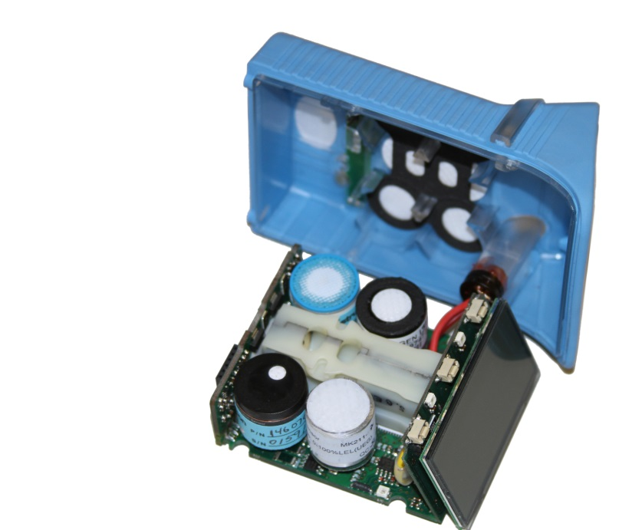
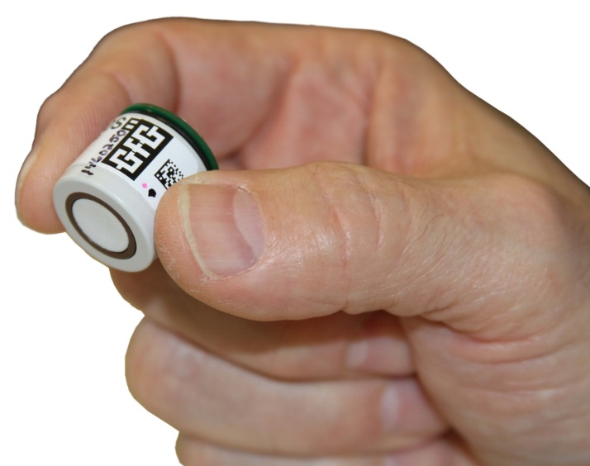
Typical Electrochemical Detection Mechanism
H₂S Sensor:
Hydrogen sulfide is oxidized at the sensing electrode:
H₂S + 4H₂O H₂ SO₄ + 8H⁺ + 8e-
The counter electrode acts to balance out the reaction at the sensing electrode by reducing oxygen present in the air to water:
2O₂ + 8H⁺ + 8e- 4H₂O
And the overall reaction is: H₂S + 2O₂ H₂ SO₄
City Technology 4HS Signal Output: 0.7 μ A / ppm H₂S
MAY 24-26 | DALLAS, TX | 4

Slide 5
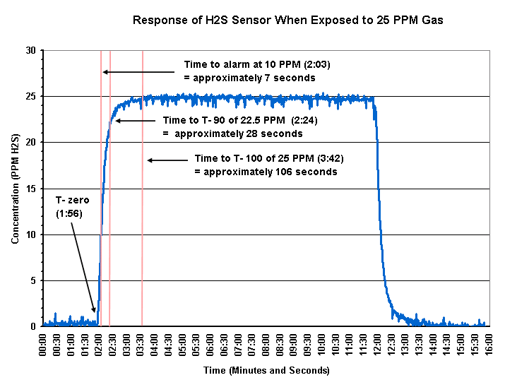

Electrochemical Sensor Performance
MAY 24-26 | DALLAS, TX | 5

Slide 6
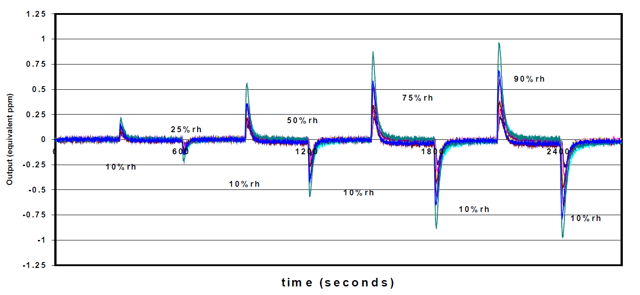
Effects of humidity on EC sensors
Response of NO₂ sensor output as function of humidity
Sudden changes in humidity can cause "transients" in readings
Sensor generally stabilizes rapidly
Avoid breathing into sensor or touching with sweaty hand
MAY 24-26 | DALLAS, TX | 6

Slide 7
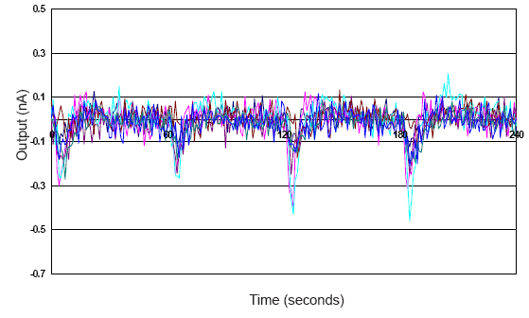
Signal to noise ratio of EC sensors
Electrochemical amperometric gas sensors have a background current in addition to the current from the oxidation or reduction of the gas to be detected
This background current is commonly referred to as zero current or “noise”
Noise is random (stochastic) fluctuation of the electrical signal around a central value
Noise is measured by the Root-Mean-Square (RMS) value of the fluctuations over time.
The SNR is defined as the average over time of the peak signal divided by the RMS noise.
When significant, can interfere with measurements at low gas concentrations.
MAY 24-26 | DALLAS, TX | 7

Slide 8
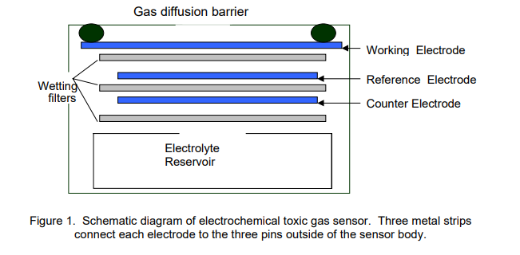
Different sensors can have different performance characteristics
Sources for zero current “noise” include:
  Anodizing or cathodic reduction of the working electrode
  Electrochemical oxidation or reduction of the sensor electrolyte
  Electrolyte contamination by the working electrode
  Reduction of oxygen in the ambient air
Typical amperometric toxic gas sensor is three electrode design
  The auxiliary (reference) electrode has the same catalyst structure as the working electrode but is not in contact with the measuring gas
  By subtracting the current of the auxiliary electrode from the total current of the working electrode, noise is removed from the measurement signal
Usability of sensor at low concentrations defined by RMS noise value
  Some NO₂ sensors limited to 0.1 ppm
  Some NO₂ sensors offer better resolution down to 0.05ppm or 0.02 ppm
  More limited measurement range is often tradeoff for better resolution
Courtesy Alphasense
MAY 24-26 | DALLAS, TX | 8

Slide 9
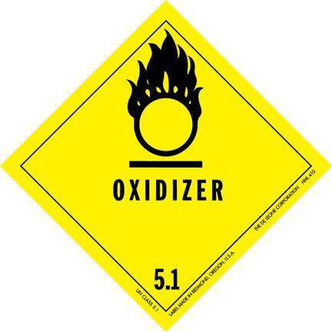
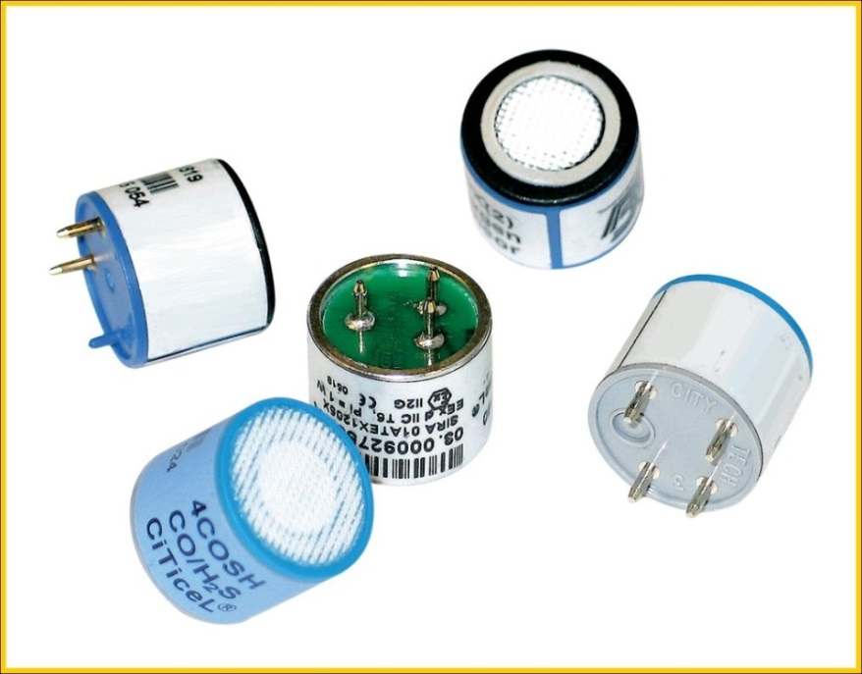
Oxidizing vs. reducing gases
Sensors for reducing gases:
  Detection reaction generates current at working electrode; overall reaction consumes O₂
    H₂S
    CO
    SO₂
    PH₃
Sensors for oxidizing gases:
  Detection reaction consumes power at working electrode; overall reaction generates O₂
    Cl₂
    NO₂
    O₃
    HCl
    HF
    ClO₂
MAY 24-26 | DALLAS, TX | 9

Slide 10
Oxidizing gas sensor detection reaction
MAY 24-26 | DALLAS, TX | 10
Chlorine sensor detection reaction:
  Sensing electrode:
    Cl₂ + 2e⁻ 2Cl ⁻
  Counter electrode:
    ½ O₂ + 2H⁺ + 2e⁻ H₂O
  Overall:
  Cl₂ + H₂O 2Cl ⁻ + ½O₂ +2H⁺
Nitrogen dioxide detection reaction:
  Sensing electrode:
    NO₂ + 2H⁺ + 2e⁻ NO + H₂O
  Counter electrode:
    ½ O₂ + 2H⁺ + 2e⁻ H₂O
  Overall:
  NO₂ NO + ½ O₂

Slide 11
Select performance characteristics typical electrochemical SO₂ sensor at 20°C
Relative responses of City Technology 4S – Rev. 2 sulfur dioxide (SO₂) sensor at 20°C
Gas | Concentration used (ppm) | Reading (ppm SO2)
Carbon monoxide (CO) | 300 | < 1
Nitric oxide (NO) | 50 | 0 to 5.0
Nitrogen dioxide (NO₂) | 6 | < −10
Hydrogen sulfide (H₂S) | 25 | < 0.1
Chlorine (Cl₂) | 5 | < −2
Ammonia (NH₃) | 20 | 0
Hydrogen (H₂) | 400 | < 1
Hydrogen cyanide (HCN) | 10 | < 5
Acetylene (C₂H₂) | 10 | < 30
Ethene (C₂H₄) | 50 | < 45
Signal: 0.5 ± 0.1 µA/ppm
Linear signal over wide range:
  0.1 µA = 0.2 ppm
  1.0 µA = 2.0 ppm
  4.0 µA = 8.0 ppm
Measurement range: 0-20 ppm SO₂
Resolution (electronics dependent): 0.1 ppm
Response Time (T₉₀): < 25 seconds
MAY 24-26 | DALLAS, TX | 11

Slide 12
Select performance characteristics typical electrochemical NO₂ sensor at 20°C
Relative responses of Sensoric 4ND CiTiceL NO2
Gas | Concentration used | Reading (ppm NO₂)
Alcohols | 1000 | 0
Carbon dioxide | 5000 | 0
Chlorine | 1 | 1
Nitric oxide (NO) | 100 | 0.4
Sulfur dioxide (SO₂) | 20 | -5
Hydrogen | 3000 | 0
Sensoric 4ND Citicel is three electrode design
Linear signal: 0.60 ± 0.15 mA/ppm
Measurement range: 0-20 ppm NO₂
Resolution (electronics dependent): 0.1 ppm
  0.012 µA = 0.02 ppm
  0.03 µA = 0.05 ppm
  0.06 µA = 0.1 ppm
Response Time (T₉₀): < 25 seconds
What about ozone?
  Not listed on sensor data sheet
  But interferes strongly (about 1.2)
  Equivalent concentration O₃ produces higher reading than NO₂
MAY 24-26 | DALLAS, TX | 12

Slide 13
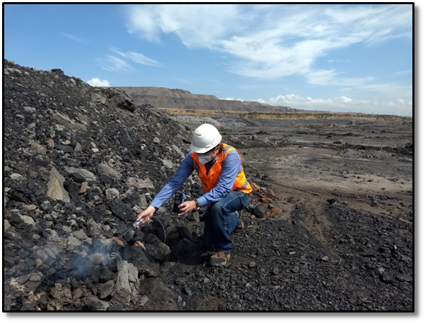
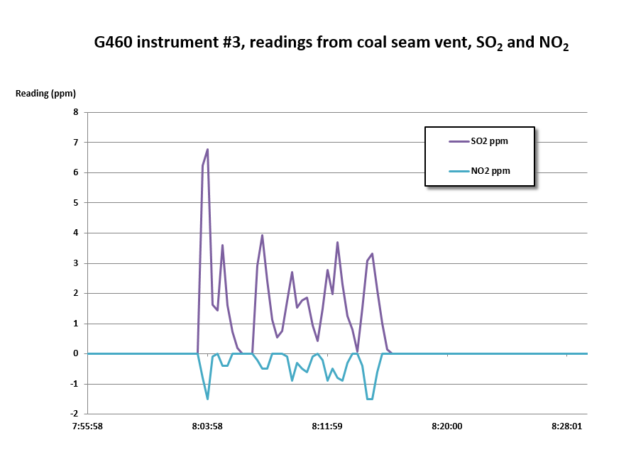
Be aware of potential cross sensitivity issues!
Incompatibility issues may make calibration difficult or impossible
Sometimes better to install incompatible sensors in different instruments

Slide 14
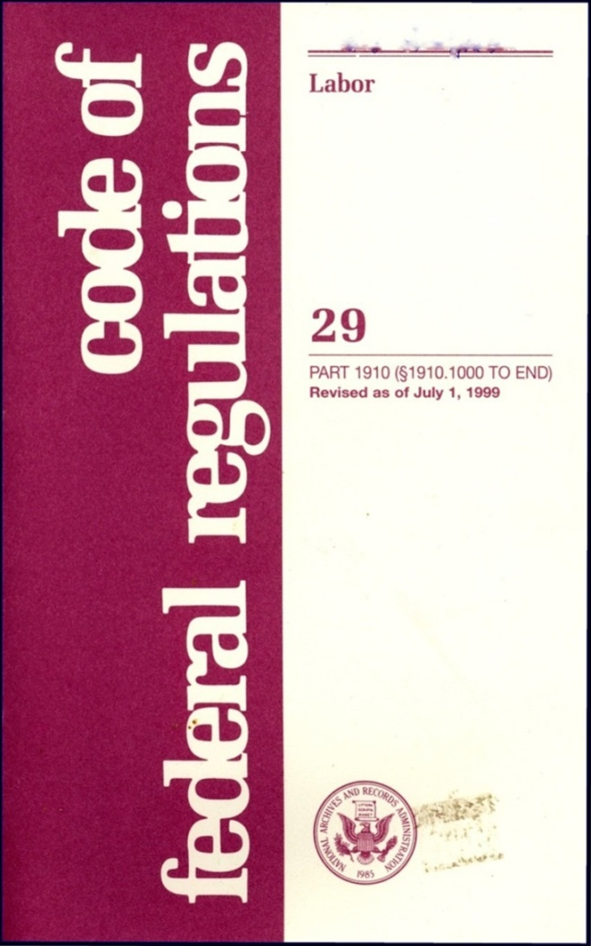


Occupational Exposure Limits (OELs)
Depend on jurisdiction and activity
Sets limits for unprotected worker exposure to a listed toxic substance
Limits for gases and vapors given in “Parts-per-Million” (ppm) concentrations
Do not provide direct guidance for how to set instrument alarms!
MAY 24-26 | DALLAS, TX | 14

Slide 15
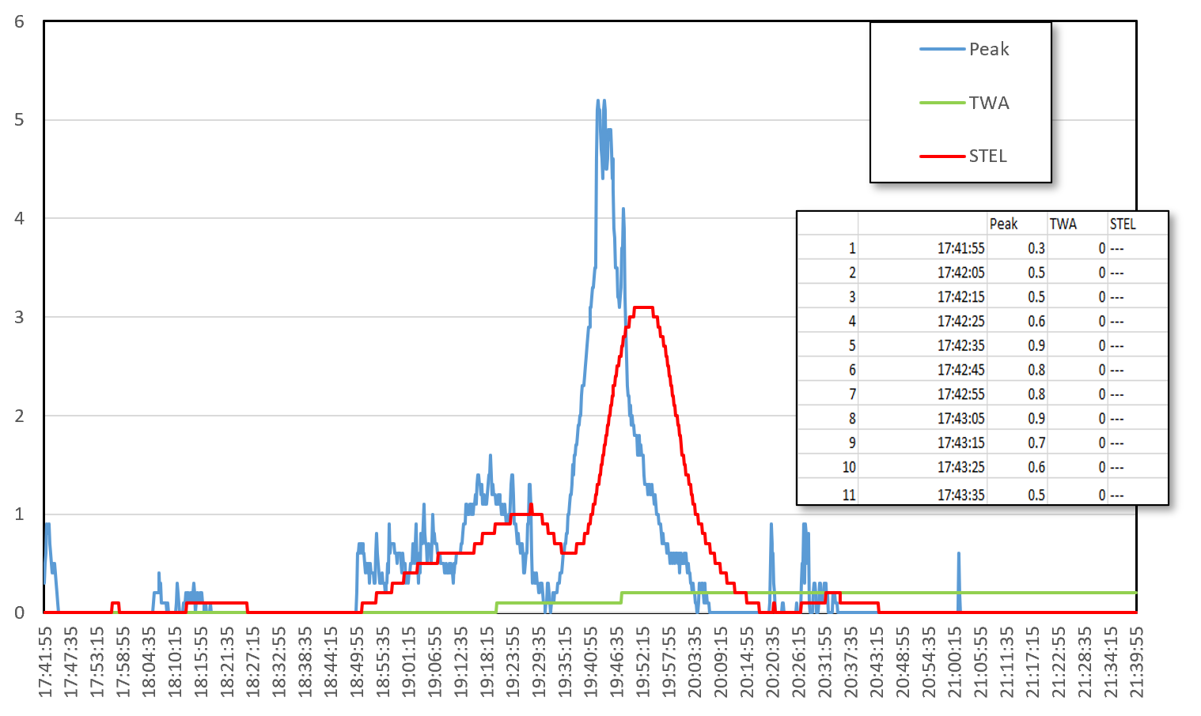
Typical alarms in personal and multi-sensor gas detectors
Gas alarms settable by user:
  Peak (instantaneous) Low
  Peak (instantaneous) High
  STEL (15 minute)
  TWA (8 hour)
Non-user settable alarms:
  Over limit concentration
  Negative alarm
Sometimes settable by user:
  Measuring range
  Resolution
MAY 24-26 | DALLAS, TX | 15

Slide 16
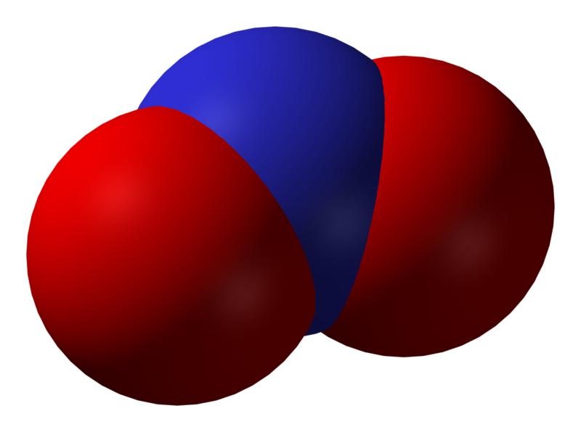



Exposure limits for NO₂
US OSHA PEL:
  Ceiling = 5 ppm
US NIOSH REL:
  15 min. STEL = 1.0 ppm
Old TLV:
  8 hr. TWA = 3.0 ppm
  5 min. STEL = 5.0 ppm
New 2012 TLV
  8 hr. TWA = 0.2 ppm

Slide 17

ACGIH Guidance
For many substances with a TLV–TWA, there is no TLV–STEL.
Never-the-less, short-term peak exposures above the TLV–TWA should be controlled, even where the 8-hour TLV–TWA is within recommended limits.
The following default short-term exposure limits apply to
those TLV–TWAs that do not have a TLV–STEL:
  Transient increases in workers’ exposure levels may exceed
  3 times the value of the TLV–TWA level for no more than 15
  minutes at a time, on no more than 4 occasions spaced 1
  Hour apart during a workday, and under no circumstances should they exceed 5 times the value of the TLV–TWA level when measured as a 15-min TWA.
  In addition, the 8-hour TWA is not to be exceeded for an 8-hour work period.
This guidance on limiting peak exposures above the value of the TLV–TWA is analogous to that for the TLV–STEL, and both represent 15-minute exposure limits.

Slide 18

Suggested alarm settings for NO₂
Suggested alarms:
  OSHA PEL or NIOSH REL:
    Low: 3.0 ppm
    High: 5.0 ppm
    STEL: 1.0 ppm
    TWA: 1.0 ppm
  TLV®:
    Low: 0.6 ppm
    High: 1.0 ppm
    STEL: 0.6 ppm
    TWA: 0.2 ppm

Slide 19

What should you do for extended work shifts?
Most industrial hygienists use Brief and Scala model
  Corrects for increased exposure time and decreased recovery time
  Simple to use
  Very conservative
Adjusted TLV =
Where h = # of hours worked per day
Model used for chemicals where the TLV® is based on acute or chronic toxicity and not for chemicals that have a TLV ® based on irritation (i.e. Ammonia)
For 12 hour shift according to this model the TWA TLV ® limit should be reduced to one-half the 8-hour value
MAY 24-26 | DALLAS, TX | 19

Slide 20
Datalogging parameters
 |  | Peak | TWA | STEL
1 | 17:41:55 | 0.3 | 0 | ---
2 | 17:42:05 | 0.5 | 0 | ---
3 | 17:42:15 | 0.5 | 0 | ---
4 | 17:42:25 | 0.6 | 0 | ---
5 | 17:42:35 | 0.9 | 0 | ---
6 | 17:42:45 | 0.8 | 0 | ---
7 | 17:42:55 | 0.8 | 0 | ---
8 | 17:43:05 | 0.9 | 0 | ---
9 | 17:43:15 | 0.7 | 0 | ---
10 | 17:43:25 | 0.6 | 0 | ---
11 | 17:43:35 | 0.5 | 0 | ---
12 | 17:43:45 | 0.4 | 0 | ---
13 | 17:43:55 | 0.5 | 0 | ---
14 | 17:44:05 | 0.4 | 0 | ---
15 | 17:44:15 | 0.5 | 0 | ---
16 | 17:44:25 | 0.4 | 0 | ---
17 | 17:44:35 | 0.3 | 0 | ---
18 | 17:44:45 | 0.2 | 0 | ---
19 | 17:44:55 | 0.1 | 0 | ---
20 | 17:45:05 | 0 | 0 | ---
21 | 17:45:15 | 0 | 0 | ---
22 | 17:45:25 | 0 | 0 | ---
23 | 17:45:35 | 0 | 0 | ---
24 | 17:45:45 | 0 | 0 | ---
25 | 17:45:55 | 0 | 0 | ---
26 | 17:46:05 | 0 | 0 | ---
27 | 17:46:15 | 0 | 0 | ---
28 | 17:46:25 | 0 | 0 | ---
29 | 17:46:35 | 0 | 0 | ---
30 | 17:46:45 | 0 | 0 | ---
31 | 17:46:55 | 0 | 0 | ---
32 | 17:47:05 | 0 | 0 | ---
33 | 17:47:15 | 0 | 0 | ---
34 | 17:47:25 | 0 | 0 | ---
35 | 17:47:35 | 0 | 0 | ---
36 | 17:47:45 | 0 | 0 | ---
37 | 17:47:55 | 0 | 0 | ---
38 | 17:48:05 | 0 | 0 | ---
39 | 17:48:15 | 0 | 0 | ---
40 | 17:48:25 | 0 | 0 | ---
60 | 17:51:45 | 0 | 0 | ---
61 | 17:51:55 | 0 | 0 | ---
62 | 17:52:05 | 0 | 0 | ---
63 | 17:52:15 | 0 | 0 | ---
64 | 17:52:25 | 0 | 0 | ---
65 | 17:52:35 | 0 | 0 | ---
66 | 17:52:45 | 0 | 0 | ---
67 | 17:52:55 | 0 | 0 | ---
68 | 17:53:05 | 0 | 0 | ---
69 | 17:53:15 | 0 | 0 | ---
70 | 17:53:25 | 0 | 0 | ---
71 | 17:53:35 | 0 | 0 | ---
72 | 17:53:45 | 0 | 0 | ---
73 | 17:53:55 | 0 | 0 | ---
74 | 17:54:05 | 0 | 0 | ---
75 | 17:54:15 | 0 | 0 | ---
76 | 17:54:25 | 0 | 0 | ---
77 | 17:54:35 | 0 | 0 | ---
78 | 17:54:45 | 0 | 0 | ---
79 | 17:54:55 | 0 | 0 | ---
80 | 17:55:05 | 0 | 0 | ---
81 | 17:55:15 | 0 | 0 | ---
82 | 17:55:25 | 0 | 0 | ---
83 | 17:55:35 | 0 | 0 | ---
84 | 17:55:45 | 0 | 0 | ---
85 | 17:55:55 | 0 | 0 | ---
86 | 17:56:05 | 0 | 0 | ---
87 | 17:56:15 | 0 | 0 | ---
88 | 17:56:25 | 0 | 0 | ---
89 | 17:56:35 | 0 | 0 | ---
90 | 17:56:45 | 0 | 0 | 0.1
91 | 17:56:55 | 0 | 0 | 0.1
92 | 17:57:05 | 0 | 0 | 0.1
93 | 17:57:15 | 0 | 0 | 0.1
94 | 17:57:25 | 0 | 0 | 0.1
95 | 17:57:35 | 0 | 0 | 0.1
Number of stored intervals in internal memory – set by manufacturer
Datalogging interval (generally 1 sec. to 1 hr.)
Logged values per interval (typically):
  User choice:
    Peak
    Average
    Representative
  STEL
  TWA
How are the time history alarm calculations affected by the choice of data-logging interval?
  They’re not!
  PEL calculations are continuously updated by the instrument
  The datalogging interval simply specifies how often the instrument stores a “snap-shot” of the current readings for the purposes of generating a printed report or database file of test results

Slide 21
So how accurate are the readings?
Instrument manufacturers frequently state accuracy of +/- 5% of readings
NO₂ sensor measurement range is typically 0 – 20 ppm
If the instrument is set to display readings in ± 0.1 ppm increments:
  From 0 – 2.0 ppm the accuracy is +/- 0.1 ppm, from 2.0 to 20 ppm the accuracy is +/- 5% of reading
If the instrument is set to display readings in ± 0.02 ppm increments:
  From 0 – 0.4 ppm the accuracy is +/- 0.02 ppm, from 0.4 to 20 ppm the accuracy is +/- 5% of reading
What about designs that digitally filter readings near zero?
  Some instruments have a “dead band” or digital filtering to reduce fluctuation in readings near zero
  Affects visible readings but not the time history calculations or logged Peak values
  Some designs introduce digital stickiness near zero, which decreases as measurement values rise, other designs use a dead-band that shows a reading of zero throughout the band
    For instance, if the instrument resolution is 0.1 ppm and has a dead-band of +/-0.2 ppm, (two steps away from zero) visible readings will show 0 ppm whenever the signal is within this band, and the first visible reading above zero would be 0.3 ppm
MAY 24-26 | DALLAS, TX | 21

Slide 22
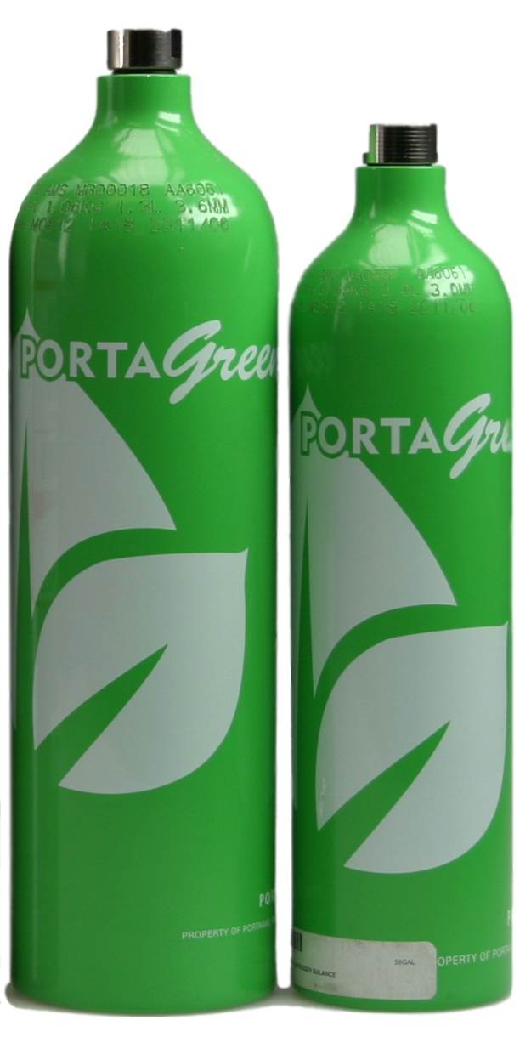
How does the accuracy of the cal gas affect the accuracy of the readings?
Standard NO₂ cal gas with 10 ppm NO₂ is available with ± 3% accuracy, 12-months shelf-life dating
Using ± 3% accuracy gas, when the resolution of the NO₂ sensor is 0.1 ppm, the new accuracy statement for the combined instrument and cal gas system becomes 0.1 ppm or ± 8% of reading, whichever is greater
  So from 0 – 1.25 ppm the accuracy is ± 0.1 ppm
  From 1.25 – 20.0 ppm the accuracy is ± 8% of reading
When the resolution of the NO₂ sensor is 0.02 ppm
  From 0 – 0.25 ppm the accuracy is ± 0.02 ppm
  From 0.25 – 20.0 ppm the accuracy is ± 8% of reading
MAY 24-26 | DALLAS, TX | 22

Slide 23
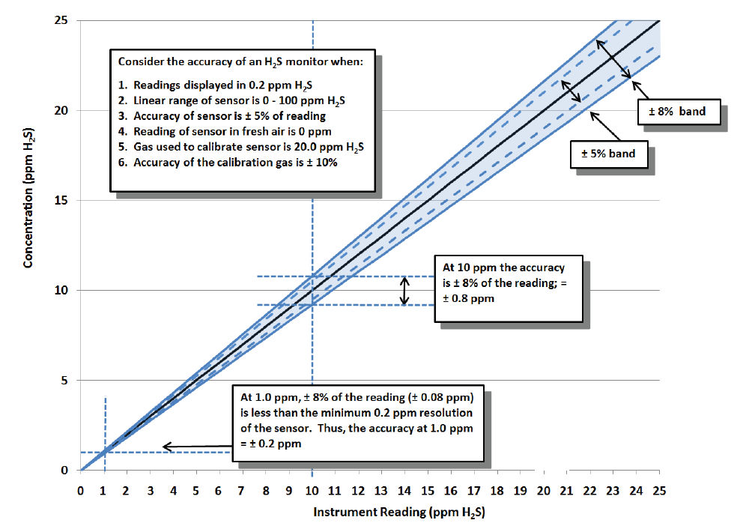
Combined effects of sensor and calibration gas accuracy
3
MAY 24-26 | DALLAS, TX | 23

Slide 24
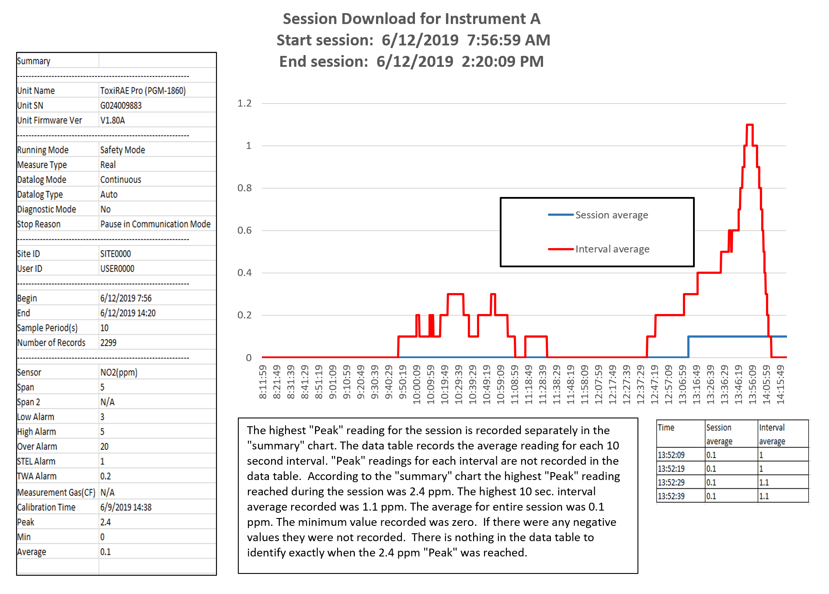
Instrument A:
Single-sensor personal NO₂ datalogger
Session duration: ~ 6.4 hr.
Low alarm: 3.0 ppm
High alarm: 5.0 ppm
STEL: 1.0 ppm
TWA: 0.2 ppm
Peak reading during session: 2.4 ppm
Session duration: 6.39 hrs.
Datalogging interval: 10 sec.
Session average (TWA): 0.1 ppm

Slide 25
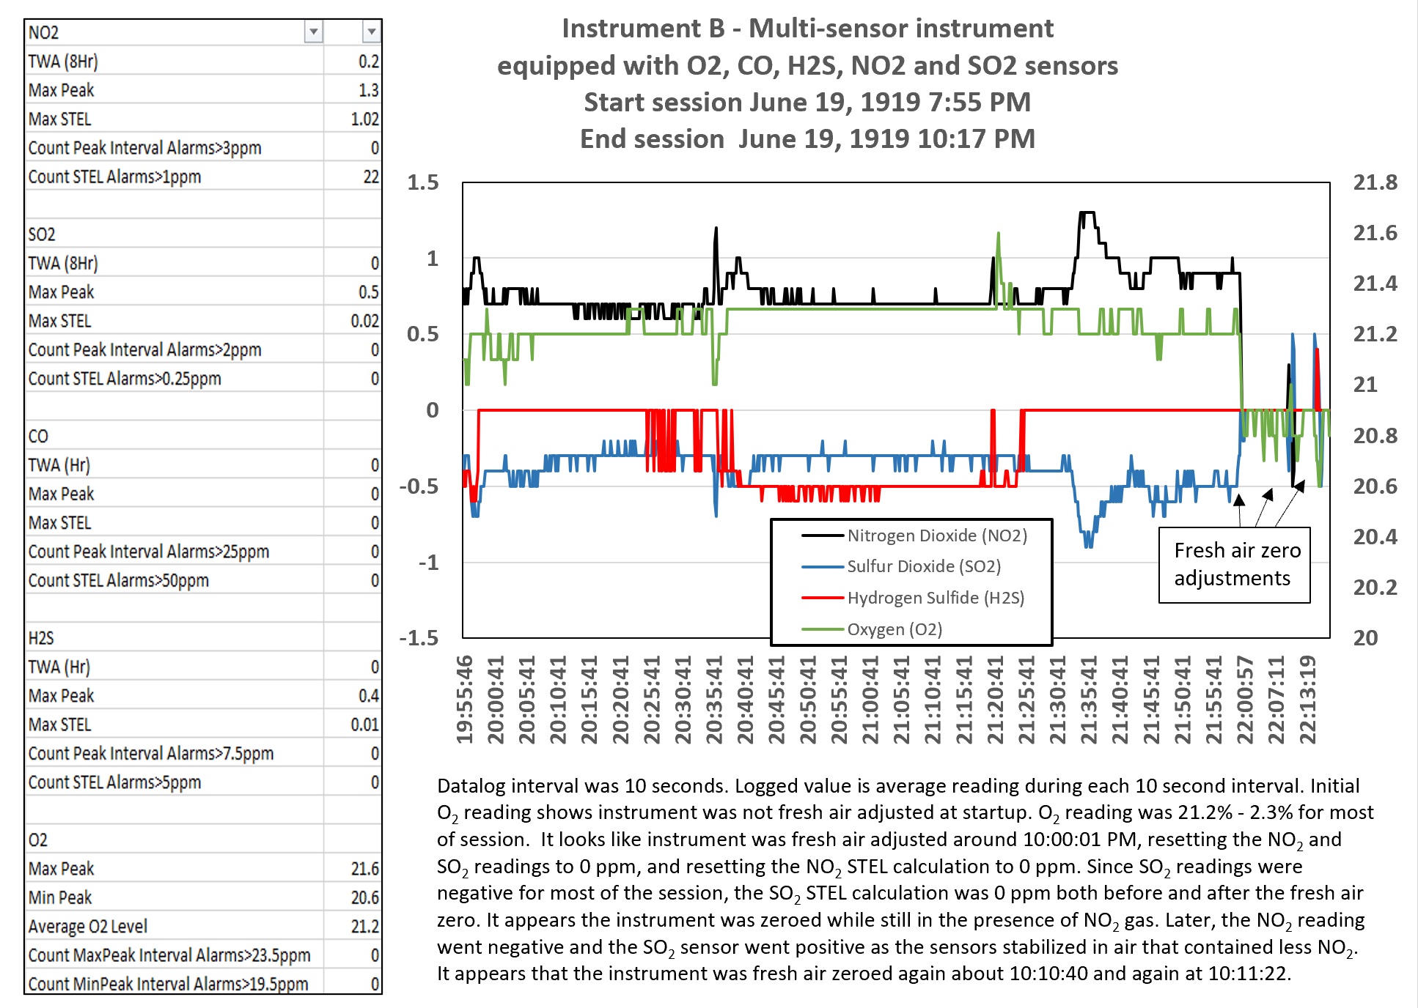
Instrument B:
Multi-sensor instrument with O₂, CO, H₂S, NO₂ and SO₂ sensors
Session duration: 6.39 hrs.
Datalogging interval: 10 sec.
NO₂ Low alarm: 3.0 ppm
NO₂ high alarm: ?
STEL alarm: 1.0 ppm
TWA alarm: ?
TWA actual: 0.2 ppm
Highest NO₂ peak reading during session: 1.3 ppm
SO₂ low alarm: 2.0 ppm
SO₂ high alarm: ?
STEL alarm: 0.25
SO₂ TWA alarm: ?
TWA actual: 0 ppm
Highest NO₂ peak reading during session: 0.5 ppm
-22.3%

Slide 26
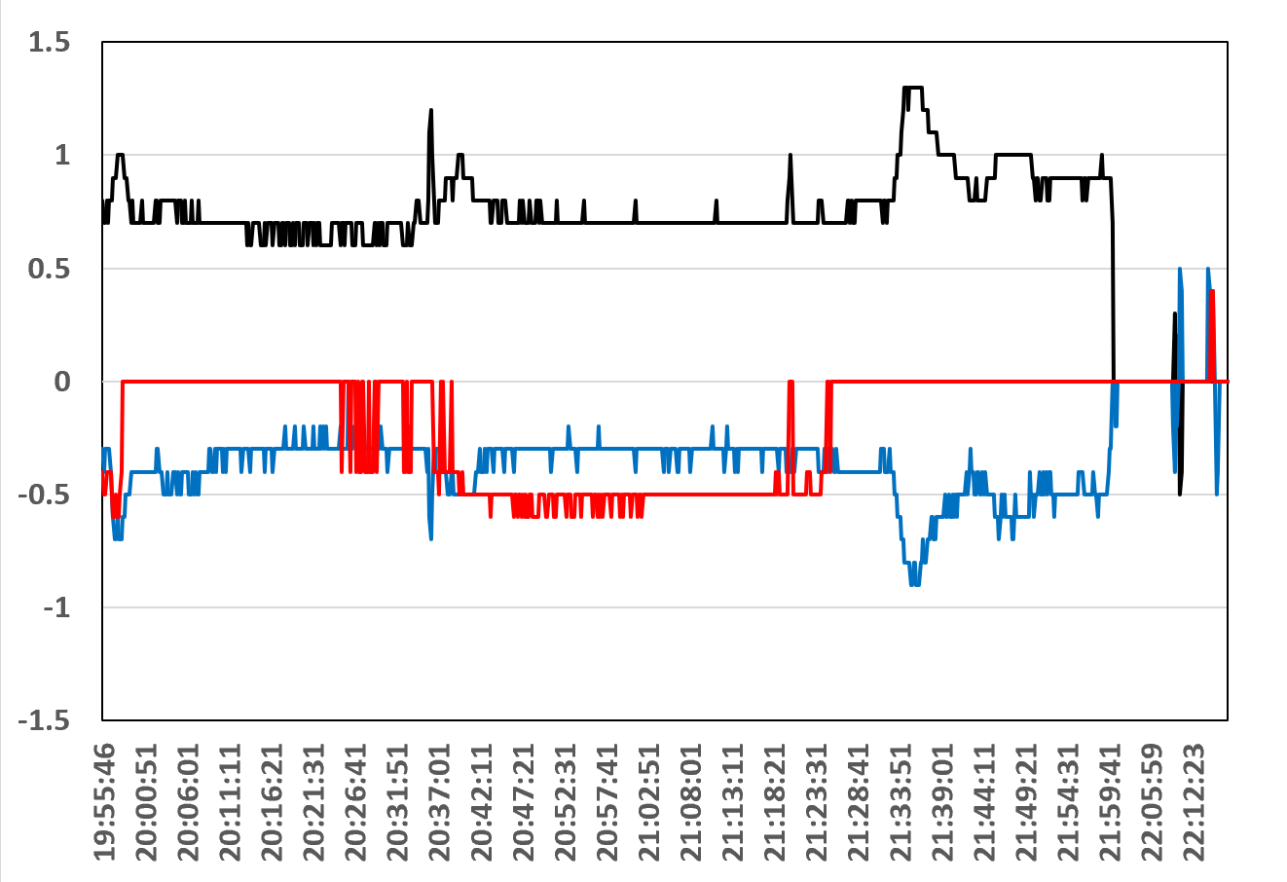
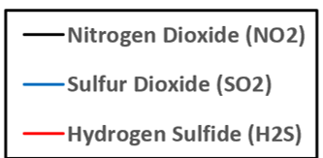
Instrument B:
Multi-sensor instrument with O₂, CO, H₂S, NO₂ and SO₂ sensors
SO₂ has strong negative interference to NO₂ of about -0.6
Response of NO₂ and SO₂ sensors mirror each other
H₂S readings not affected by NO₂
Negative H₂S readings probably due to sensor needing fresh air adjustment
True H₂S concentration probably about 0.4 ppm

Slide 27
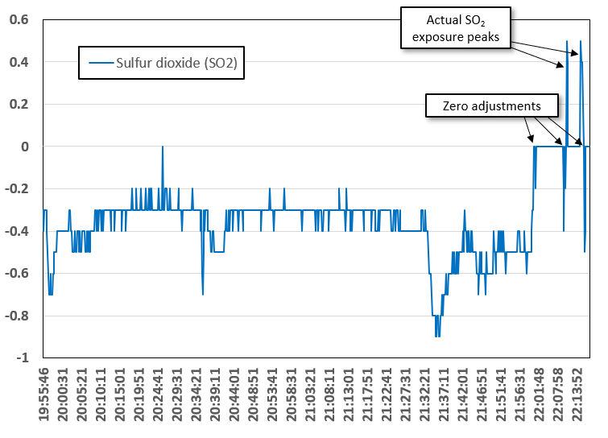
Instrument B:
Multi-sensor instrument with O₂, CO, H₂S, NO₂ and SO₂ sensors
Chart shows results for SO₂ only
SO₂ readings were negative for most of session because of presence of NO₂ gas
The SO₂ sensor (along with the other sensors) was zero adjusted three times at 22:00, 22:09 and 22:17 in the probable presence of about 0.5 ppm SO₂ gas.

Slide 28
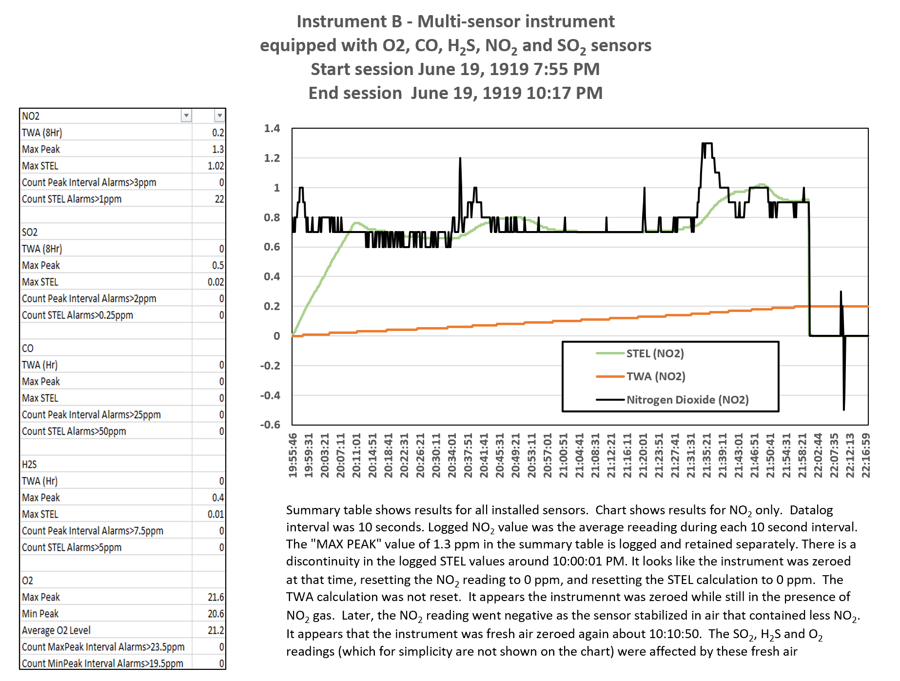
Instrument B:
Multi-sensor instrument with with O2, CO, H₂S, NO₂ and SO₂ sensors
NO₂ results (actual logged, STEL and TWA)
Low alarm: 3.0 ppm
High alarm: ?
STEL alarm: 1.0 ppm
TWA alarm: ?
TWA (projected): 0.2 ppm
Peak reading during session: 2.4 ppm
Session duration: 6.39 hrs.
Session average: 0.1 ppm

Slide 29
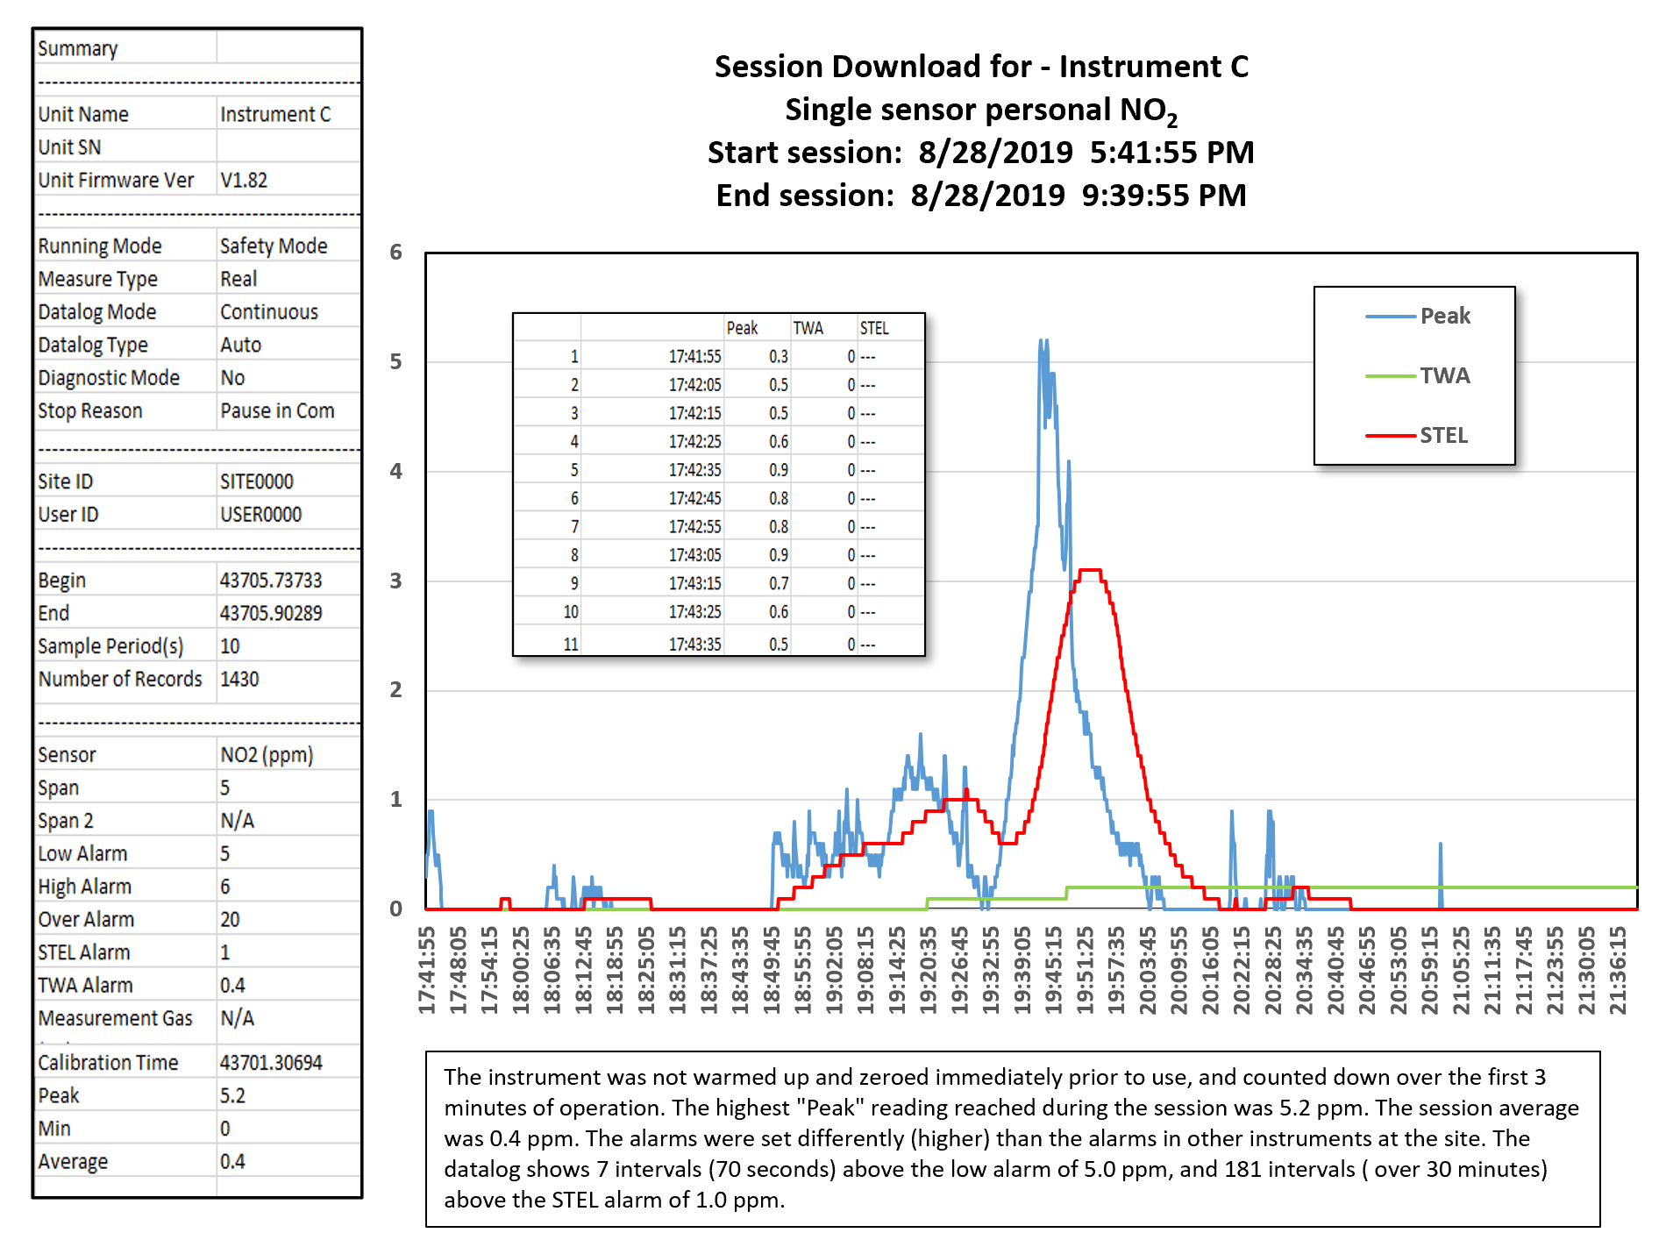
Instrument C:
Single-sensor personal NO₂ datalogger
Session duration: 4 hours
Datalogging interval: 10 sec.
Low alarm: 5.0 ppm
High alarm: 6.0 ppm
STEL alarm: 1.0 ppm
TWA alarm: 0.4 ppm
Peak reading during session: 5.2 ppm
Session duration: ~4 hrs.
Session average (TWA): 0.2 ppm

Slide 30
Important problem: Instrument NO₂ alarms inconsistent!
 | Resolution | Low | High | STEL | TWA
Instrument A | 0.1 ppm | 3.0 ppm | 5.0 ppm | 1.0 ppm | 0.2 ppm
Instrument B | 0.1 ppm | 3.0 ppm | ? | 1.0 ppm | ?
Instrument C | 0.1 ppm | 5.0 ppm | 6.0 ppm | 1.0 ppm | 0.4 ppm
When you have more than one type of instrument in service:
  Make sure alarms match
  Make sure datalogger settings match
  Make sure you understand differences in the way the instruments record information and calculate alarms
MAY 24-26 | DALLAS, TX | 30

Slide 31
Conclusions
Define the objectives behind the use of your real time instruments
  Instrument capabilities need to match requirements
  Instrument settings need to match objectives
  Make sure you have sufficient resolution and accuracy
  Make sure you understand interfering analytes and the effects of ambient conditions on readings
Datalogging record needs to support objectives
  Study the manual!
  Download results and determine whether you understand how the instrument records information, and calculates alarms
Make sure users are trained
  Fresh air adjust before each day’s use
  Test and calibrate according to statutory and manufacturer requirements
  Surveil to make sure settings are correct and that users follow proper procedures
  Document!
MAY 24-26 | DALLAS, TX | 31

Slide 32
Thank You!
Bob Henderson
bhenderson@gfg-inc.com

